Slide 1
Scouting America Shotgun Range Safety Briefing
NO LIVE AMMUNITION in the classroom
NO EXCEPTIONS!

Slide 2
Orientation Goal
To provide beginning shooters with the knowledge, skills, and attitude necessary to shoot a shotgun safely under the direct supervision of a NRA Certified Shotgun Instructor or a Certified NCS Range Activities Director.

Slide 3
NRA Gun Safety Rules
ALWAYS keep your gun pointed in a safe direction
ALWAYS keep your finger off the trigger until ready to shoot
ALWAYS keep your gun unloaded until ready to use

Slide 4
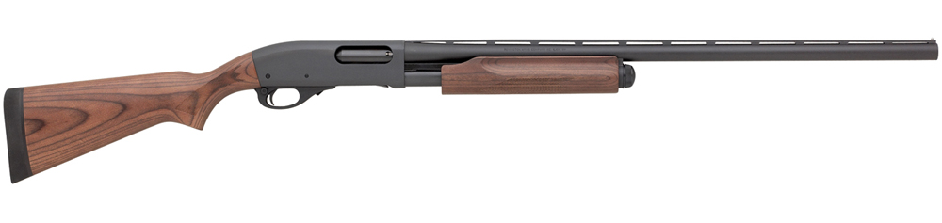
Shotgun Parts
Pump
Loading Port
Bead Front Sight
Rib
Grip
Chamber
Barrel
Comb
Muzzle
Safety
Trigger
Magazine Loading Port
Forearm
Butt
Trigger Guard
Action Release

Slide 5

Shotgun Parts
Semi-automtic
Loading Port
Bead Front Sight
Grip
Chamber
Barrel
Rib
Comb
Muzzle
Butt
Magazine Loading Port
Forearm
Safety
Trigger
Trigger Guard
Action Release

Slide 6
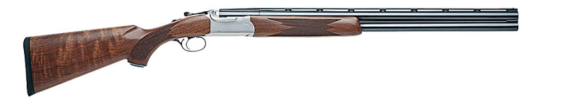
Shotgun Parts
Break Action
Action Release
Upper Barrel
Bead Front Sight
Safety
Chambers
Rib
Comb
Grip
Muzzles
Forearm
Lower Barrel
Trigger
Butt
Trigger Guard

Slide 7
Demonstrate Shotgun Operation
Instructor demonstration only
  Loading with Dummy Ammo
  Cocking
  Firing “Dry-fire only” with Dummy Ammo
  Unloading
During Live-fire on the range, your instructor
will load and unload the Shotgun for you.
7

Slide 8
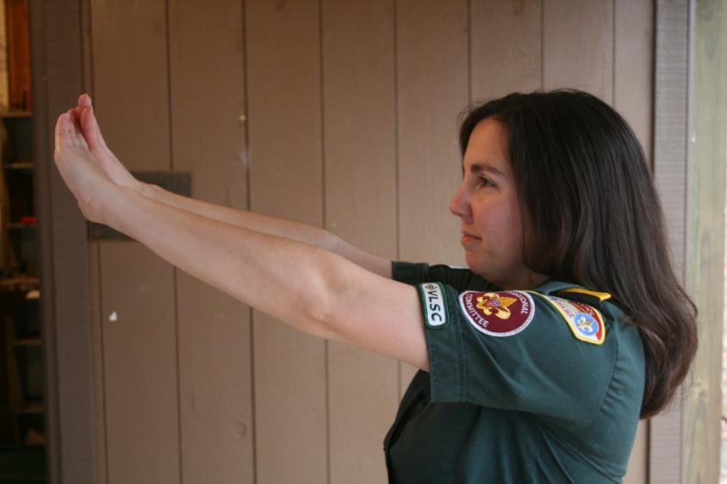
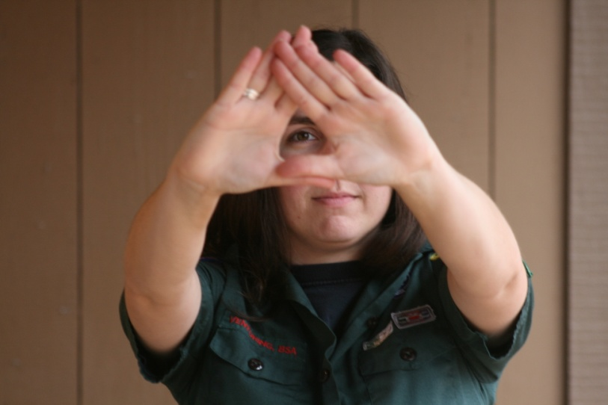
Shooting Fundamentals
Determining the Dominant Eye
Extend arms forward and form opening between the hands
With both eyes open, look at a distant object through opening
Bring hands to face while looking at object – Opening will be aligned with the dominant eye
Notes:
8

Slide 9
Shotgun Shooting Fundamentals
1. Position
2. Mount
3. Vision
4. Movement
5. Focus on the Target
Scouts will be shooting straight away targets

Slide 10
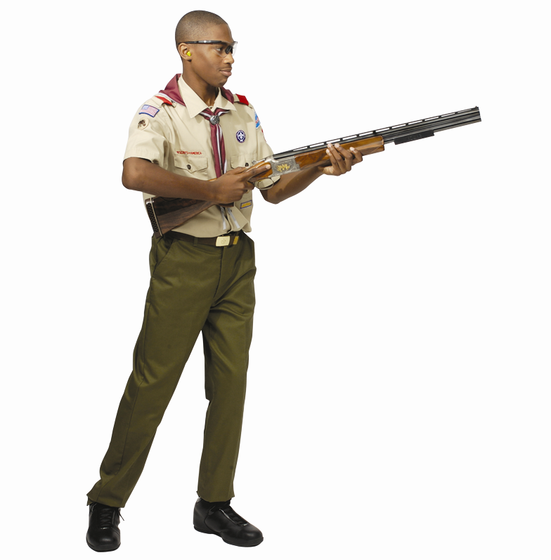
Shotgun Shooting Fundamentals
Position
When you are in proper position:
Your stance is aligned with the target-breaking point.
Your feet are about shoulder width apart, with the toes on your lead foot turned slightly outward.
The knee of your lead leg is bent slightly; the back leg remains straight.
Approximately 60% of your body weight is on the lead leg, and 40% on rear leg.
Your stance should be comfortable and balanced so that it may be maintained before, during, and after the shot.
Notes:
10

Slide 11
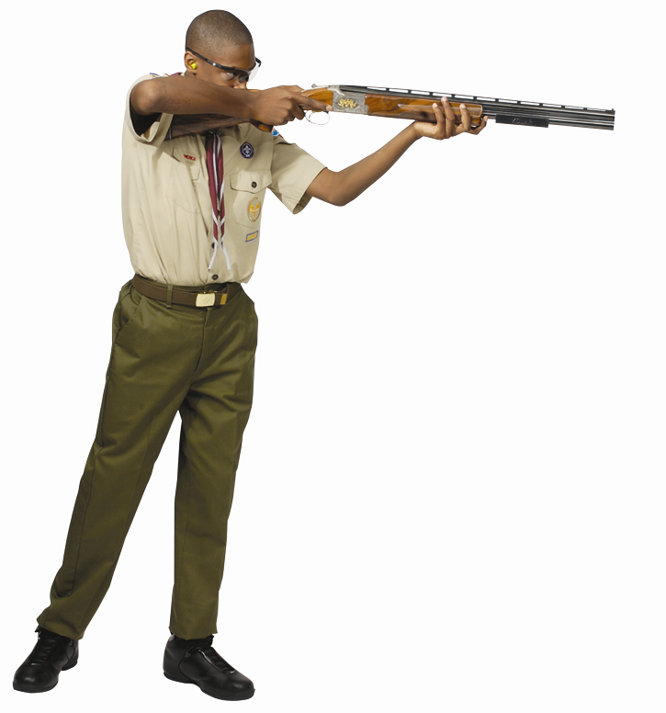
Shotgun Shooting Fundamentals
Mount
The shotgun is brought up to the your face to keep the head erect level.
The cheek is pressed firmly against the stock.
The head is as far forward on the comb as possible without straining the neck.
The butt of the shotgun is in the pocket of the shoulder.
Notes:
11

Slide 12
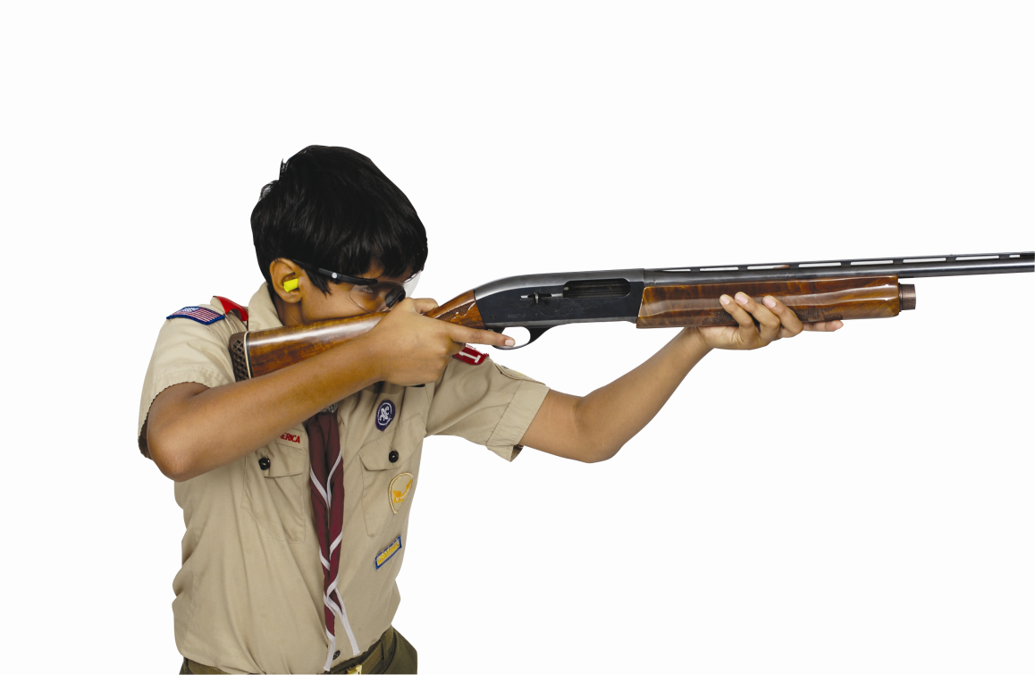
Shotgun Shooting Fundamentals
Vision
The target must be seen clearly at the earliest point possible.
You must be looking past the beads and focusing on the field of fire where the target is in focus.
The Sight Picture is the visual relationship of the shotgun muzzle to the target.
When acquiring the sight picture, the focus must be on the target.
Notes:
12

Slide 13
Shotgun Shooting Fundamentals
Movement
See the Target.
Swinging to the Target—The entire body moves as a unit.
Leads—Pass-through, Pull-away, or Sustained
Trigger Pull—The shotgun trigger is pulled quickly the instant the sight picture is correct.
Follow-Through—Follow-through means the swing must continue if the shot pellets are to hit the target.

Slide 14
Most Important Fundamentals!
The most IMPORTANT shotgun shooting fundamental is……..
  See the Target “Focus on the target”
  You must learn to concentrate on the target.

Slide 15
Range Safety Briefing
Range layout
  Ready Area
  Shooting Station
  Target Path
  Down range shot drop zone

Slide 16
Range Safety Briefing
NRA Safe Gun Handling Rules
ALWAYS keep your gun pointed in a safe direction
ALWAYS keep your finger off the trigger until ready to shoot
ALWAYS keep your gun unloaded until ready to use

Slide 17
Range Safety Briefing
Other Safety Rules
  Know your target and what is beyond
  Wear eye and ear protection as appropriate
  Never use alcohol or drugs before or while shooting
  Be aware that certain types of guns and many shooting activities require additional safety precautions
Range Commands
  “Commence Firing”
  “Cease Firing”
  “Pull”

Slide 18
At The Shooting Station
One instructor will be at each firing point.
Watch straightaway target.
Point finger at the target all way to the ground.
Point finger and say “bang” on touching target.
The instructor will hold the shotgun by the forearm.
Place your hands on the grip. When you have control of the shotgun, say “Thank you” and the instructor will let go.
You will then Dry-fire. TAKE YOUR TIME. Focus on safety and the shooting fundamentals. When you are comfortable, tell the Instructor you are ready to shoot.
Your instructor will then load the shotgun and hold it by forearm.
Place your hands on the grip. When you have control of the shotgun, say “Thank you” and the instructor will let go.
You will Live-fire the prescribed number of shoots.

Slide 19
Questions
Do you have any questions before you move to the Ready Area?

