Slide 1
Scouting America Rifle Range Safety Briefing
NO AMMUNITION in the classroom
NO EXCEPTIONS!

Slide 2
Orientation Goal
To provide beginning shooters with the knowledge, skills, and attitude necessary to shoot a rifle safely under the direct supervision of an NRA Certified Rifle Instructor or Certified NCS Range Activities Director.

Slide 3
NRA Gun Safety Rules
ALWAYS keep your gun pointed in a safe direction
ALWAYS keep your finger off the trigger until ready to shoot
ALWAYS keep your gun unloaded until ready to use

Slide 4
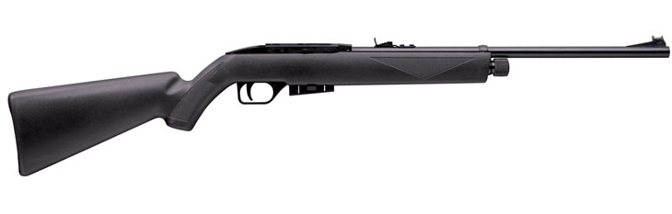
Rifle Parts…Air Rifle
Loading Port
Rear Sight
Chamber
Front Sight
Grip
Barrel
Comb
Muzzle
Butt
Piercing Tube Cap
Trigger
Safety
Pellet Magazine
Forearm
Toe
Trigger Guard

Slide 5
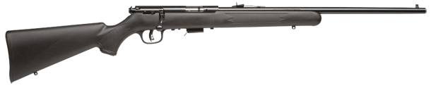
Rifle Parts…Bolt Action
Chamber
Barrel
Grip
Rear Sight
Comb
Safety
Front Sight
Bolt
Butt
Muzzle
Forearm
Trigger
Box Magazine
Bolt Handle
Toe
Trigger Guard
5
Notes:
5

Slide 6
Demonstrate Rifle Operation
Instructor demonstration only
  Loading with Dummy Ammo
  Cocking
  Firing “Dry-fire only” with Dummy Ammo
  Unloading
  Returning rifle to safe position at the shooting station.
6

Slide 7
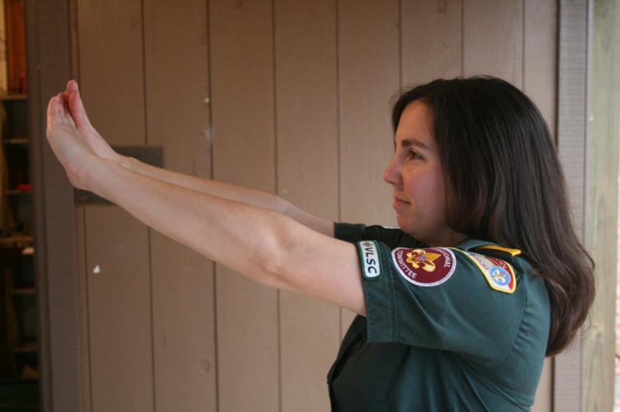
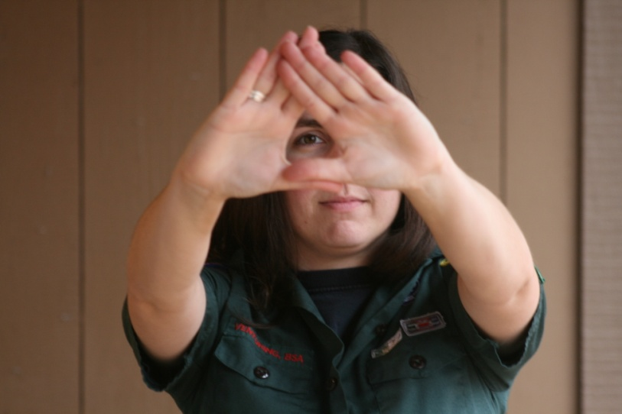
Shooting Fundamentals
Determining the Dominant Eye
Extend arms forward and form opening between the hands
With both eyes open, look at a distant object through opening
Bring hands to face while looking at object – Opening will be aligned with the dominant eye
Notes:
7

Slide 8
Rifle Shooting Fundamentals
1. AIMING (sight alignment & sight picture)
2. BREATH CONTROL
3. HOLD CONTROL
4. TRIGGER CONTROL
5. FOLLOW-THROUGH

Slide 9
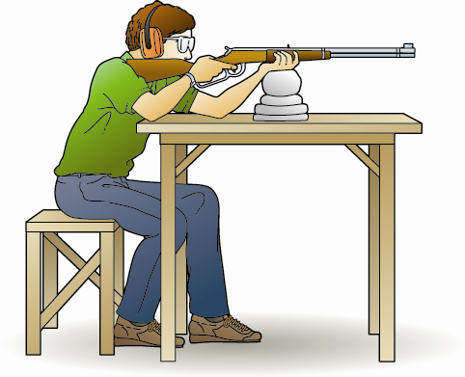
Bench Rest Position
Feet flat on the ground with the legs relaxed.
Seated directly behind the front support with slight lean forward.
Butt of the rifle in the shoulder close to neck.
Elbows on the table to support the rifle.
Support hand under the Forearm.
Trigger hand.
Face firmly against the stock with eye looking straight down the sights.
Align the position to target.
Notes:
9

Slide 10
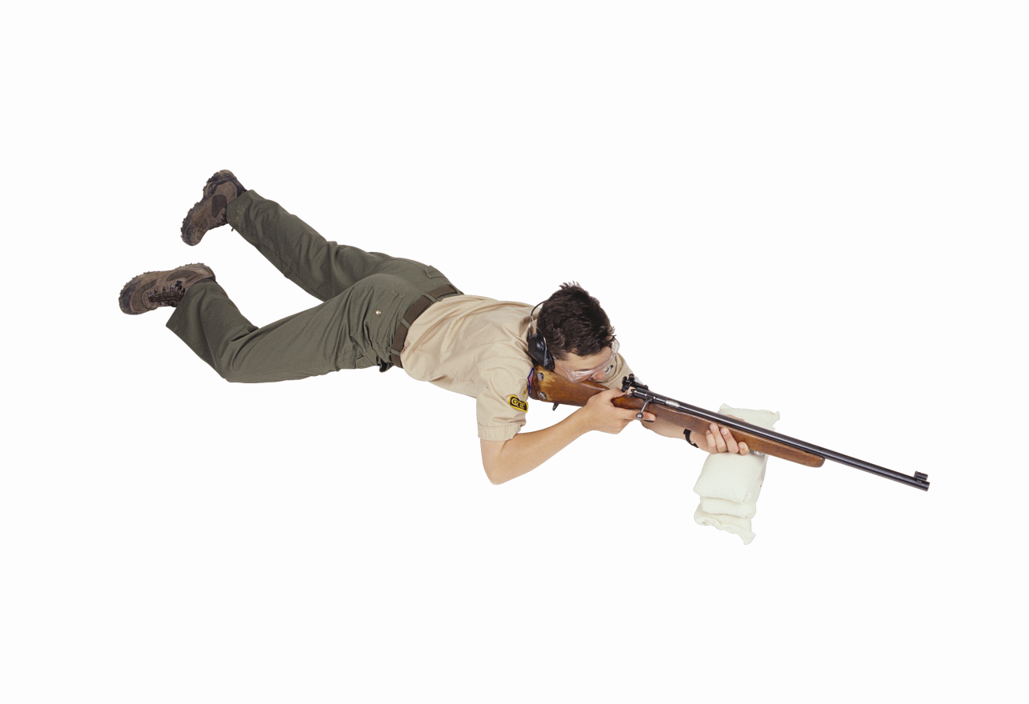
Prone Supported Position
Feet and legs are flat on the ground with the legs relaxed.
Butt of the rifle in the shoulder close to neck.
Elbows on the ground to support the rifle.
Support hand under the Forearm.
Trigger hand.
Face firmly against the stock with eye looking straight down the sights.
Align the position to target.
Notes:
10

Slide 11
FUNDAMENTALS “Aiming”
Notch Rear and Post Front Sight
FRONT SIGHT IS IN SHARP FOCUS
Sight Alignment
With Post-and-Notch sights:
The tops of the front and rear sights are even
The front post is centered in the rear notch
  Sight Picture
  6 O'clock Hold on the Bullseye
Notes:
3 Min. Cumulative Time: 8 Min.
Instructor Notes: (Review Part I in Handbook)
NEW information: The bullseye has replaced the blank target and 6 O’clock hold on bullseye.
Ask What is a fundamental?
Fundamentals are basic building blocks on which we can develop and expand.
Ask what is "Aiming?"
Aiming is the process of positioning the rifle so that the bullet will hit the target.
The process first involves sight alignment and then sight picture.
Ask What makes up sight alignment?
The proper positioning of the shooting eye, rear sight and front sight.
Ask What makes up sight picture?
The alignment of the shooting eye, rear sight, front sight and target or adding the target to aligned sights.
The sight picture varies with the type of sights you are using, but the basic rule is to focus on the front sight (the rear sight and target will be slightly out of focus).
Explain 6 O’clock hold on the bullseye.
Ball on a fence post. The ball is the bullseye and the post is the front sight.

Slide 12
FUNDAMENTALS “Aiming”
Aperture Rear and Post Front Sight
FRONT SIGHT IS IN SHARP FOCUS
Sight Alignment
Aperture Rear and Post Front Sight
The tops of the front is center in the rear sights aperture
  Sight Picture
  6 O'clock Hold on the Bullseye
Notes:
3 Min. Cumulative Time: 8 Min.
Instructor Notes: (Review Part I in Handbook)
NEW information: The bullseye has replaced the blank target and 6 O’clock hold on bullseye.
Ask What is a fundamental?
Fundamentals are basic building blocks on which we can develop and expand.
Ask what is "Aiming?"
Aiming is the process of positioning the rifle so that the bullet will hit the target.
The process first involves sight alignment and then sight picture.
Ask What makes up sight alignment?
The proper positioning of the shooting eye, rear sight and front sight.
Ask What makes up sight picture?
The alignment of the shooting eye, rear sight, front sight and target or adding the target to aligned sights.
The sight picture varies with the type of sights you are using, but the basic rule is to focus on the front sight (the rear sight and target will be slightly out of focus).
Explain 6 O’clock hold on the bullseye.
Ball on a fence post. The ball is the bullseye and the post is the front sight.

Slide 13
FUNDAMENTALS “Aiming”
Aperture Rear and Aperture Front Sight
FRONT SIGHT IS IN SHARP FOCUS
Sight Alignment
Aperture Rear and Post Front Sight
The front aperture is center in the rear sights aperture
  Sight Picture
  Bullseye is center in the front sight aperture
Notes:
3 Min. Cumulative Time: 8 Min.
Instructor Notes: (Review Part I in Handbook)
NEW information: The bullseye has replaced the blank target and 6 O’clock hold on bullseye.
Ask What is a fundamental?
Fundamentals are basic building blocks on which we can develop and expand.
Ask what is "Aiming?"
Aiming is the process of positioning the rifle so that the bullet will hit the target.
The process first involves sight alignment and then sight picture.
Ask What makes up sight alignment?
The proper positioning of the shooting eye, rear sight and front sight.
Ask What makes up sight picture?
The alignment of the shooting eye, rear sight, front sight and target or adding the target to aligned sights.
The sight picture varies with the type of sights you are using, but the basic rule is to focus on the front sight (the rear sight and target will be slightly out of focus).
Explain 6 O’clock hold on the bullseye.
Ball on a fence post. The ball is the bullseye and the post is the front sight.

Slide 14
FUNDAMENTALS “Aiming”
Scope
FOCUS ON THE TARGET
Sight Alignment
Looking through the scope , You see the whole scope tube (not just small hole in tube)
  Sight Picture
  Cross Hairs are centered on the target
Notes:
3 Min. Cumulative Time: 8 Min.
Instructor Notes: (Review Part I in Handbook)
NEW information: The bullseye has replaced the blank target and 6 O’clock hold on bullseye.
Ask What is a fundamental?
Fundamentals are basic building blocks on which we can develop and expand.
Ask what is "Aiming?"
Aiming is the process of positioning the rifle so that the bullet will hit the target.
The process first involves sight alignment and then sight picture.
Ask What makes up sight alignment?
The proper positioning of the shooting eye, rear sight and front sight.
Ask What makes up sight picture?
The alignment of the shooting eye, rear sight, front sight and target or adding the target to aligned sights.
The sight picture varies with the type of sights you are using, but the basic rule is to focus on the front sight (the rear sight and target will be slightly out of focus).
Explain 6 O’clock hold on the bullseye.
Ball on a fence post. The ball is the bullseye and the post is the front sight.

Slide 15
Shooting Fundamentals
Breath Control
Body movement while breathing can produce gun movement that impairs shooting.
  Stop breathing momentarily while firing the shot! (Respiratory pause)

Slide 16
Shooting Fundamentals
Hold Control
Body movement affects the shot.
  Hold your body still.
  Hold control allows you to maintain the proper sight picture and sight alignment during the process of firing the shot.

Slide 17
Shooting Fundamentals
Trigger Control
Trigger is pulled straight to the rear in a smooth, continuous manner without disturbing the sight alignment.
Gradually and evenly increasing pressure until the mechanism releases.
SURPRISE yourself when the gun shoots.

Slide 18
Shooting Fundamentals
Follow-Through
In Rifle Shooting:
Follow-through means to maintain aiming (perfect sight alignment and acceptable sight picture), breath control, hold control, and trigger control until the gun settles back into the aiming area after firing.
18

Slide 19
Shooting Fundamentals
The Fundamentals…A Review
“Maintaining perfect sight alignment and acceptable sight picture.” –
“Stop breathing.” –
“Holding still.” –
“Moving only your trigger finger.” –
“To maintain position, and continue aiming, breath control, hold control, and trigger control until the gun settles back into the aiming area after the shot is fired.” –
AIMING
BREATH CONTROL
HOLD CONTROL
TRIGGER CONTROL
FOLLOW-THROUGH

Slide 20
Most Important Fundamentals!
NOTE –
The TWO most IMPORTANT shooting fundamentals are……..
  “Maintaining sight alignment” – AIMING
  “Moving only the trigger finger” – TRIGGER CONTROL

Slide 21
Range Safety Briefing
Range layout
  Ready Area
  Firing Line
  Target Area
  Back Stop

Slide 22
Range Safety Briefing
NRA Safe Gun Handling Rules
ALWAYS keep your gun pointed in a safe direction.
ALWAYS keep your finger off the trigger until ready to shoot.
ALWAYS keep your gun unloaded until ready to use.

Slide 23
Range Safety Briefing
Other Safety Rules
  Know your target and what is beyond
  Wear eye and ear protection as appropriate
  Never use alcohol or drugs before or while shooting
  Be aware that certain types of guns and many shooting activities require additional safety precautions
Range Commands
  “Commence Firing”
  “Cease Firing”

Slide 24
At The Firing Line
One instructor will supervise 8 firing points.
The instructor will demonstrate how to load the rifle.
The instructor will provide guidance as the shooters take their first shots.
TAKE YOUR TIME. Focus on safety and the shooting fundamentals. When you are comfortable in the shooting position, tell the Instructor you are ready when they ask if the line is ready to shoot.
Your instructor will then describe the course of fire (targets and number of shots).
You will fire the prescribed number of shoots. Strive for consistent shot groups, do not adjust your point of aim.
When you have completed the course of fire, lay the rifle down bolt up so the instructor can see the rifle is not loaded.
Do not leave the shooting position until instructed to do so by the range safety officer.

Slide 25
Questions
What questions do you have before you move to the line?

