Slide 1
Effective Design
Implementing basic design principles can make your projects impactful and engaging
Notes:
Slide 1- Enhancing Scout Project Designs
- Today, we'll explore design principles that make Scout projects visually impactful and engaging.

Slide 2
Key Design Concepts
These principles are foundational for good design
Legibility | How easily text can be read
Hierarchy | Organizing information from most to least important
Consistency | Maintaining a uniform design
Visual Balance | Creating harmony in the design
Simplicity | The power of clear and uncluttered visuals
Notes:
Slide 2- Key Design Concepts
- Define each concept

Slide 3
Legibility
The Art of Readability
Notes:
Slides 3-5- Legibility: The Art of Readability
- Legibility ensures that your audience can easily read and understand your message.
Additional Resource: Typography Tutorial - 10 rules to help you rule type by The Futur
https://www.youtube.com/watch?v=QrNi9FmdlxY

Slide 4
Legibility
Unable to read or understand the message

Slide 5
Legibility
Logo enlarged for visibility
Text placed against simple background with good contrast
Image from https://scouting.webdamdb.com/bp/#/

Slide 6
Hierarchy of Information
Guiding Your Audience
Notes:
Slides 6-8- Hierarchy of Information: Guiding Your Audience
It's about organizing information in a way that guides your audience's attention.
- Stress the use of clear headings that emphasize the most important ideas first.

Slide 7
(Double-sided flyer)
Hierarchy of Information
Confusing hierarchy with mixed priorities
Information is poorly ordered

Slide 8
(Double-sided flyer)
Hierarchy of Information
Key elements capture attention first
Secondary information noticed after main points
Image from https://scouting.webdamdb.com/bp/#/

Slide 9
Consistency
Creating a Unified Look
Notes:
Slides 9-11- Consistency: Creating a Unified Look
Consistency establishes trust and familiarity.

Slide 10
Consistency
Inconsistent design elements
Haphazard and disorganized

Slide 11
Consistency
Complimentary typefaces
Text is clearly organized
Photographs work together
Limited color palette
Image from https://scouting.webdamdb.com/bp/#/

Slide 12
Visual Balance
Creating Harmony
Notes:
Slides 12-14- Visual Balance: Creating Harmony
Balance ensures that your design is visually appealing and easy to follow.

Slide 13
Visual Balance
Elements clumped randomly

Slide 14
Visual Balance
Elements arranged so they are easy to follow
Image from https://scouting.webdamdb.com/bp/#/

Slide 15
Simplicity
Less is Sometimes More
Notes:
Slides 15-17- Simplicity: Less is Sometimes More
Simplicity helps your message shine through by removing distractions.
- Encourage simplifying designs by eliminating unnecessary elements.

Slide 16
Simplicity
Cluttered, confusing layout
Viewer overloaded with detail

Slide 17
Simplicity
Important text easily read
Simple, powerful image with clear focal point
Image from https://scouting.webdamdb.com/bp/#/

Slide 18
Simplicity: Cognitive Load Theory
Overloading decreases attention
Simplicity prevents overload
Notes:
Slides 18-19- Simplicity: Understanding Cognitive Load Theory
Mental capacity for processing is limited.
Overloading decreases attention and learning.
Simplicity in presentations prevents overload.

Slide 19
Simplicity: Cognitive Load Theory
1-6-6 rule
One idea per slide
about 6 word per line
about 6 lines per slide
Image from https://scouting.webdamdb.com/bp/#/
Notes:
Slides 18-19- Simplicity: Understanding Cognitive Load Theory
1-6-6 rule: One idea per slide; about 6 word per line; about 6 lines per slide

Slide 20
Interesting Photography
Photographs tell stories Scouting has great stories!!
Reinforces themes such as
Inclusivity
Action
Fun
Image from https://scouting.webdamdb.com/bp/#/
Notes:
Slide 20- Interesting Photography
Enhancing Projects with Photography
Photographs tell stories. Scouting has great stories!!
Look for moments of warmth, humor, and friendship.
Show Scouts rising to meet challenges and moments of success.
Tips for capturing engaging photos:
Reinforce themes such as: Inclusivity, Action and Fun
Additional Resource: Capture Your Scouting Memories with These Photographic Tips
https://scoutingmagazine.org/2020/11/capture-your-scouting-memories-with-these-photographic-tips/

Slide 21
Inclusive Design
Reach more people
Language Produce marketing materials in multiple languages
Color Combinations Use high-contrast colors
Avoid red-green for color blindness
Images from https://scouting.webdamdb.com/bp/#/
Notes:
Slide 21- Inclusive Design
Designing for broad audiences to reach more people
Language: Market to wider audiences by producing marketing materials in multiple languages.
Color Combinations: Opt for high-contrast color combinations and avoid using red and green together as they can be indistinguishable for people with color blindness.

Slide 22
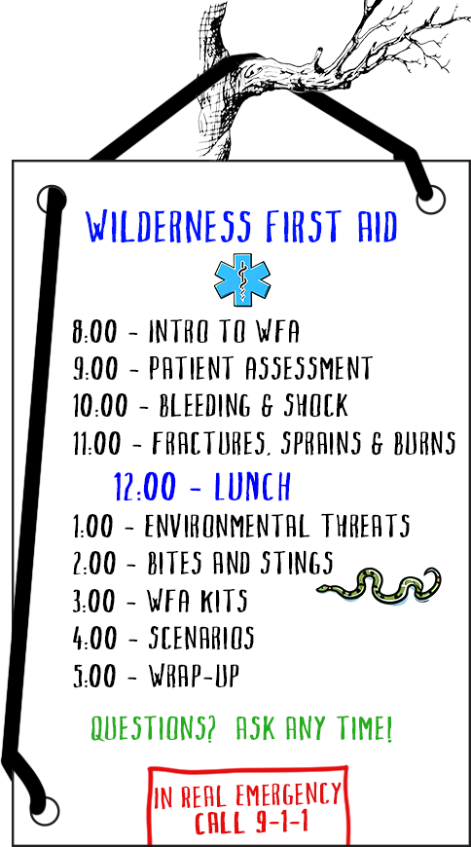
Flip Charts & Whiteboards
Use bold markers for visibility
Write in large handwriting
Use different colors for emphasis
Keep whiteboards clean
Notes:
Slide 22- Utilizing Flip Charts & Whiteboards Effectively
Use bold markers for visibility
Write in large handwriting
Use different colors for emphasis but ensure contrast
Keep whiteboards clean and erase fully to avoid ghosting

Slide 23
Handouts
Paper is high-resolution and easily available
Useful when technology is unreliable or unavailable
Portable
Interactive – checklists, notes, foldable projects
Image from https://scouting.webdamdb.com/bp/#/
Notes:
Slide 23- Engaging Handouts
Paper is high-resolution and easily available
Useful when technology is unreliable or unavailable
Handouts can be taken home, providing a lasting reference for your audience
Participants can draw, check off boxes, take notes, or engage with the content in other hands-on ways

Slide 24
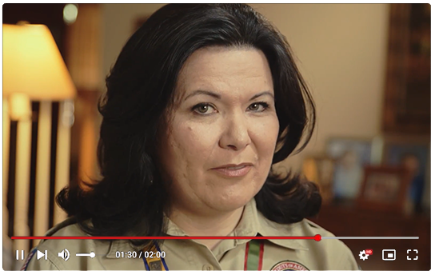
Digital Media
Videos can tell compelling, engaging stories
Capture attention with change
Use animations and transitions
Ensure animations enhance, not distract
Reveal Bullets One by One
Guide audience’s focus to each key point
Image from https://scouting.webdamdb.com/bp/#/
Notes:
Slide 24- Leveraging Digital Media
Videos can tell compelling, engaging stories
Capture attention with change
Use animations and transitions.
Ensure animations enhance, not distract

Slide 25
Room for Creativity
Use these guidelines as a foundation, but don't be afraid to experiment and innovate
Notes:
Slide 25- Room for Creativity
Use these guidelines as a foundation, but don't be afraid to experiment and innovate.
Seek feedback to see if your designs meet your goals.

Slide 26
Conclusion
Good design enhances clarity, maintains interest, and ensures your message resonates
Notes:
Slide 26- Conclusion
Good design enhances clarity, maintains interest, and ensures your message resonates.
Seek feedback to ensure your designs are effective and impactful.

Slide 27
Questions?

