Slide 1
CRM User Forum
March 20, 2024
John Kuehn ~ Valerie Eaton
Cornelia Ellis ~ Don Day

Slide 2
Objectives
Global Write-off & Write-off Data List
The 990
Special Events – Auctions
Tracking your 2024 Appeals
Appeal progress report by Category
Daily Revenue Transactions List
Recurring Gift List
Appeal Progress Data List
Batches
Using Group ID to credit units in FOS appeal
Blackbaud Merchant Services

Slide 3
Global Write-off Process
Should be ran yearly
Run when you no longer want older pledges in overdue reminder
Closes pledge in CRM
Does not write to PeopleSoft
Reduces data entry errors with mismatched appeals
Pledge payments want to fulfill oldest pledges first

Slide 4
Write-off Overview
Revenue Tab – Global Pledge Write-off
  Click chevron next to council – Edit Process
  Edit appeal(s) to write-off
  Preview results
  When ready – click Start to run process
  The process runs – see results in “Write-Offs Data List”
  See detailed presentation on February recording

Slide 5
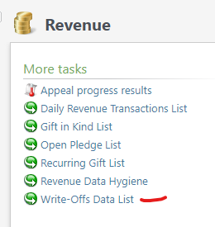
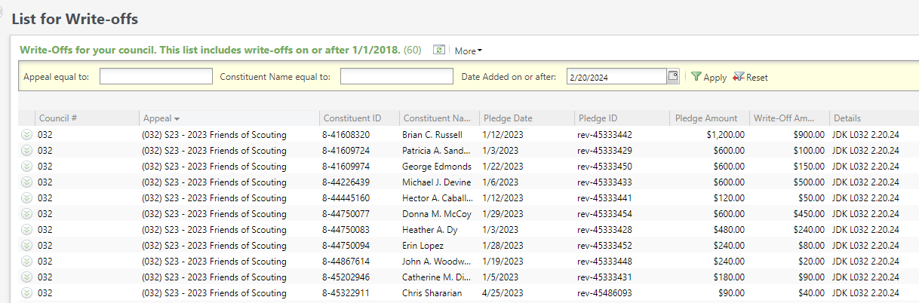
Global Pledge Write-off
Proceed to the data list under revenue. Use your council number as the Site ID and click search and select your council. This open the list. Next place the date in that you ran the process and click apply. This will generate the write-off list for you to download using the "More" button.

Slide 6
Reports for IRS-990

Slide 7
IRS 990
Download Direction from User Guide under Reports
  IRS 990 Schedule B
Process is similar to running contribution statements.
Provides a list of donor(s) who have pledged or donated $5,000 or more in the previous tax year.
No need to create a query.

Slide 8
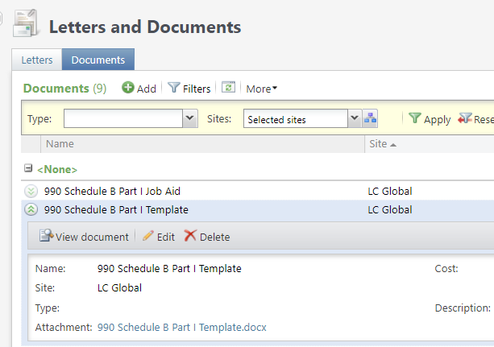
IRS 990
Under Marketing & Communication you can navigate to Letters and Documents. On the document tab you will find the Job Aid and the 990 template you will need for mail merge. Drop the chevron and click "View document". Save to your desktop. There is no need to click the edit button

Slide 9
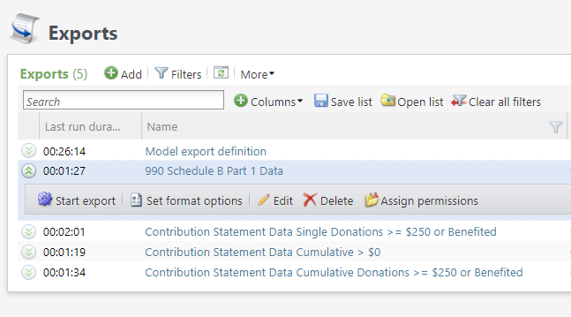
IRS 990
Export is found under Administration / Exports. Drop the chevron and click start. There is no need to edit the process.

Slide 10
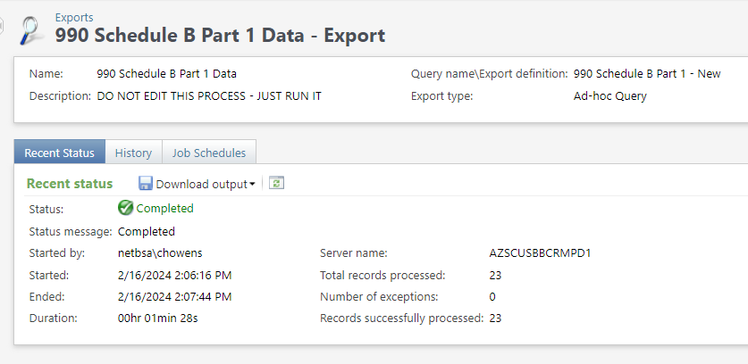
IRS 990
When the process completes, use the "Download output" button to export to Excel. Save the file to your desktop so that you can connect your 990 template to it for the mail merge process.

Slide 11
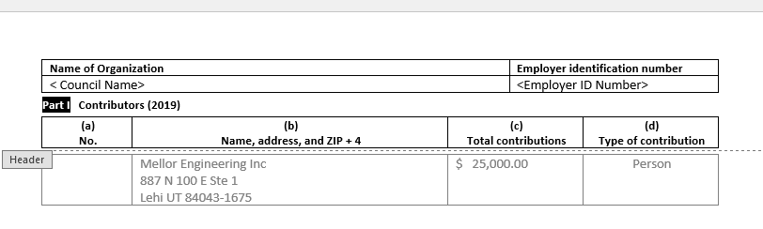
IRS 990
Below is the template. You will need to double click the header and add your Council Name, Employer ID Number and update the year next to Contributors. Save your template then mail merge it to your export file. Note: Remove <> and () when changing out information above.

Slide 12
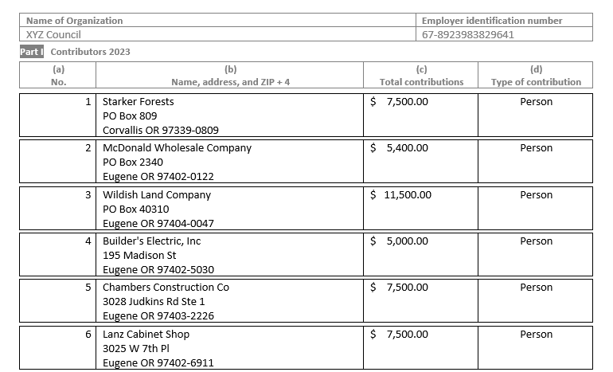
IRS 990 – Sample Output

Slide 13
PeopleSoft Transactions

Slide 14
Need to be done PeopleSoft
Beginning of the year in PeopleSoft, after closing the prior year these GL transactions required:
Journal entry to move balances to new accounts
Run a Posted detail in PS and Pledge Receivable report in CRM
Contribution - Pledges
1301 (CR) to 1321 (DR) (move from current year to prior)
1331 (CR) to 1301 (DR) (move from future to current)
Allowance
1371 (DR) to 1381 (CR) (move current to prior)
1391 (DR) to 1371 (CR) (move future to current)

Slide 15
Accounts
  Prior Year
132# is your Contributions Receivable Prior year account. This is populated with pledges you expect to be paid late after you close your books(GJ from 130#).
  Check to see that the prior year pledge receivable and allowance accounts are zero. (132# and 138#)
  If not, the account should be close out.
  The remaining uncollectible pledges are written off. Prior year write-offs are charged to account 9432 (Uncollectible Pledges written off) or 4002 (Contributions – Prior year).

Slide 16
Auctions

Slide 17
Auctions
Creating
Adding inventory
  Individual
  Batch
  Importing
Assigning a buyer
Adding payment from buyer

Slide 18
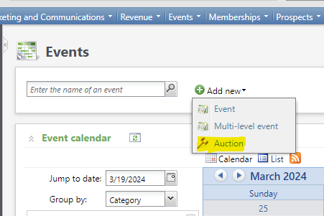
Creating an Auction
Proceed to the events functional Area
Click the "Add new" button
Select Auction

Slide 19
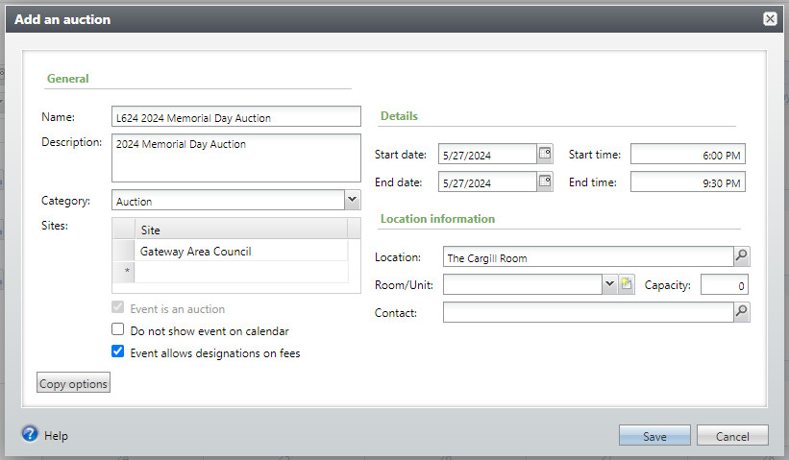
Creating Auction
Fill in your data
  Name
  Description
  Date & Time
  Location
Check allow Designation on fees
Click Save

Slide 20
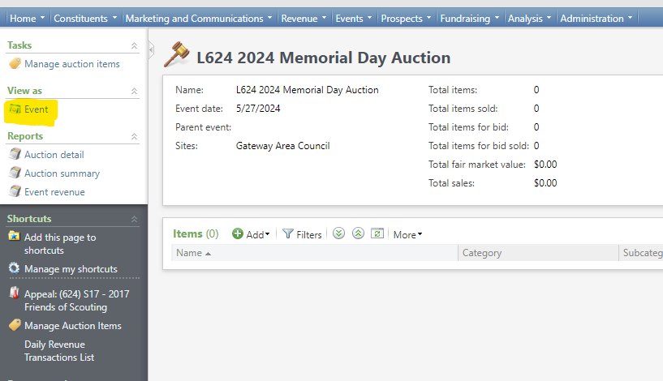
Creating Auction
Event will default to auction view.
Switch to event view to add
  Designation
  Appeal
  Registration Options

Slide 21
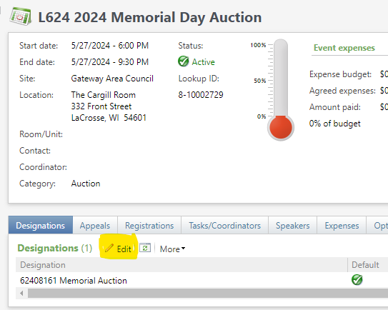
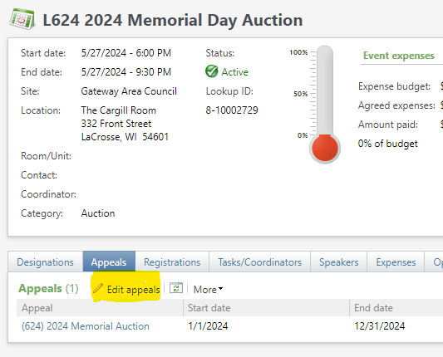
Auction Creation

Slide 22
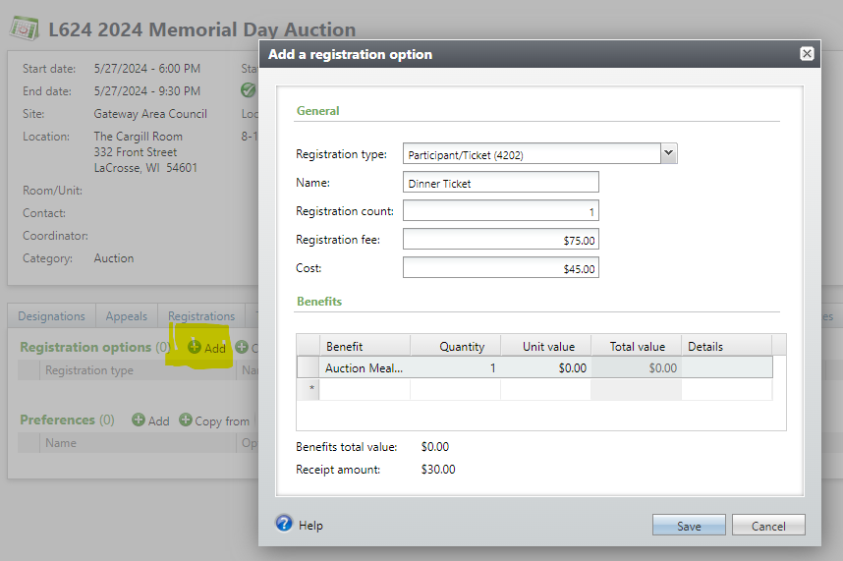
Creating Auction
Add registration option
  Allows you to track attendees
  Provides a head count for dinner
  Allows seating chart configuration

Slide 23
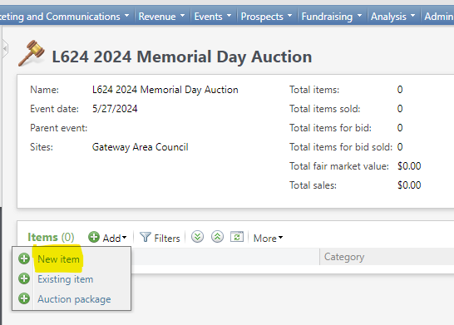
Add Auction Item - Individually
Switch back to auction view
Click the "Add" button
Select "New Item"
Fill in the new item form

Slide 24
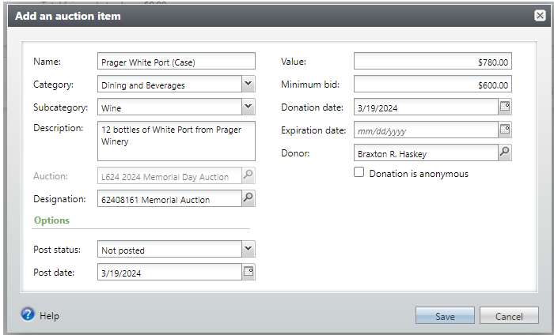
Add Auction Item - Individually
Add the name of the item
Pick the Category and Subcategory
Provide description
Add the designation
Add value and minimum bid
Assign the donor
Click save

Slide 25
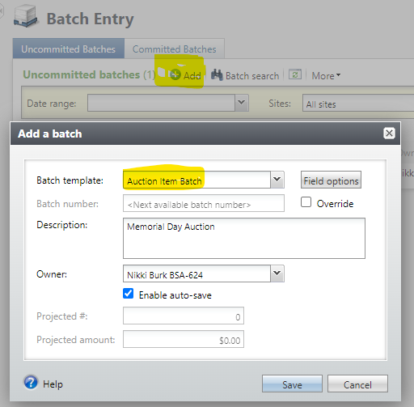
Auction Item by Batch
Proceed to batch entry
Click the "Add" button
Select the Auction Item Batch
Place a description in the batch line
Click "Save"

Slide 26
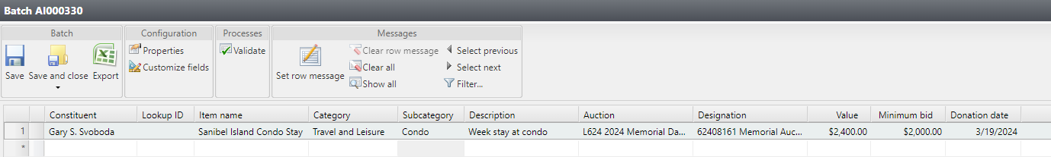
Auction Item by Batch
Fill in the blanks in the batch
Blanks match the individual add form
Constituent is the donor who provided the item
Validate, Save and Close and Commit batch

Slide 27
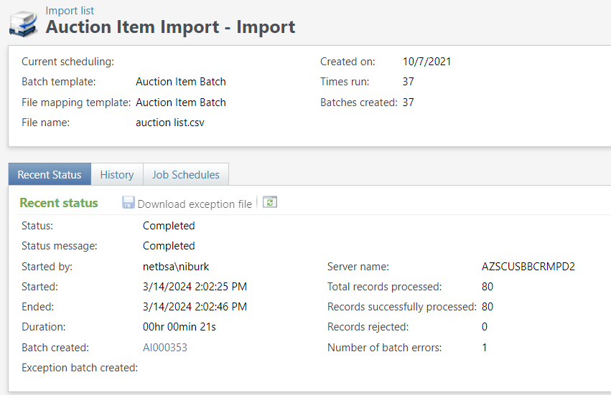
Auction Item by Import
Use excel template
Copy and save page as a CSV file
Use the Auction Item Import tool to import file into an Auction Item Batch.
Edit, Review, Validate, Save & Close, Commit the batch.

Slide 28
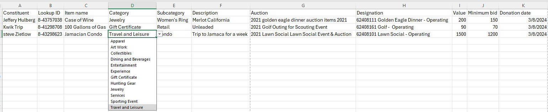
Auction Item Import
Use the template
Category and Subcategory are pick list to ensure accuracy
Once columns are completed, copy and paste to a new file and save as a CVS file to use import feature.

Slide 29
Auction Batch Import
Template will be posted to user guides under event
Direction on how use template and import feature will be posted under events
Both items will be added to the Workplace Files

Slide 30
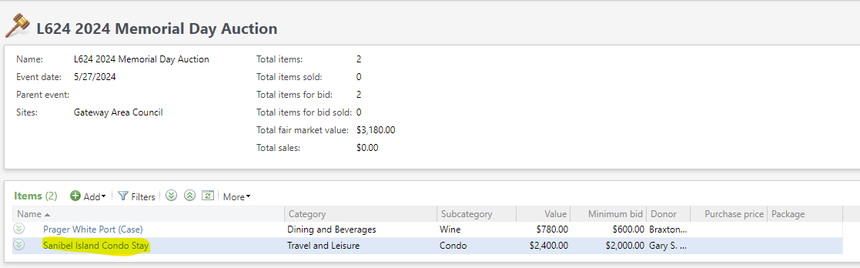
Auctions – Assigning Buyer
One Auction Item is added a buyer can be added.
Click the name of the Auction item to do this.

Slide 31
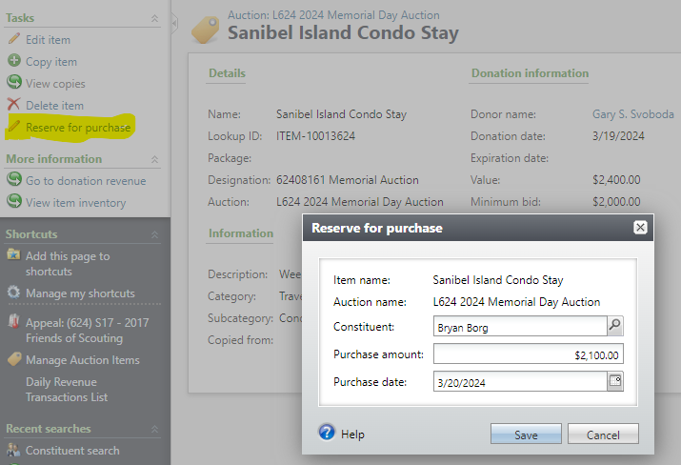
Auction – Add a Buyer
Click Reserve for Purchase
Conduct a constituent search to find buyer
Add new if buyer not in CRM.
Add purchase date

Slide 32
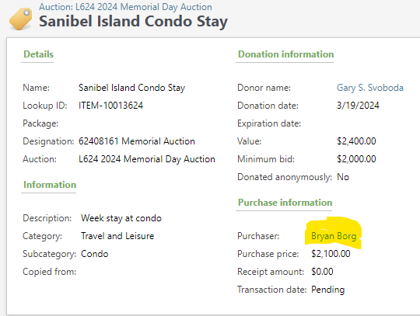
Auction- Add Payment
Payment can't be added in batch
Proceed to the purchaser's record
Under Task click "Add a Payment"
BSA Auction Admin role will be needed

Slide 33
Auction – Add Payment
Fill in amount
Inbound channel = Special Event Fundraising
Drop application – Select Auction Purchase
Click the Add button to connect payment to application
Add payment information
Add appeal on Marketing tab

Slide 34
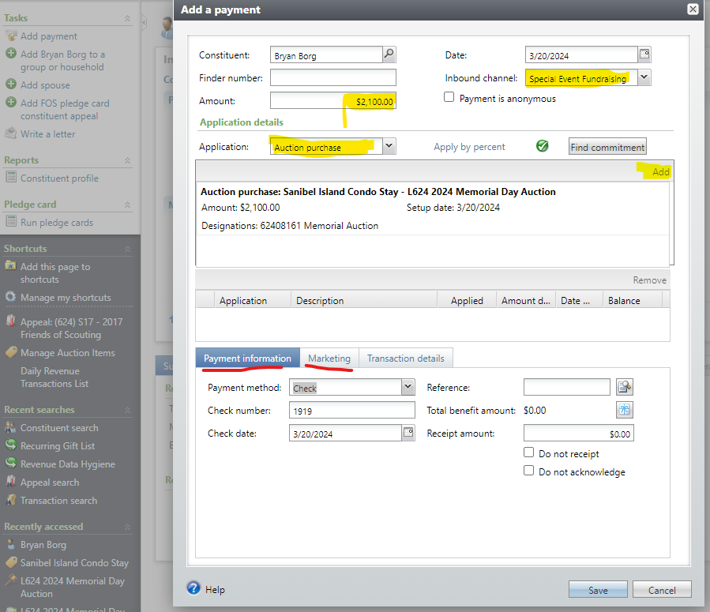
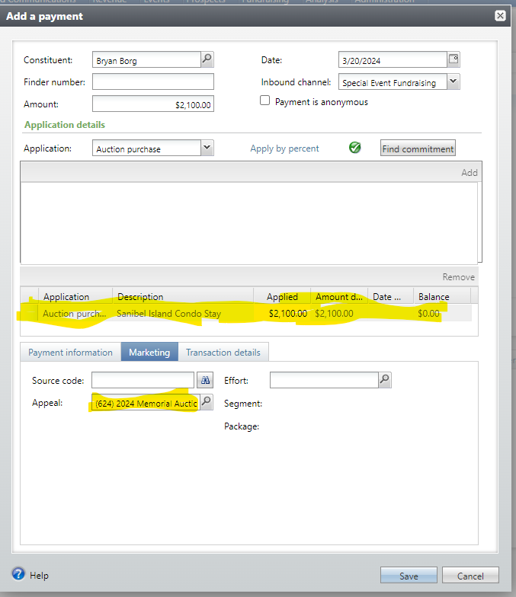
Auction – Add Payment

Slide 35
Auction Items
When Auction items are created
  Increase in Temporary Inventory (Account 1751)
  Increase in Items for Resale (Account 4209)
When Auction items are sold
  Item is cleared from Temporary Inventory (Account 1751)
  Increase in Items for Resale (Account 4209) if purchaser paid more than the value of the item originally entered.
  Decrease in Items for Resale (Account 4209) if purchaser paid less than the original value of the item originally entered.

Slide 36
Tracking your 2024 Appeals
Reports
Data List

Slide 37
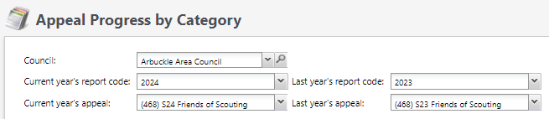
Appeal Progress By Category
Found under Revenue \ Reports \ Appeal Progress by Category
When you click the link, select your council. Then select the appeal years you want to compare. Then select the appeals from the appeal years and click view report on the right.

Slide 38
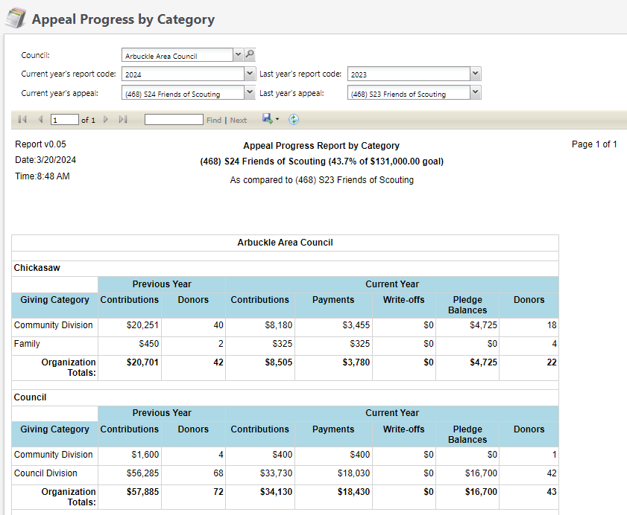
Appeal Progress by Category
This is a sample of the report. It can be downloaded as a PDF. Provides a comparison by Structure and category with summary at bottom of report.

Slide 39
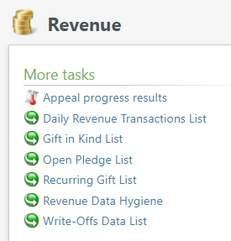
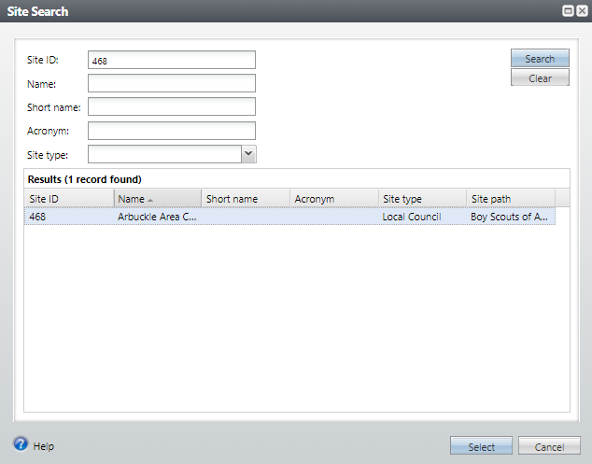
Daily Revenue Transactions List
Found under Revenue \ More Tasks \ Daily Revenue Transactions
Click the link and then insert your Site ID (Council #) and then select your council.

Slide 40
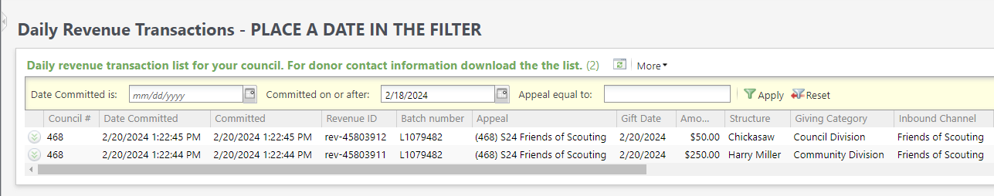
Daily Revenue Transactions
Place a date in a filter and click apply. If you need a report for a specific date, use the first filter. If you would the list for the week, use the "On or after" filter. More info is included in the download file.

Slide 41
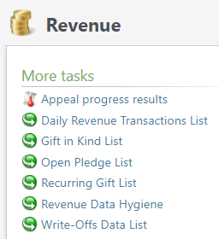
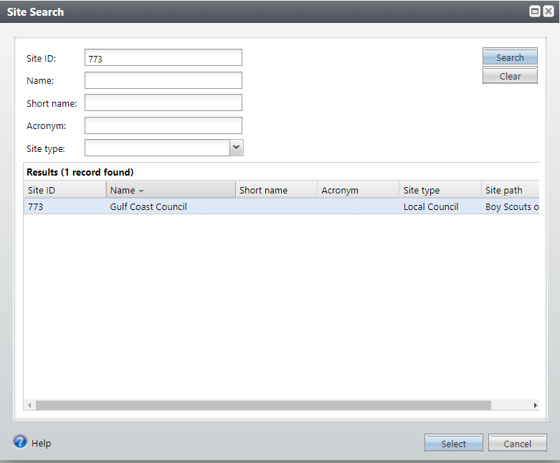
Recurring Gift List
Found under Revenue \ More Tasks \ Recurring Gift List
Provides list of Recurrences you have in the CRM.
Click the link and then insert your Site ID (Council #) and then select your council.

Slide 42
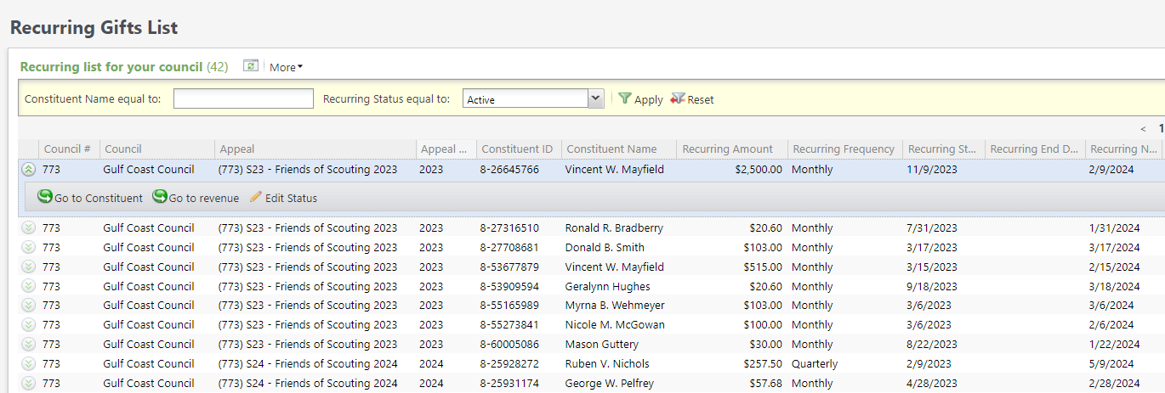
Recurring Gift List
This list provides a quick way to view all your active recurring gift. by clicking the go to revenue button, you can jump to the recurrence and make changes to the appeal, BSA structure, giving category or solicitor. You can also change the status to canceled or terminated.

Slide 43
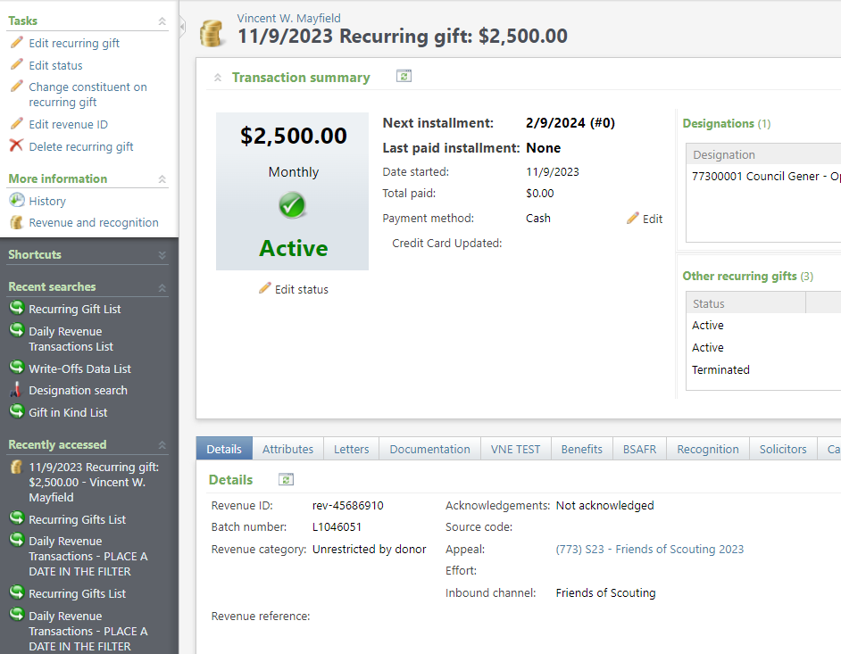
Recurring Gift List
Edit the recurrence to update the appeal. Change the solicitor on the Solicitor tab. Update the Giving Category or BSA Structure on the Attribute tab. These changes will not affect the GL. You can also edit the status of the recurrence on this page.

Slide 44
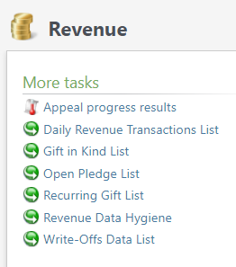
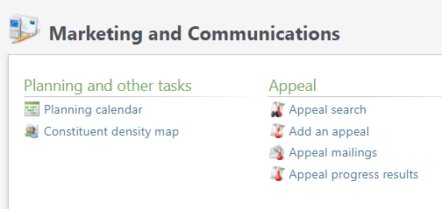
Appeal Progress Data List
Found under Revenue \ More Tasks \ Appeal Progress Results
Or Marketing & Communications \ Appeal \ Appeal Progress Results

Slide 45
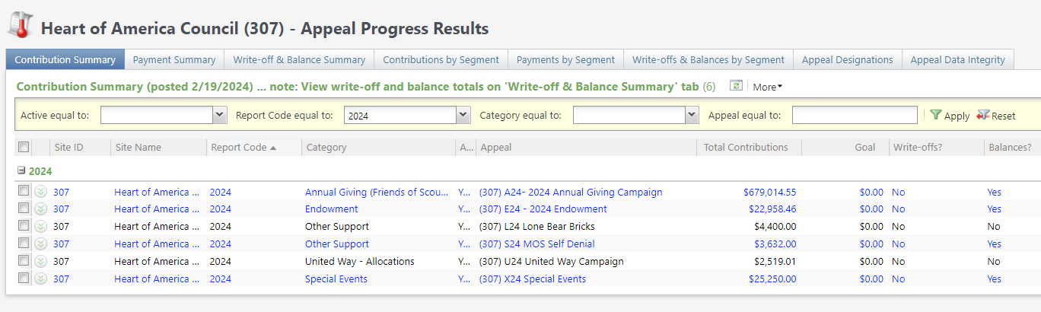
Appeal Progress Results
The "Contribution Summary" tab filtered to the appeal year gives you a quick snapshot of the progress of your appeals.

Slide 46
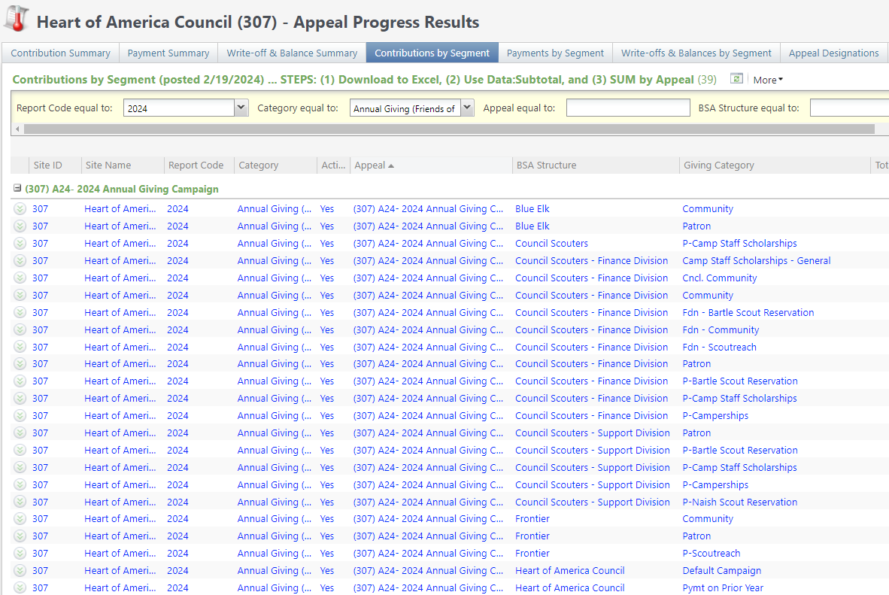
The "Contributions by Segment" tab gives you a quick report sorted by BSA Structure and Giving Category. A District Executive could run this to see progress.

Slide 47
Batches

Slide 48
Using Group ID in batch
Why?
  Improves solicitor reporting
  Units
  Groups
  Aligns pledge card history

Slide 49
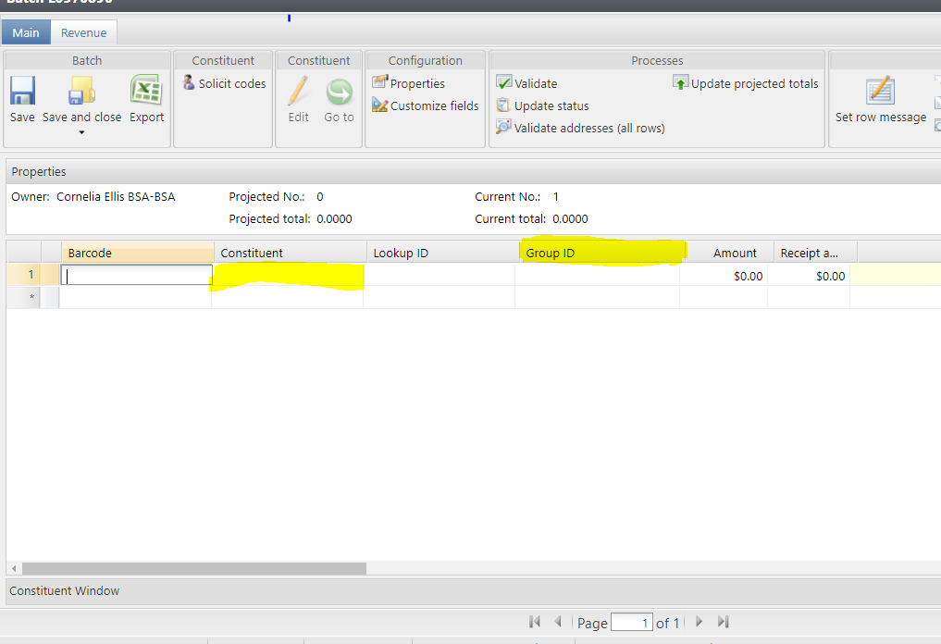
Revenue Batch
When entering a Unit to a Revenue batch select the Constituent then in the Group ID enter the information of the Unit. (Troop 0003, etc)

Slide 50
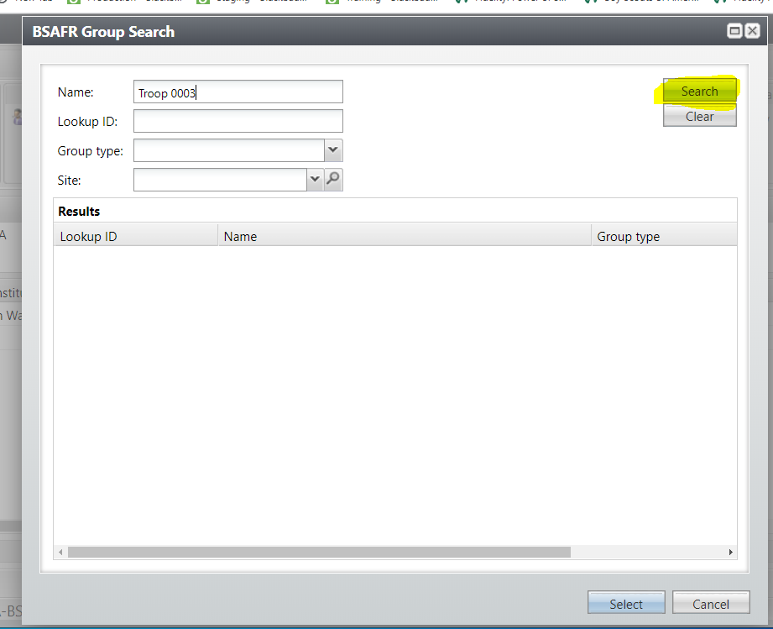
Search for the BSAFR Group

Slide 51
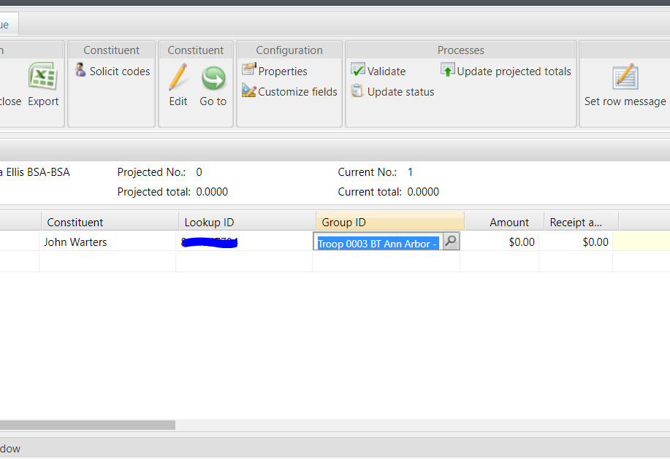
Populate in the BSAFR Group
The Group ID will populate with the Unit information. This will attach to the pledge or payment and will show on the Unit and Constituent's profile.
The Giving Category and BSA Structure columns will also fill in from the group.

Slide 52
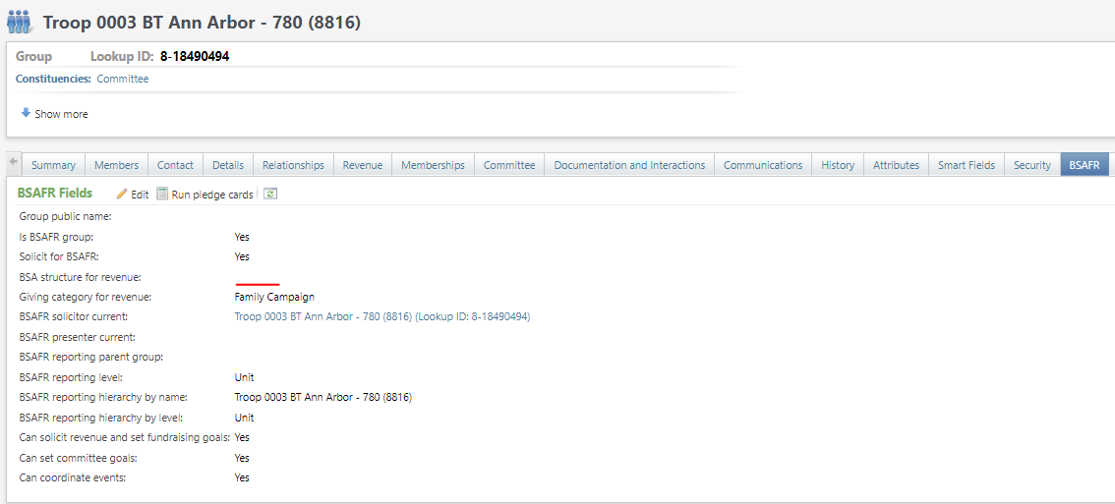
BSAFR Group Fields

Slide 53
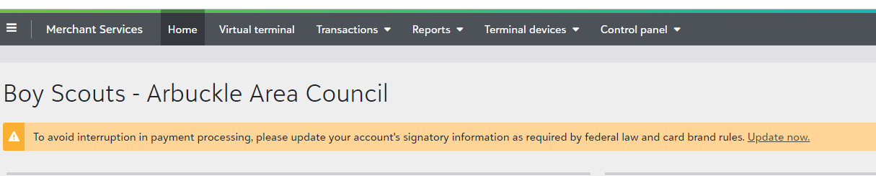
Blackbaud Merchant Services
Required Signatory Check.
If not completed, account will stop disbursements April 1.
Log into BBMS and see if you have an orange banner on home page
Click the link and complete the information

Slide 54
PAUSE and breathe…

Slide 55
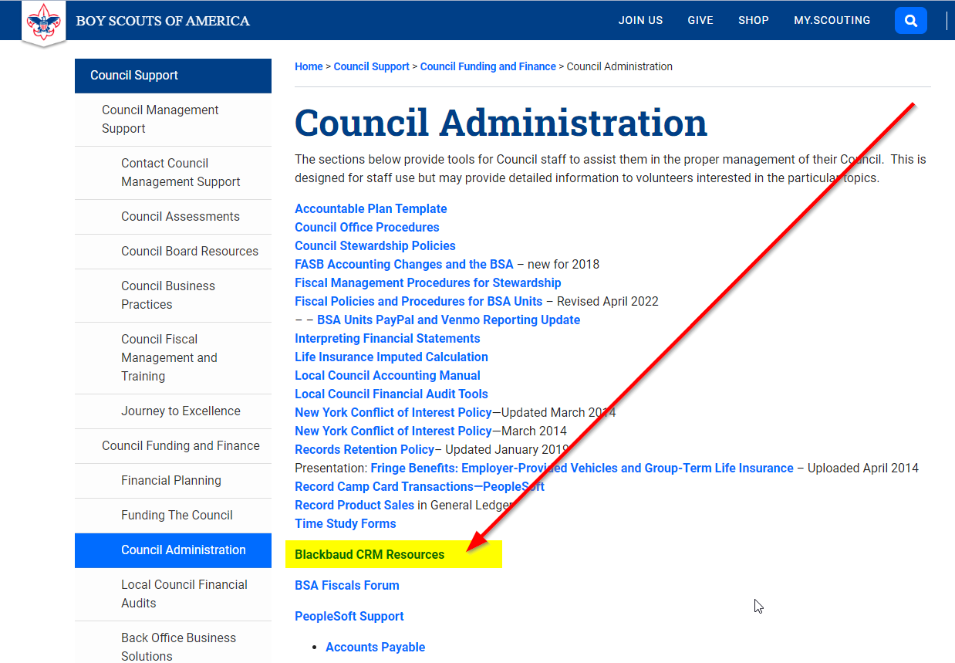
www.scouting.org/financeimpact

Slide 56
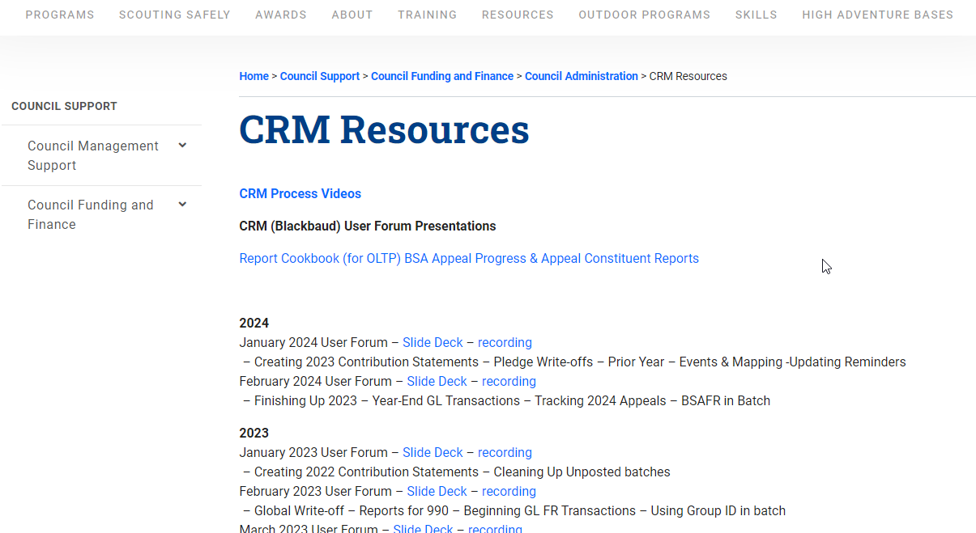

Slide 57
Member Care
Phone 972-580-2489
http://membercare.scouting.org
  Creating an incident directly in JIRA

Slide 58
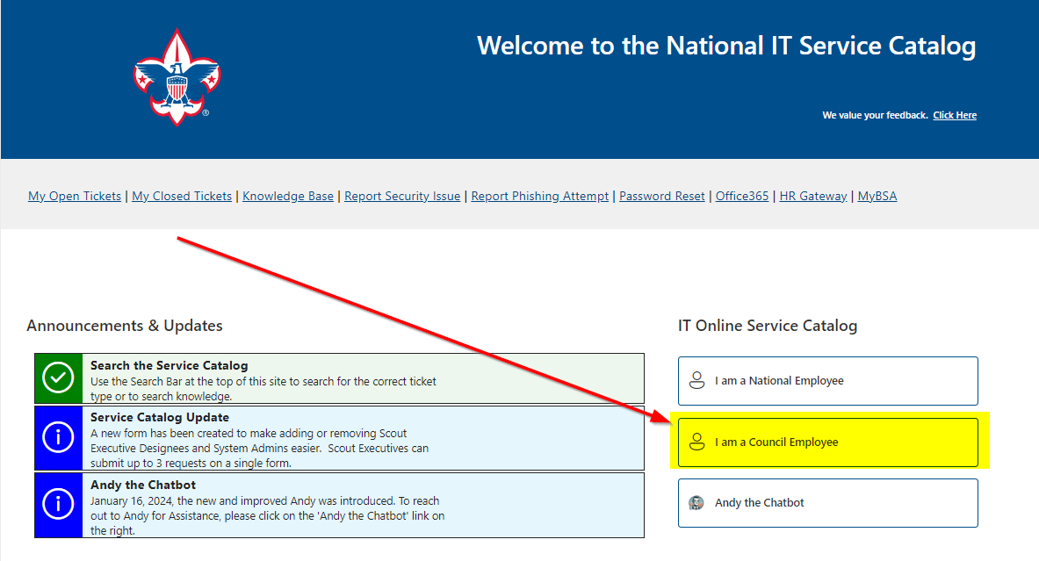

Slide 59
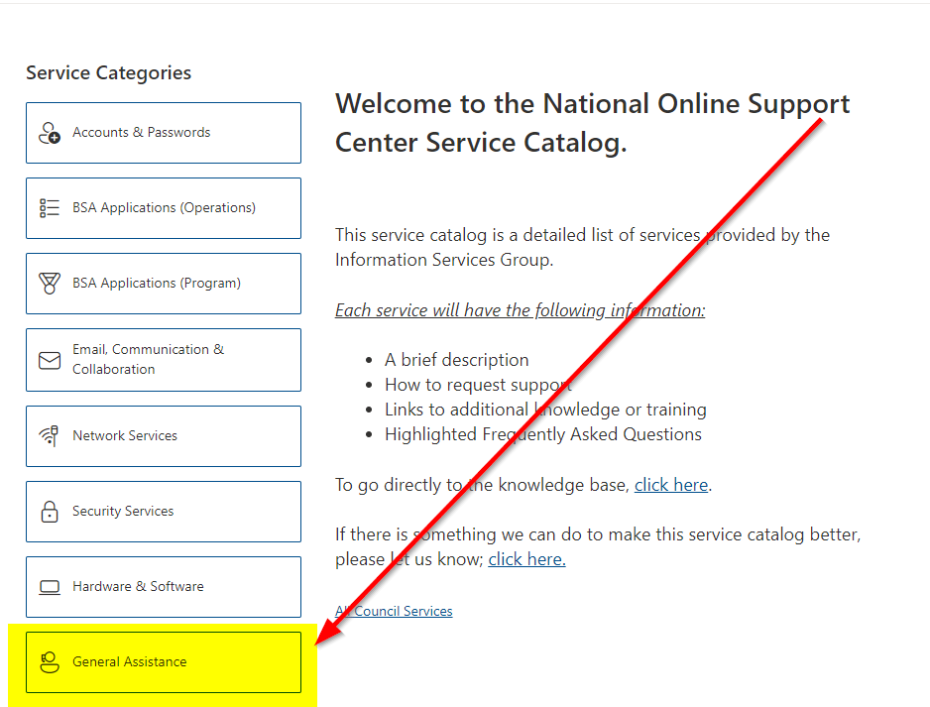

Slide 60
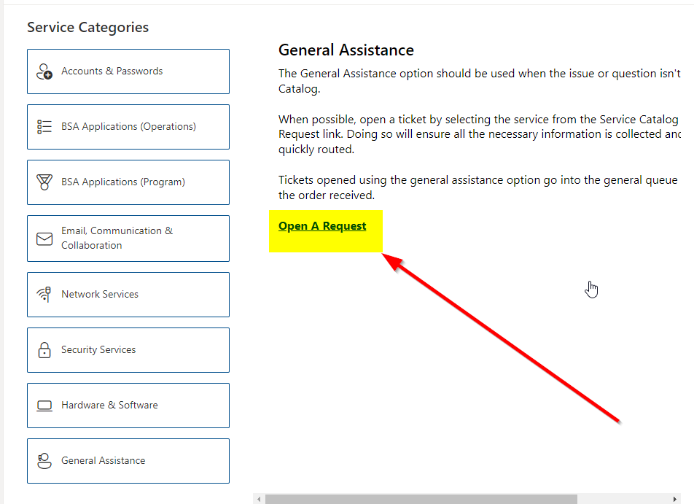

Slide 61
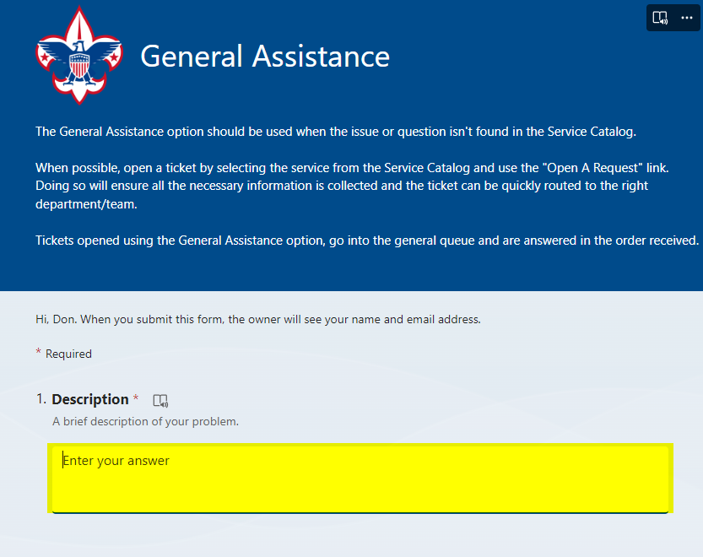

Slide 62
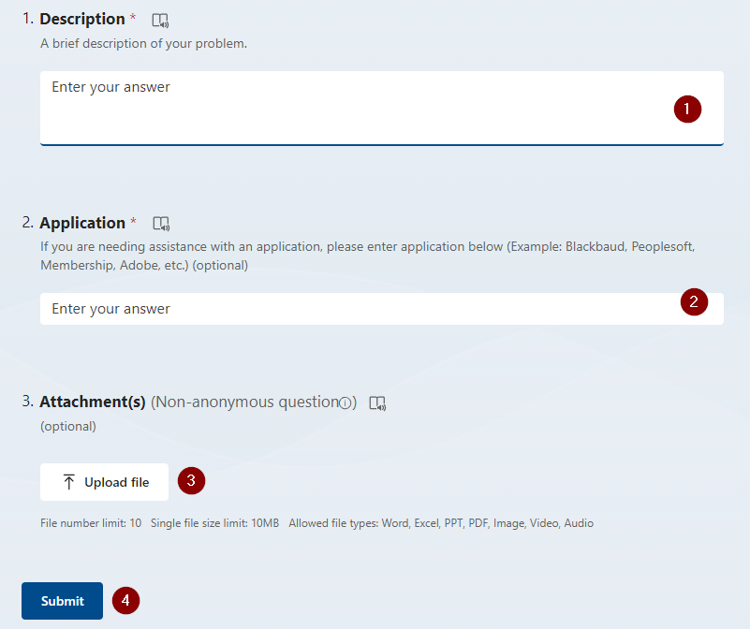
Fill in the Boxes – Add an Attachment
CLICK - Submit

Slide 63
Next Forum
April 17, 2024
10:00 am & 2:00 pm CT

Slide 64
Questions & Answers

