Slide 1
BSA Shotgun Range Safety Briefing
NO LIVE AMMUNITION in the classroom NO EXCEPTIONS!

Slide 2
Orientation Goal
To provide beginning shooters with the knowledge, skills, and attitude necessary to shoot a shotgun safely under the direct supervision of a NRA Certified Shotgun Instructor or a Certified NCS Shooting Sports Director.

Slide 3
NRA Gun Safety Rules
ALWAYS keep your gun pointed in a safe direction
ALWAYS keep your finger off the trigger until ready to shoot
ALWAYS keep your gun unloaded until ready to use

Slide 4
Shotgun Parts Pump
Loading Port
Bead Front Sight
Rib
Grip
Chamber
Barrel
Comb
Muzzle
Safety
Trigger
Magazine Loading Port
Forearm
Butt
Trigger Guard
Action Release

Slide 5
Shotgun Parts Semi-automtic
Loading Port
Bead Front Sight
Grip
Chamber
Barrel
Rib
Comb
Muzzle
Butt
Magazine Loading Port
Forearm
Safety
Trigger
Trigger Guard
Action Release

Slide 6
Shotgun Parts Break Action
Action Release
Upper Barrel
Bead Front Sight
Safety
Chambers
Rib
Comb
Grip
Muzzles
Forearm
Lower Barrel
Trigger
Butt
Trigger Guard

Slide 7
Demonstrate Shotgun Operation
Instructor demonstration only
Loading with Dummy Ammo
Cocking
Firing “Dry-fire only” with Dummy Ammo
Unloading
During Live-fire on the range, your instructor will load and unload the Shotgun for you.
7

Slide 8
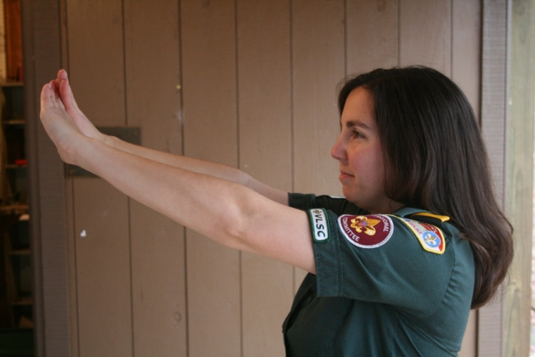
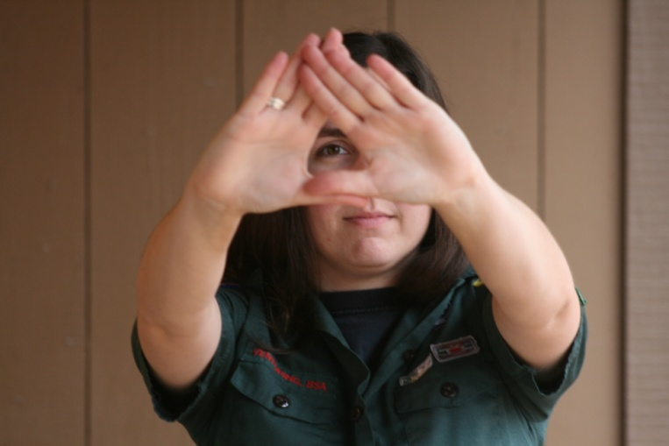
Shooting Fundamentals Determining the Dominant Eye
Extend arms forward and form opening between the hands
With both eyes open, look at a distant object through opening
Bring hands to face while looking at object – Opening will be aligned with the dominant eye
Notes:
8

Slide 9
Shotgun Shooting Fundamentals
1. Stance
2. Hold Point
3. Mount
4. See the Target
5. Swing
6. Pull the Trigger
7. Follow Through
Scouts will be shooting straight away targets

Slide 10
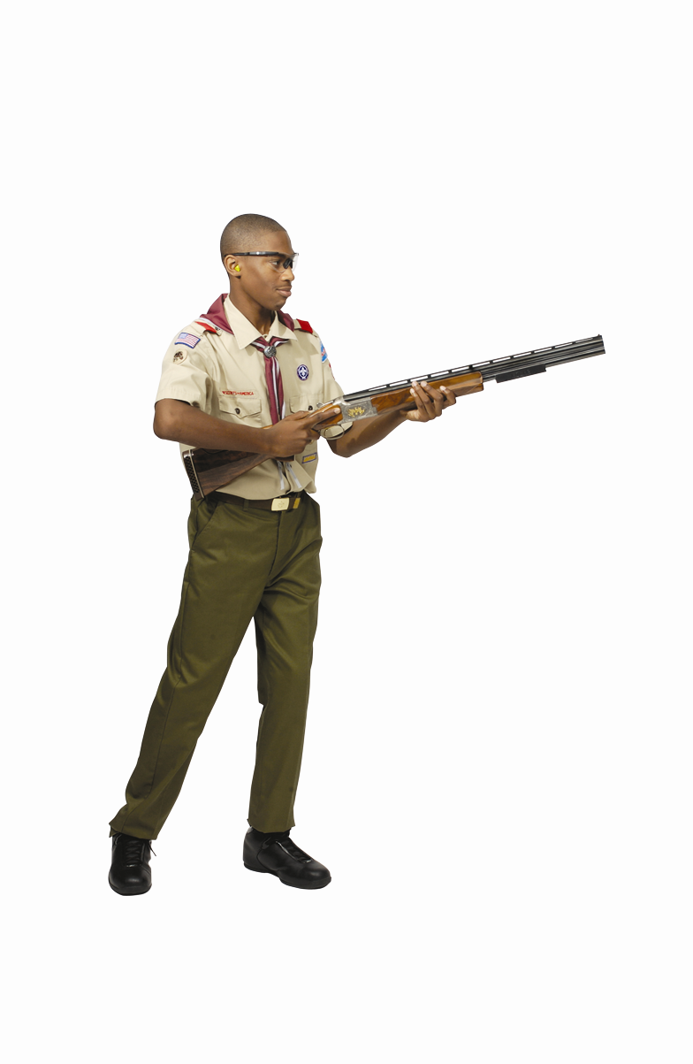
Shotgun Shooting Fundamentals
Stance
Stance aligned with target breaking point.
Feet about shoulder width apart, with toes on lead foot turned slightly outward.
Knee of the lead bent slightly; back leg remains straight.
Approximately 60 % of body weigh on lead leg and 40 % on rear leg.
Stance comfortable and balanced so that it may be maintained before, during, and after the shot.
Notes:
10

Slide 11
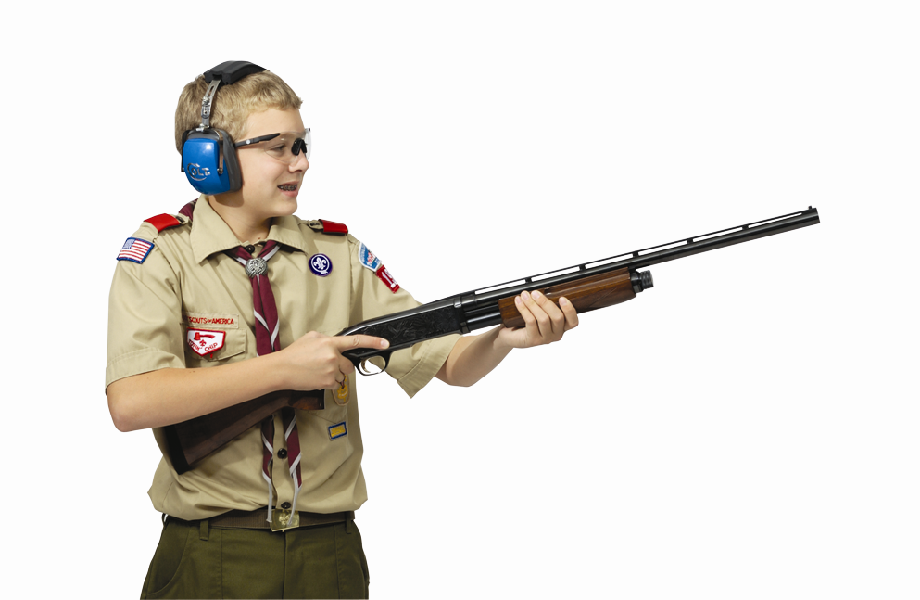
Shotgun Shooting Fundamentals
Hold Point
Know where the target will first appear and the direction it will be traveling.
Your hold point will be aligned just under the flight path of target to allow a clear view of where the target will first appear.
The shotgun is pointed at the hold point, but the eyes are focused on the area where the target will first appear.
Notes:
11

Slide 12
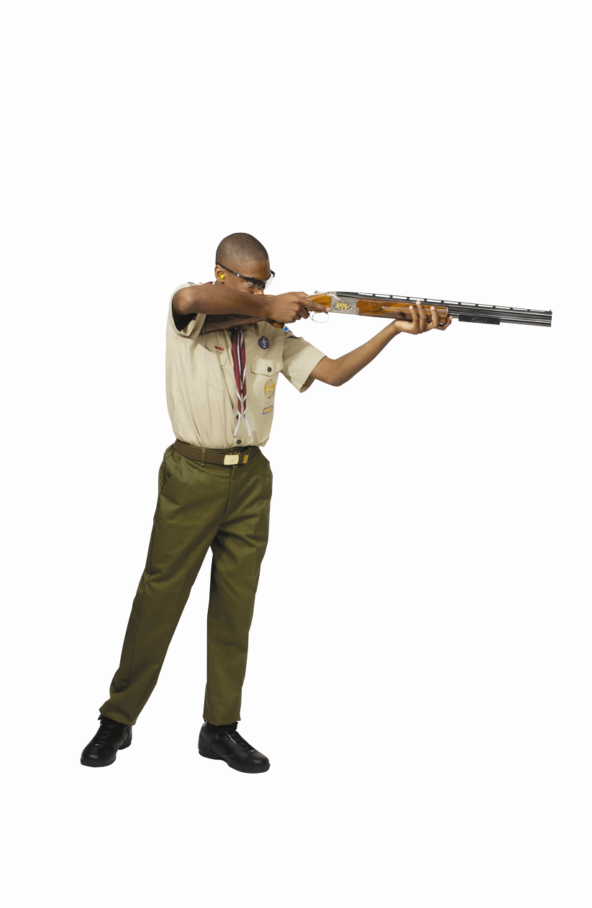
Shotgun Shooting Fundamentals Mount
The shotgun is brought up to the your face to keep the head erect level.
The cheek is pressed firmly against the stock.
The head is as far forward on the comb as possible without straining the neck.
The butt of the shotgun is in the pocket of the shoulder.
Notes:
12

Slide 13
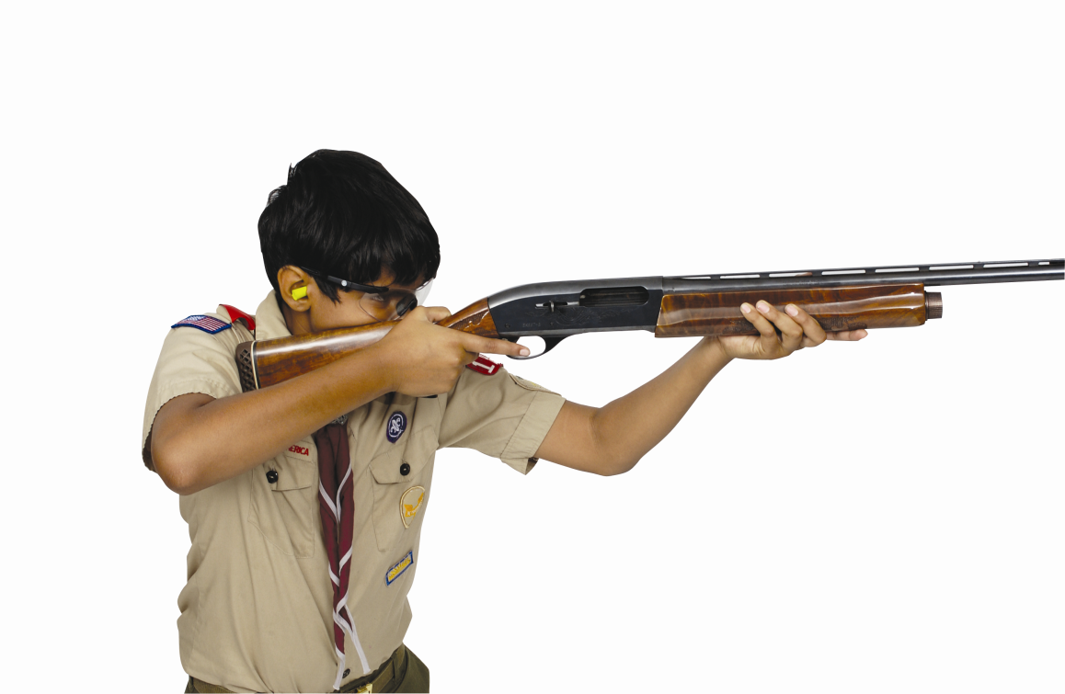
Shotgun Shooting Fundamentals
See the Target
The target must be seen clearly at the earliest point possible.
You must be looking past the beads and focusing on the field of fire where the target is in focus.
The Sight Picture is the visual relationship of the shotgun muzzle to the target.
When acquiring the sight picture, the focus must be on the target.
Notes:
13

Slide 14
Shotgun Shooting Fundamentals Swing
The swing begins with the shotgun already mounted on the shoulder.
When the target is clearly seen, the shotgun is pointed at the target.
Notes:
14

Slide 15
Shotgun Shooting Fundamentals Trigger Pull
The trigger must be pulled the instant the sight picture is correct (the target and the muzzle meet) for straight away targets.

Slide 16
Shotgun Shooting Fundamentals Follow Through
Follow-through means continuing to do everything that was being done at the time the shot was fired.
The swing must continue if the shot pellets are to hit the target. The trigger is pulled while the shotgun is moving, and the gun must continue to move after the shot is fired.

Slide 17
Most Important Fundamentals!
The most IMPORTANT shotgun shooting fundamental is……..
See the Target “Focus on the target”
You must learn to concentrate on the target.

Slide 18
Range Safety Briefing
Range layout
Ready Area
Shooting Station
Target Path
Down range shot drop zone

Slide 19
Range Safety Briefing
NRA Safe Gun Handling Rules
ALWAYS keep your gun pointed in a safe direction
ALWAYS keep your finger off the trigger until ready to shoot
ALWAYS keep your gun unloaded until ready to use

Slide 20
Range Safety Briefing
Other Safety Rules
Know your target and what is beyond
Wear eye and ear protection as appropriate
Never use alcohol or drugs before or while shooting
Be aware that certain types of guns and many shooting activities require additional safety precautions
Range Commands
“Commence Firing”
“Cease Firing”
“Pull”

Slide 21
At The Shooting Station
One instructor will be at each firing point.
Watch straightaway target.
Point finger at the target all way to the ground.
Point finger and say “bang” on touching target.
The instructor will hold the shotgun by the forearm.
Place your hands on the grip. When you have control of the shotgun, say “Thank you” and the instructor will let go.
You will then Dry-fire. TAKE YOUR TIME. Focus on safety and the shooting fundamentals. When you are comfortable, tell the Instructor you are ready to shoot.
Your instructor will then load the shotgun and hold it by forearm.
Place your hands on the grip. When you have control of the shotgun, say “Thank you” and the instructor will let go.
You will Live-fire the prescribed number of shoots.

Slide 22
Questions
Do you have any questions before you move to the Ready Area?

