Slide 1
STEM Training
This slide is informational for the training staff. Delete or skip when using this PPT.
This training is meant as a general introduction to Nova and Supernova Awards and part of a series of STEM training.
  What is STEM
  Nova and Supernova Awards
  How to Teach a Nova Award, I Planning
  How to Teach a Nova Award, II Implementation
  Dr. Albert Einstein Supernova Award
Nova Awards Counselors should complete 1-4.
Supernova Award Mentors should complete 1-5.
Einstein Award Mentors should complete 5.
Check the Notes pages for a script you can adapt for your use.
Some slides have animations which you can click in time with your descriptions.
There is an optional Quiz.

Slide 2
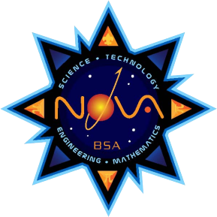
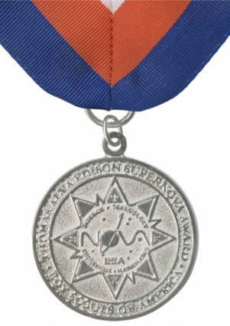
Nova and Supernova Training
Notes:
In this module we will cover the basic requirements and training for Nova Awards Counselors and Supernova Awards Mentors.
After you are finished, there are supplemental training courses on specific STEM activities and topics you can take to deepen your understanding of the ways to employ STEM activities and awards into scouting activities.

Slide 3
Objectives
Registration
Award Requirements
Risk Assessments
EDGE Methods
Recording & Reporting
Notes:
After watching this module, you will be able to: (click for each)
Know how to register as a Nova Awards Counselor & Supernova Awards Mentor
Understand where to find the requirements for each Nova and Supernova award
Do basic risk assessment
Understand how the EDGE method can be applied to Nova and Supernova Award activities
Report completion of award requirements so that scouts can receive recognition

Slide 4
Nova Awards Counselor
21 years or older
Apply
Youth Protection Training
No scientific background required!
Notes:
(click for each bullet)
To be a registered Nova Awards Counselor, each year you must be 21 years of age or older, apply and be registered under the Nova Awards counselor position code 58; and must be current on the Youth Protection Training (YPT). There is no cost to apply, but you must reapply annually and remain current with YPT. You do not need to have scientific background to be a Nova counselor.
Scouts are encouraged to work with adults other than their own parent, guardian, or unit leader as frequently as possible. However, a parent or guardian may counsel their own child for a Nova if working with a small group of youth at the same time AND if the parent or guardian is a currently registered Nova counselor.

Slide 5
Supernova Awards Mentor
21 years or older
Apply
Supernova Awards Mentor Information Form
Youth Protection Training
Subject Matter Expert in STEM field
Notes:
(click for each bullet)
To be a Supernova mentor, you must apply and be registered under the Supernova Awards mentor position code 52, and submit a Supernova Awards Mentor Information form, be 21 years of age or older, and be current on your Youth Protection Training. Again, there is no cost to apply for this position, but it must be renewed annually.
Supernova Mentors do need to be a subject matter expert in a STEM field. An adult may only mentor their own Cub Scout if the mentoring is done simultaneously for a group of Cub Scouts that includes their own child. Scouts BSA, Venturing, and Sea Scouts must work with a currently registered Supernova awards mentor other than their own parent/guardian/unit leader.

Slide 6
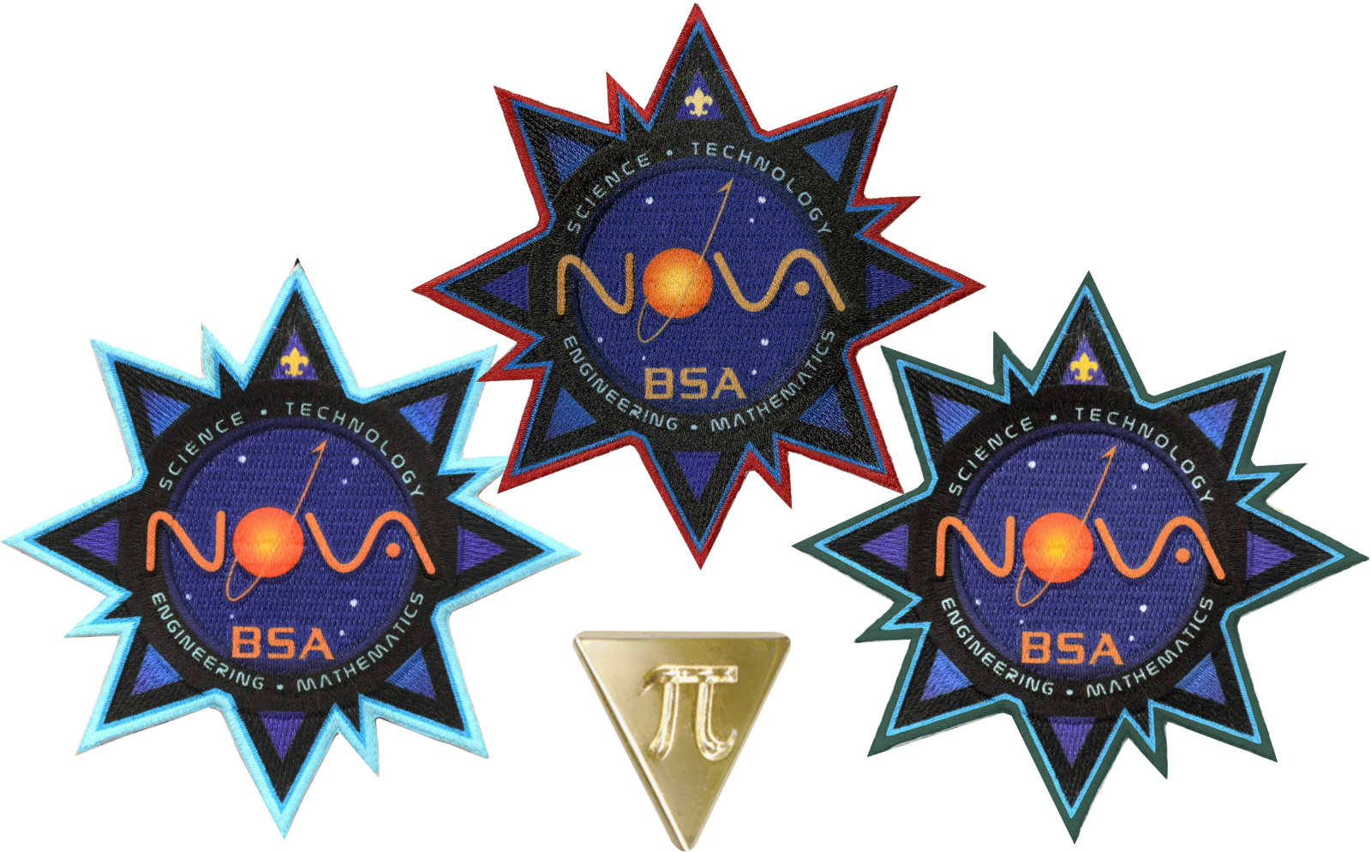
STEM Nova Awards
Notes:
The Nova Award is a special patch that can be worn on the uniform, with different edge colors for Cub Scouts, Scouts BSA, Venturing and Sea Scouts. When a second Nova award is earned, the youth will get a pi pin to add to the patch. There are a number of different Nova awards available for all ranks in our traditional program. Counseling youth working on Nova awards requirements is similar to working on Cub Scout adventures, Scouts BSA merit badges, or Venturing / Sea Scout explorations. The requirements for each can be found online. Links can be found in the Supplemental information for this training. Spend some time getting familiar with the requirements and have a plan for helping the youth complete them.
For more details on how to conduct effective Nova classes, see the supplemental training “How to Teach a Nova Award Class”.

Slide 7
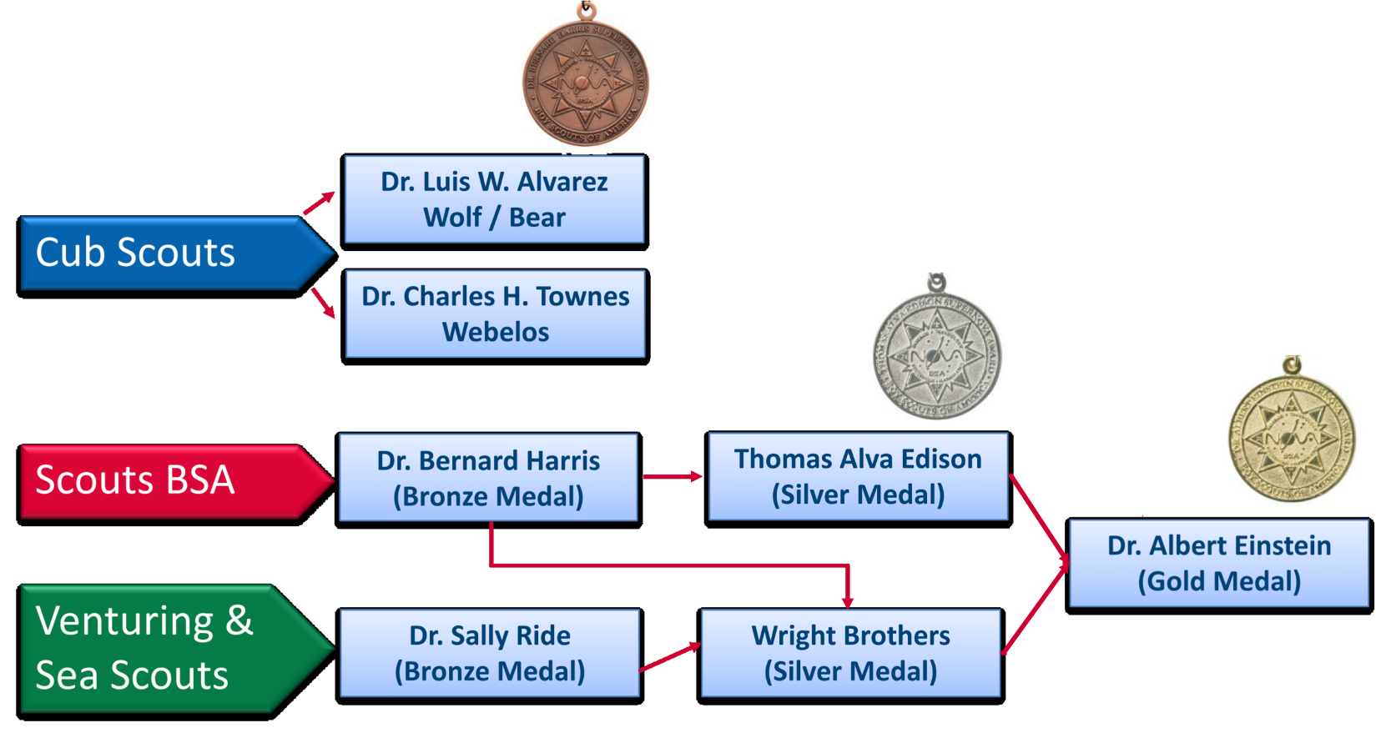
STEM Supernova Awards
Notes:
There are bronze, silver and gold Supernova awards with specific rank requirements and prerequisites. Spend some time getting familiar with the requirements for each rank.
Cub Scouts must be Wolf or Bear rank to work on the Dr. Luis Walter Alvarez Supernova Award
Webelos and AOL youth work on the Dr. Charles H. Townes Supernova award. The requirements include STEM activities and projects.
For Scouts BSA, the youth must be first class or higher, have completed 3 of the Nova awards (one each in three of four STEM categories), merit badges and STEM activities to earn the Dr. Bernard Harris Supernova Award. For Scouts BSA youth interested in going further can complete requirements for the Thomas Alva Edison award.
Similarly, Venturers and Sea Scouts can earn the Dr. Sally Ride, then the Wright Brothers Award. The Dr. Albert Einstein Award is the highest BSA award in STEM. This Award has its own supplemental training module.
Scouts receive the medal and optional bar pin for their uniform.
Mentoring youth working on Supernova Awards usually requires a longer commitment than Novas.
See the links in the supplemental information to find the requirements and prerequisites for each award.

Slide 8
Getting Started
Lay out the plan
Recordkeeping
Notes:
Apart from being aware of the requirements, you should lay out expectations in the first meeting and help identify where the youth may need to focus effort. But the youth should select the options within the requirements to fulfill, and it is your job to both guide them and evaluate their work.
Tracking progress through recordkeeping is also important. Notebooks and files should be stored securely so that they may be found and referenced if needed later.

Slide 9
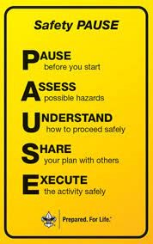
Is it safe?
Notes:
Safety is very important in Scouting and STEM activities require special attention. As outlined in the Guide to Safe Scouting, conduct a Safety PAUSE. Pause before you start; Assess the hazards; Understand how to proceed safely; Share your plan with others; and Execute the activity safely. Remember, if you cannot conduct the activity safely, then you cannot conduct the activity at all!

Slide 10
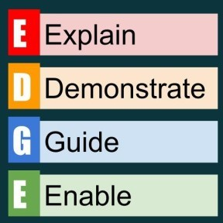
EDGE Method
Notes:
The EDGE method works well for Nova and Supernova Awards activities just like other areas of scouting. Remember, EDGE stands for explain, demonstrate, guide, and enable. With younger scouts and Nova Awards counseling, you’ll do more explaining and demonstrating. With older youth and Supernova Awards activities, you’ll do more of the latter two. Use your judgment and interactions to figure out how to progress through each step.

Slide 11
Recordkeeping
Notes:
Reporting completion of Nova awards goes to the youth’s unit leader. If using Scoutbook, the counselor may be linked to the scout, or the unit leader may fill in the completion themselves after conferring with the counselor.
For Supernova awards, the Supernova Award Application must be completed. You should have the youth first get their unit leader’s signature plus theirs, then sign off completion of the award as the Mentor. This document is then transmitted to the district or council STEM committee (or Advancement and Recognitions Committee, if there is no STEM committee).
Remember, the youth are expected to fulfill the requirements as written; no more, no less.

Slide 12
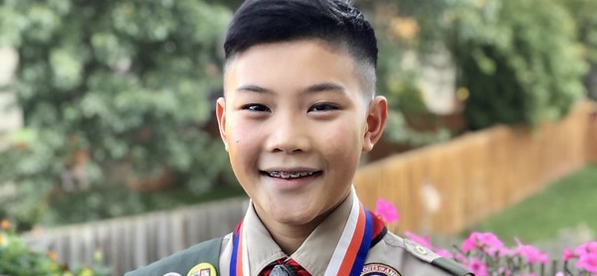
Celebrate!
Notes:
Nova and Supernova Awards are typically presented at a unit Court of Awards. If possible, the mentor should attend to congratulate the youth. For Supernova Awards, you may consider acknowledgement in District or Council newsletters to further recognize the significance of the accomplishment.

Slide 13
Quiz
When registering as a Nova Awards Counselor, which of the following is NOT required?
Complete the appropriate Adult Application
Be up-to-date on Youth Protection Training
Be 21 years old
Be a subject matter expert in a STEM field
Notes:
D is answer

Slide 14
Quiz
When registering as a Supernova Awards Mentor, which of the following is required?
Complete the appropriate Adult Application
Be up-to-date on Youth Protection Training
Be 21 years old
Be a subject matter expert in a STEM field
Complete the Supernova Awards Mentor Information Form
All the above
Notes:
F is answer

Slide 15
Quiz
Which of the following does PAUSE stand for?
Pause, Assess, Understand, Share, Execute
Plan, Allow, Utilize, Shine, Entertain
Peruse, Allocate, Use, Search, Evaluate
Notes:
A is answer

Slide 16
Quiz
How do you report completion of the requirements for Supernova awards?
Tell the unit leader
Complete the Supernova Award Application and transmit it to the district or council STEM committee.
Nothing is required
Notes:
B is answer

Slide 17
Quiz
Which of the following does EDGE stand for?
Evaluate, Digest, Glue, Exit
Elucidate, Disseminate, Gravitate, Enervate
Explain, Demonstrate, Guide, Enable
Notes:
C is answer

Slide 18
Notes:
Counseling Nova awards and Mentoring Supernova Awards is a great opportunity to support STEM in Scouting. It gives you an opportunity to show the youth how important STEM can be to exploration and critical thinking.
Remember, that there is additional training for the mentor of the Dr. Albert Einstein Gold Supernova Award.
Thank you for making the commitment to tomorrow’s leaders!

Slide 19

Congratulations!
Notes:
Course completed. Congratulations! Now that you have completed this course, be sure and register with your council to be a Nova Award Counselor and Supernova Award Mentor.

