Slide 1
STEM Training
This slide is informational for the training staff. Delete or skip when using this PPT.
This training is part of a series of STEM training.
What is STEM
Nova and Supernova Awards
How to Teach a Nova Award, I Planning
How to Teach a Nova Award, II Implementation
Einstein Awards
Nova Awards Counselors should complete 1-4.
Supernova Award Mentors should complete 1-5.
Einstein Award Mentors should complete 5.
Check the Notes pages for a script you can adapt for your use.
Some slides have animations which you can click in time with your descriptions.
There is an optional Quiz.

Slide 2
How to teach a Nova Award Part II - Implementation
Notes:
Teaching Nova awards both in person and online can be successful and rewarding to youth and adults, but like all scouting events you’ll find that some planning can help improve all aspects of the Nova experience
Welcome to Part 2 of How to Teach a Nova Award class. This module focuses on strategies for running a class successfully

Slide 3
Objectives
Preparation
Scheduling
Communication
Evaluation
Notes:
After watching this module, you will be able to: (click for each)
Know how to prepare for the class
Setup a schedule so that you can complete the tasks
Communicate effectively so you can do more
Evaluate the class to be more successful in the future

Slide 4
Preparation
Notes:
Having a script of what you need to say is important to staying organized. Sometimes, it’s important to have the specifics written down to refer to. It’s also important to use the script to not get off-topic. Scripts can also help you practice saying what’s important and remembering key details. Done well, these can be passed along to other counselors who can use some or all the ideas for their own classes!

Slide 5
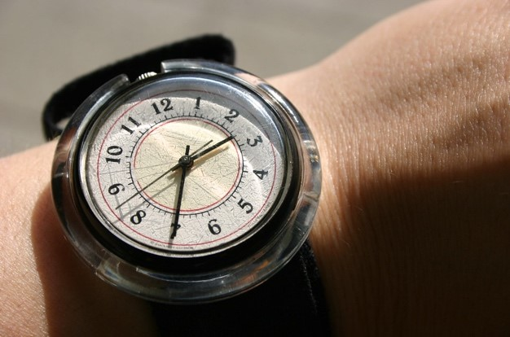
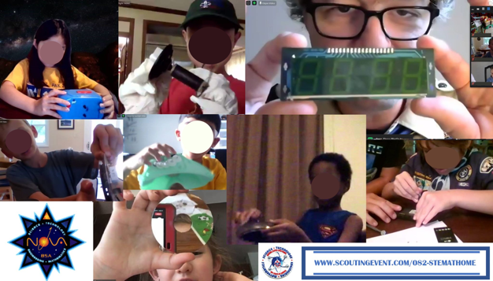
Schedule
Notes:
Since you now know what you need to cover, you must figure out how much time for, and the order of, each task. Dry runs can tell you how long to expect for each part. And while you’ll always have more to cover than class will allow, remember that short breaks are needed.
Also, be as flexible as possible. If something is working well, fun, and engaging, you may consider letting it run longer. Those “magic moments” are rare, and you’ll do well to recognize them and embrace them!

Slide 6
Tell
Show
Do
Review
Notes:
Tell/Show/Do/Review – TSDR - follows in the same vein as the EDGE method (or explain, demonstrate, guide, enable). Be succinct and clear to quickly get to the DO part. In STEM, it’s usually ok to underexplain a concept and let the youth explore answers and solutions rather than pushing them towards preconceived answers. Remember, this is an opportunity for youth to learn, not for you to demonstrate how smart you are.
Once you feel the task is done, start reviewing—you usually don’t have to wait, everyone will catch on that it’s time to move on. This will help you maintain control and refocus.

Slide 7
Address
Address each person directly
Be
Be specific with your question
Give
Give several seconds to answer
Confirm
Confirm by repeating or rewording answers with specific terminology to reinforce.
Notes:
Effective questions are a key to effective learning. Similarly, effective listening will tell you what is understood and what needs work.
As part of scripting, you will want to quiz your class to find out if they understand something. If your class is online, quizzes and polls are useful to gauge general knowledge, but often you’ll need to directly call on a youth. Remember to:
1. address each person directly, 2. be specific in your question, 3. give them several seconds to answer 4. Confirm by repeating or rewording their answer(s) with specific terminology you want to reinforce.
Struggling to answer is a good sign that youth are thinking—don’t rush to rephrase a question until they prompt you. Listen to the clues they are giving you about what they need.
Remember: each youth’s questions deserve to be heard because, ultimately, we are there to serve them.

Slide 8
Notes:
Conclusions don’t need to take long, but you should do them to signal a close to the class. Take a minute to quickly summarize what was learned, and maybe also ask the youth for brief feedback about what worked and what could be improved. Remind them what requirements need to be completed and how to contact you.
And it never hurts to thank your team and speakers again.
Finally, have a closing statement that calls the scouts to action. It can be corny or profound, but it’s your last chance to give a gentle push to take what you’ve taught and run with it.

Slide 9
Following Up
Completing requirements
Thanking team
Evaluating
Notes:
Congratulations on finishing your class! You’re almost done, but there are few details you should follow-up on to ensure loose ends get tied up and to ensure the best experience for future classes.

Slide 10
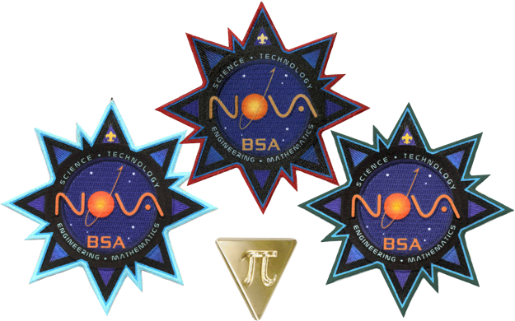
Completing Requirements
Notes:
Give a day or two, but follow-up with attendees to ensure they complete any remaining requirements. Typically, these are the read/watch requirements, and sometimes there are things that didn’t get covered in time during class.
Sometimes, you may need to rely on parents to find a STEM professional and/or help visiting a facility. As much as possible, make it easy and provide the resources needed to complete these requirements.
Don’t forget to use your tracking system to log completion in a timely manner and get the youth their awards.

Slide 11
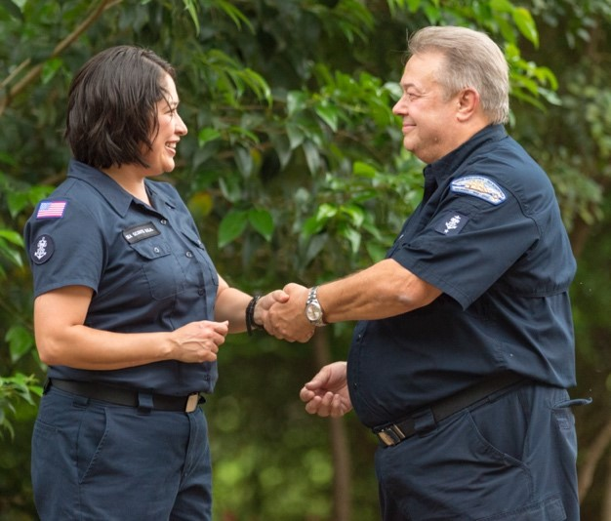
Thanking Team
Notes:
Thank your team for a job well done. Make sure you address any concerns and solicit their feedback. Even small tokens of appreciation can mean a lot to ensuring your team wants to work with you again. Volunteering can be a thankless job, but it won’t be on your watch!

Slide 12
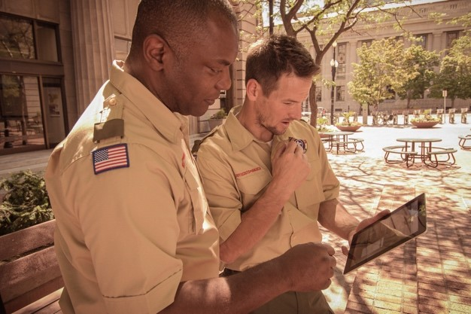
Evaluations
Notes:
Take the time to perform a self-assessment and figure out what worked, what didn’t, and what you want to try next. Examples might be: “Give more specific instructions for the do-ahead activities,” “the speaker was AMAZING! See if we can use them again in the future!” or “the main activity took much longer to do complete than anticipated—rehearse the demo better so it’s clearer.”
Make an effort to improve yourself and the program, and everyone will benefit!

Slide 13
Quiz
Which are key parts to class PREPARATION?
Developing a script of what you want to say and cover
Actively questioning and listening
Sending a follow-up to complete unfinished requirements
Notes:
Which are the key parts to class preparation?
A is the answer.

Slide 14
Quiz
When SCHEDULING, which parts are important to consider?
Length of each task
Breaks
Order of activities
Flexibility
All of these
Notes:
When scheduling, which parts are important to consider?
E is the answer.

Slide 15
Quiz
Which is NOT a part of TSDR?
Tell
Signal
Do
Review
Notes:
Which isn’t a part of clear communication by the TSDR method?
B is the answer.

Slide 16
Quiz
During your follow-up, which of these are needed:
Remind youth to complete requirements
Thank your team
Perform an evaluation and aim to improve
All of the above
Notes:
During the follow-up, which of these are needed?
D is the answer.

Slide 17
Notes:
Great job! You’ve completed Part Two of How to Teach a Nova class.
With what you’ve learned, you’re ready to help train the next generation of Scouts in STEM!

Slide 18
Congratulations!
Notes:
Congratulations!

