Slide 1
STEM Training
This slide is informational for the training staff. Delete or skip when using this PPT.
This training is part of a series of STEM training.
  What is STEM
  Nova and Supernova Awards
  How to Teach a Nova Award, I Planning
  How to Teach a Nova Award, II Implementation
  Dr. Albert Einstein Supernova Award
Nova Awards Counselors should complete 1-4.
Supernova Award Mentors should complete 1-5.
Einstein Award Mentors should complete 5.
Check the Notes pages for a script you can adapt for your use.
Some slides have animations which you can click in time with your descriptions.
There is an optional Quiz.

Slide 2

How to teach a Nova Award
Part I - Planning
Notes:
Teaching Nova awards both in person and online can be successful and rewarding to youth and adults, but like all scouting events you’ll find that some planning can help improve all aspects of the Nova experience
In Part One, we will talk about what goes into planning a Nova class online or in-person, and in the Part Two we will cover how to handle the class itself and afterwards.

Slide 3
Objectives
Be able to identify the key aspects to host a Nova Award classroom
How to build a team
How to advertise your class, and
How to ensure progress is documented.
Notes:
After watching this module, you will be able to: (click for each)
Be able to identify the key aspects to host a Nova Award classroom
How to build a team
How to advertise your class, and
How to ensure progress is documented.
There are many Nova Awards available. You should always teach something you’re passionate about. Youth identify genuine enthusiasm and gravitate towards it.
But with so many choices, sometimes factors such as [the Activities], [the group makeup and size], and [the class timing] can make a class truly special or act to limit some of the activities you might have in mind.

Slide 4
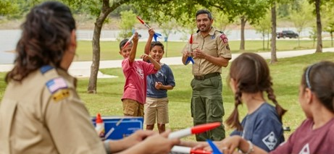
Activities
Notes:
Having fun and doing something interesting should be the focus of your STEM meeting. Build around activities that meet the goals of the class, that are interactive, and that stretch the abilities of the youth. Strive to pair each requirement with an activity that engages rather than lectures. This can also be an excellent opportunity to bring in outside help and demonstrations from experts. More on that later.

Slide 5

Group
Notes:
Your group size and makeup can dictate the types of classes you may want to pursue. Give careful thought as to how many participants can reasonably be engaged with the available supplies, location, and volunteers.
Maturity is another major factor, as interests change. And it never hurts to ask the group well ahead about what they might be interested in.

Slide 6
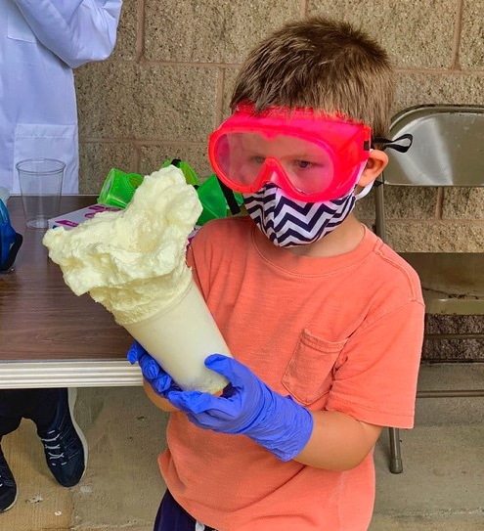

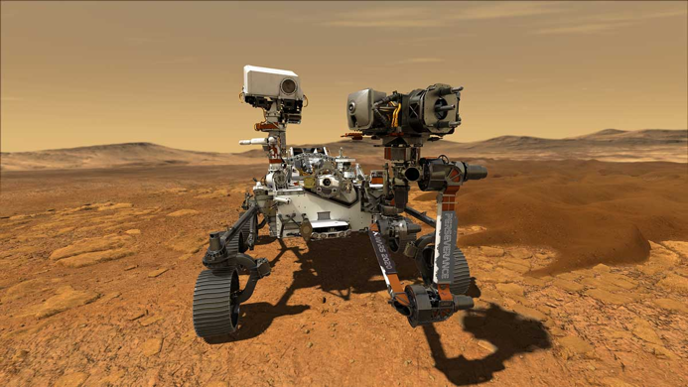
Timing
Elephant Toothpaste
Cub Scouts Can Code
Mars Perseverance Rover
Notes:
One feature of having so many options is that there’s always one that’s right for the time of year and availability of resources. The spring and summer may be ideal times to get outside and do classes in a park with rocket launches and messy reactions.
The winter might be the ideal time to learn the basics of coding.
Sometimes, an event like a space mission, such as the Perseverance mission to Mars, can be perfect to build around—and you should always be on the lookout for those!

Slide 7
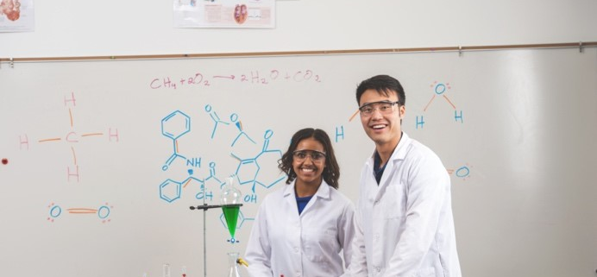
Building a Team
Notes:
Something you’ve learned in other scouting training is that many hands make light work. This is true in STEM classes too. It may be fun to try and do everything yourself, but it can be overwhelming and even sideline volunteers who would help you!
Nobody expects you to carry the load alone. Consider finding support in the form of subject matter experts to meet with youth; older Scouts who want to teach Cubs as part of Supernova Awards; and other adults to handle registration and records or teach part of the class with you. By allowing them to focus on a small task, they’ll do a great job and bring their passion as well.
And above all else, THANK YOUR TEAM! If you want volunteers to help you out again, or at least tell others what a great experience they had with you, then both verbal thank yous and even small tokens of appreciation go a long way to acknowledging the work put in by everyone in the team.

Slide 8

Advertising
Notes:
You must tell people you have a Nova class if you want them to show up! Remember, you want to meet your audience where they are—so if it’s a small den gathering, you can email the parents directly. But if you’re advertising a big event nationwide, you’ll want to getting into district and council newsletters well ahead of time, and consider different social media outlets and interest groups. Don’t expect people to find out about you—instead be proactive and make contacts with local units, district, council, and even national representatives. We’re all here to help!
Also keep your advertising crisp. Have the relevant information like the class, date, location, registration and contacts, as well as a description of the activities—especially if you have an outside speaker highlight. By keeping the message concise, you’re demonstrating that you’ve put thought and effort into your class and that it will be worth all scouts’ time.
.

Slide 9
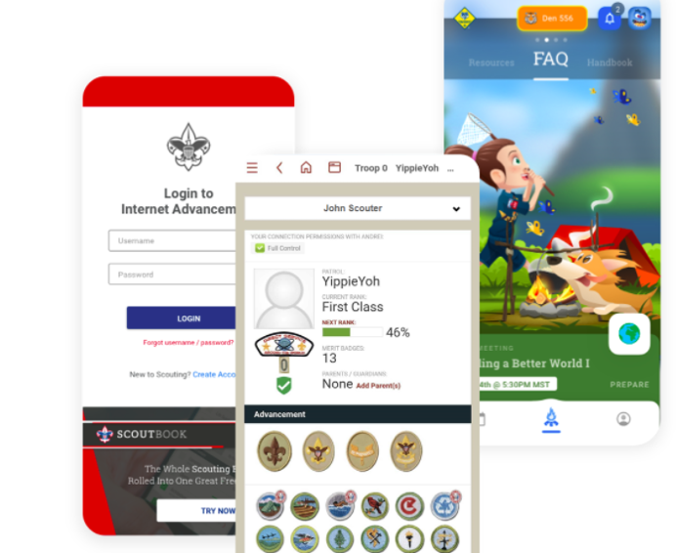
Tracking
Notes:
Keeping track of achievements will ensure that scouts can be awarded in a timely manner. Whether you use Scoutbook, a spreadsheet, or an online classroom, make sure it’s easy for you and the parents to access, record, and update.

Slide 10
Quiz
When selecting a Nova Award, you should
Pick one you’re passionate about
Do what nobody else has done
Find one that lends itself to the available facilities
A & C
Notes:
D is the answer .

Slide 11
Quiz
For building your team, which are useful or important?
Finding subject matter experts
Employing older youth to teach younger scouts
Sharing the tasks with several people
Thanking your team
All of these
Notes:
E is the answer.

Slide 12
Quiz
For advertising your Nova Award class, you should:
Hire an agency
Be proactive and reach out to your prospective attendees with a crisp message
Give long descriptions, many details, and big graphics in your pitch.
Notes:
B is the answer.

Slide 13
Quiz
When tracking progress, which is the best option:
Only paper forms
Whatever is easiest for you and the youth/parents to access, use, and maintain.
Notes:
B is the answer.

Slide 14
Notes:
Congratulations on completing the first part of How to Teach a Nova Class Part 1 - Planning. In part 2, we’ll cover more details about hosting the event.

Slide 15

Congratulations!
Notes:
Congratulations!

