Slide 1
STEM Training
This slide is informational for the training staff. Delete or skip when using this PPT.
This training is part of a series of STEM training.
What is STEM
Nova and Supernova Awards
How to Teach a Nova Award, I Planning
How to Teach a Nova Award, II Implementation
Dr. Albert Einstein Supernova Award
Training is strongly recommended:
Nova Awards Counselors should complete 1-4.
Supernova Award Mentors should complete 1-5.
Einstein Award Mentors should complete 1-5.
Check the Notes pages for a script you can adapt for your use.
Some slides have animations which you can click in time with your descriptions.
There is an optional Quiz.
Notes:
A good reference for this module is the Guide to Einstein.

Slide 2
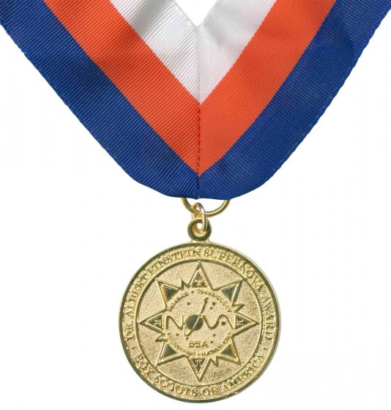
Dr. Albert Einstein Gold Supernova Award
Notes:
The Dr. Albert Einstein Gold Supernova Award is the most prestigious STEM award in the BSA. Beyond the other Supernova awards, which require a high degree of dedication on the part of the Scout, this award moves to the next level.
The purpose of this module is to identify and explore the expectation of a youth seeking to earn this award, and to educate the mentor and potential reviewers with what is, and is not, expected.

Slide 3
Objectives
Understand the Requirements
Emphasize Recordkeeping
How to Mentor the Research Project
Track the Approval
Present the Award
Notes:
After watching this module, you will be able to: (click for each)
Understand the Dr. Albert Einstein Gold Supernova Award requirements
Advise the Scout about the required recordkeeping
Understand how to help the Scout identify an appropriate research project and then mentor them from concept to presentation
Shepherd the award application through the approval process
Make the presentation of the award appropriate to the scale of the award

Slide 4
Requirements Overview
Be a registered Scouts BSA (age 14 and First Class) and submit their Einstein Supernova application before age 18, or Venturer or Sea Scout and submit their Einstein Supernova application before age 21.
Complete 4 additional Supernova activity topics
Design a new Nova-like Award
Earn the Thomas Edison or Wright Brothers Supernova Award
Do Research Project
Notes:
Be a registered Scouts BSA (age 14 and First Class) and submit their Einstein Supernova application before age 18, or Venturer or Sea Scout and submit their Einstein Supernova application before age 21.
Earn the Thomas Edison Supernova Award while a registered Scouts BSA or the Wright Brothers Supernova Award while a registered Venturer or Sea Scout.
Complete 4 additional Supernova Award activity topics, one from each of the four STEM areas, for a total of eight (8) or two (2) in each of the STEM areas.
The new Nova-like Award should represent a novel idea in an area of STEM that the scout can identify as being of interest to other scouts and be comparable in format and difficulty to existing Nova Awards. Review the existing list with the Scout before starting.
With guidance from mentor, select a STEM-related concern and develop a Research Project related to that area. I'll go into more details on the next slides.

Slide 5
Requirements – The Research Project
Propose
Propose Research Project idea to council STEM Committee
Complete
Complete a Research Project
Prepare
Prepare a report and oral presentation
Notes:
Finally, the research project should be challenging and require significant time and effort (approximately 100 hours). Communications with the council STEM committee regarding the research project proposal and final submission are vital for proper review. Last-minute applications that do not follow this path run the strong risk of being rejected and requiring improvements.

Slide 6
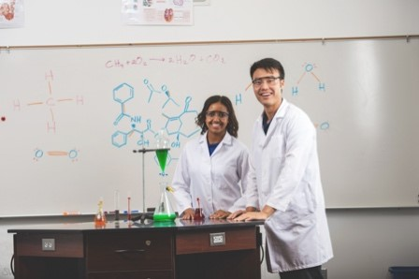
Mentoring
Notes:
Mentoring a Scout for this award is no easy task and should not be undertaken lightly. While nobody should expect the candidate to perform at the level of a graduate student with the same academic record and training, similar skills are being learned and evaluated.
First, the mentor cannot be the scout’s parent, close relative, guardian, or unit leader. Seek assistance from your district and/or council committees for help identifying a mentor if necessary.
As a STEM-trained professional, you are no doubt familiar with the rigor needed for proper execution of a research project, and the time spent by your own mentors to bring you up to the level expected in your field. Your role here is the same.
Multiple mentors and/or Subject Matter Experts (SME) may be needed for different parts of the Dr. Albert Einstein Supernova Award. You should be ready to help identify experts in other fields to assist the youth. Their role could be brief or highly involved, but you should quickly identify assistance and make a connection.

Slide 7
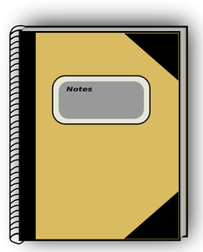
Recordkeeping
Notes:
Documentation of all steps in the Dr. Albert Einstein Gold Supernova Award is scrutinized, including previous Nova and Supernova Awards. In some instances, if records of completion cannot be located, a Scout may be asked to repeat the activities. Scouts are encouraged to provide their Scouting advancement records to show they have earned all the merit badges and Supernova awards leading to the Einstein award.
As the mentor you can show the Scout how to keep good records early in the process to ensure the final application comes together quickly and all necessary information is easily located. It is the Scout’s responsibility to keep the records, not yours.

Slide 8
Research Project
Developing a Research Project Proposal
Guiding the research
Prepare written report and oral presentation
Present Research Project
Notes:
We will talk about four steps to complete the research project.

Slide 9
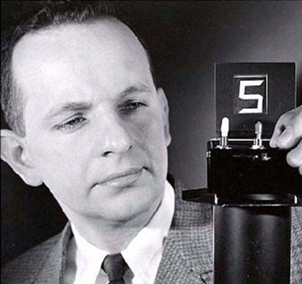
Developing a Proposal
What are you trying to do? Explain it with no jargon.
How is that challenge currently addressed? What are the shortcomings and limitations?
What is the new idea, and why is it superior to the existing approaches?
Dr. George H. Heilmeier
Notes:
A one-page written proposal is the starting point for the project. Many Scouts have never written a document like this, and even many STEM-trained adults may have a difficult time constructing a proposal. The proposal must convey a tremendous amount of information in a brief format.
One approach would be to answer the following questions in order (appear as read):
1. What are you trying to do? Explain it with no jargon.
2. How is that challenge currently addressed? What are the shortcomings and limitations?
3. What is the new idea, and why is it superior to the existing approaches?
These questions are paraphrased from of the Heilmeier Catechism pioneered by Dr. Heilmeier while directing the Defense Advanced Research Projects Agency to ensure all proposals were well-researched and supported. You will find that high school students (and adults!) are perfectly capable of understanding this, and with your mentoring can produce exceptionally strong research ideas and ways to study them.
Once ready, this proposal MUST be submitted and approved by the local council STEM committee before the scout starts work. The committee may require revisions and clarifications or suggest a change in scope. What if your council doesn't have a STEM committee? Then, an ad hoc committee can be convened by the council Advancement and Recognition committee, or you can seek assistance from any one of a number councils around the nation that have strong STEM committees.
For reference only: https://www.darpa.mil/work-with-us/heilmeier-catechism

Slide 10
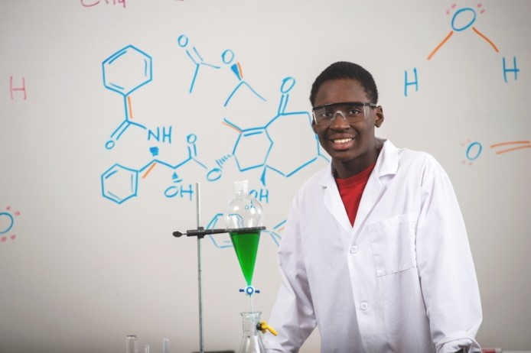
Guiding the Research
Notes:
Once the proposal has been approved, the scout can commence work in earnest. The Scout does the project, the mentor guides, asks questions, and encourages. When outside expertise is needed you should facilitate that interaction and learning.
It is critical that the work be clearly documented, ideally in writing and conversations with the mentor. This will facilitate the composition of the final report and presentation and provide the additional proof of the work.
You should expect the candidate to spend approximately 100 hours on this project. You can expect a significant investment on your own part as well, through updates and feedback that can run on for many months. However, if the scope of the proposal is correct, the work should be comfortably completed within a year.

Slide 11
Prepare written report
Notes:
Once the work is completed, the candidate must prepare and present both a written report and oral presentation of the work. There is no formal length for either; however, both must correctly and completely explain and detail the project. As a guide, the written report will likely exceed 10 pages, and the oral presentation will take approximately 45 minutes, plus time for questions.
The entire submission process could take several iterations due to questions raised by the review committee. Remember, the candidate has likely never undertaken this type of report and will require strong guidance.

Slide 12
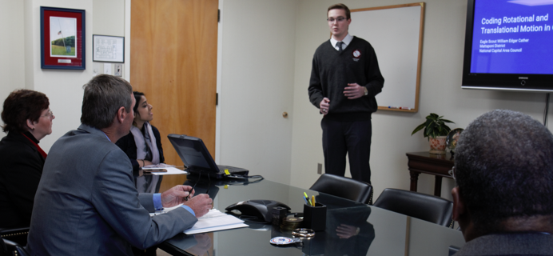
Present the project
Notes:
Finally, the candidate will present their research to the council STEM committee. The report should be submitted well in advance of the presentation so that the committee members may have time to review it and provide feedback. The formal presentation with the committee may vary but will likely be 45 minutes with plenty of time for questions. The presentation can be live or online.
Your job as a mentor is to help prepare the candidate in advance so that everything goes smoothly. Remember that the committee is there to ensure that the Scout is successful. Their expectations are that the youth has mastery over the fundamentals of the underlying science, the questions being investigated, and what methods were used. The candidate should explain the work in a clear, organized fashion, comprehensible to an adult with a STEM background. Finally, the conclusions should be supported by the results.
This is a lot to ask of a young adult. Apart from the academic research, you may find that coaching and encouraging are equally important to the Scout. Encourage persistence, simplicity, and staying positive!

Slide 13
Submit award application
Council Approval
Scout Executive Approval
Notes:
Finally, you should help submit the application and documentation for approval. This will pass through:
Council STEM chair approval
Scout Executive approval
At each level, the application may be sent back for clarification. This is much like the peer-review process. You should act as a liaison, clarifying the feedback to the scout, and ensuring timely turnaround. You should alert your candidate that this could happen and is normal in a scientific review process.

Slide 14
Present the award
Notes:
Presentation of the Dr. Albert Einstein Gold Supernova Award should be made at a significant event, such as a major STEM event, annual council awards event or other high-profile Scouting function.
As always, your job as a mentor is to prepare the new awardee for the attention. Not all Scouts crave the spotlight, while some are natural performers. Remind them of the Scouting principles that guide them, and they’ll be great!

Slide 15
Quiz
To earn the Dr. Albert Einstein Gold Supernova Award, the applicant must first earn the Thomas Edison or Wright Brothers Supernova Award.
True
False
Notes:
True

Slide 16
Quiz
If records of completion for requirements cannot be located, a Scout may be asked to repeat them.
True
False
Notes:
True

Slide 17
Quiz
Which of the following is NOT a part of a successful research project?
Developing a research project proposal
Doing experimental work when the Scout cannot
Preparing a written report and oral presentation
Present research project
Notes:
B is the answer.

Slide 18
Quiz
Which of the following is the first place the awards package is submitted after mentor review?
Local scouting unit
National Science Foundation
Council STEM committee approval
Local university academic department
Notes:
C is the answer.

Slide 19
Quiz
Ideally, how should the Dr. Albert Einstein Supernova Award be presented?
A court of honor
A scientific conference
Council awards event
No ceremony is needed
Notes:
C is the answer.

Slide 20
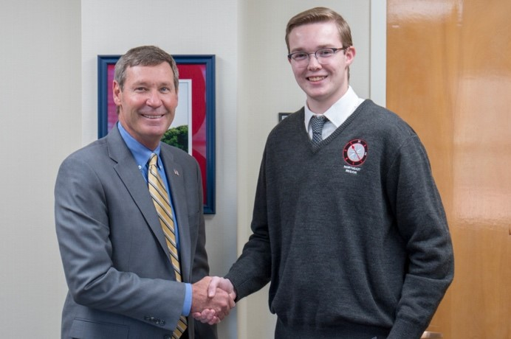
Notes:
The Dr. Albert Einstein Gold Supernova Award is the highest STEM-related award in all of Scouting. With proper training, you can assist aspiring Scouts to achieve this impressive goal!

Slide 21
Congratulations!
Notes:
Congratulations!

