Slide 1
STEM Training
This slide is informational for the training staff. Delete or skip when using this PPT.
This training is meant as a general introduction to Nova and Supernova Awards and part of a series of STEM training.
What is STEM
Nova and Supernova Awards
How to Teach a Nova Award, I Planning
How to Teach a Nova Award, II
Dr. Albert Einstein Supernova Award
Nova Awards Counselors should complete 1-4.
Supernova Award Mentors should complete 1-5.
Einstein Award Mentors should complete 5.
Check the Notes pages for a script you can adapt for your use.
Some slides have animations which you can click in time with your descriptions.
There is an optional Quiz.

Slide 2
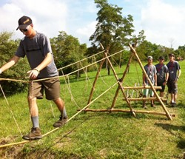
Scouts do STEM
(Science, Technology, Engineering, Math)
Notes:
The Boy Scouts of America have been doing STEM throughout our history. Whether they are building a Pinewood Derby car or constructing a monkey bridge, scouts are doing and using STEM.

Slide 3
Objectives
Recognize that the BSA has always done STEM
Know how STEM activities support BSA mission
Be aware of the many methods for incorporating STEM into BSA program
Notes:
After watching this module, you will be able to: (click for each objective to appear)
recognize that the BSA has always done STEM
know how STEM activities support the BSA mission
be aware of the many methods for incorporating STEM into the BSA program

Slide 4
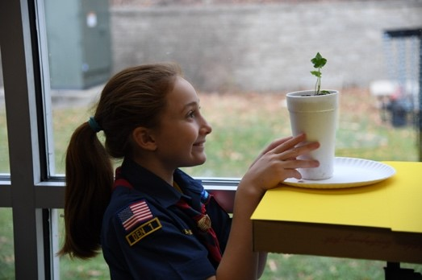
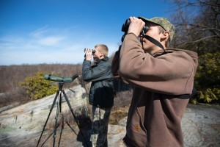
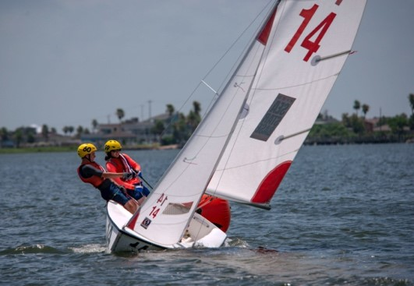
Science is the quest to understand how the world works
Notes:
(click)When a Cub Scout plants seeds and watches plants grow, that is science.
(click)When a Scout researches hawks and their migration patterns, that is science.
(click) When Sea Scouts note the direction and strength of the wind and how tight the sail must be to catch it and stay on course, that is science. Scouts not only learn science, they use it in their Scouting adventures.
By understanding how the world works, they can help find solutions to our problems. Just being aware of the world around them gives them a greater appreciation of that world and its people.

Slide 5
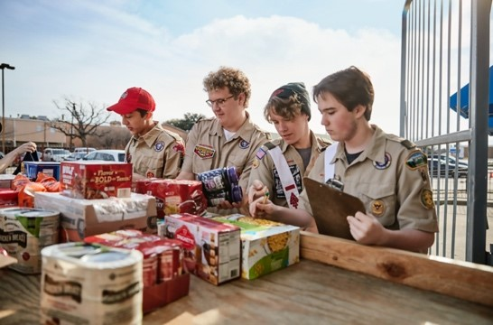
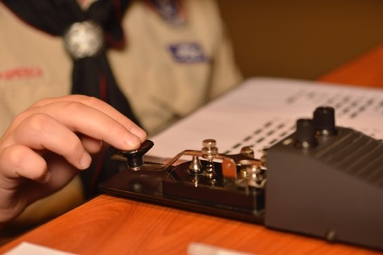
Technology helps create solutions for practical problems
Notes:
(click) When a Venturer helps the Scouting for Food drive be more effective by creating an online signup form for food the local food pantry needs, they are using technology.
(click) If a Scout creates a digital map of the local cemetery, they are using technology.
(click) When Scouting youth reach out to other scouts around the world over ham radio in the Jamboree on the Air, they are using technology.

Slide 6
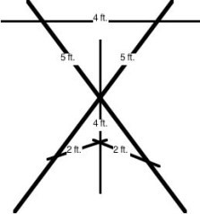
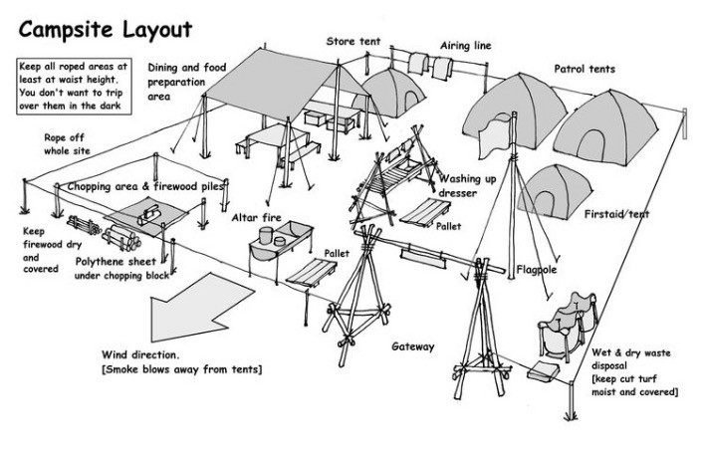
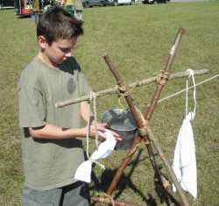
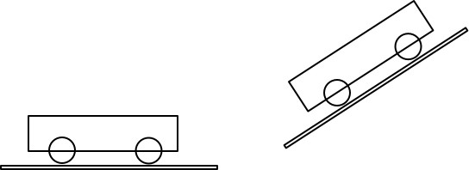
Engineering involves using science to design, build, and use engines, machines, structures, and systems
Notes:
Narration:
(click) When Scouting youth build pioneering projects such as a hand washing station or a monkey bridge, they use engineering principles.
(click) When Cub Scouts build their Pinewood Derby cars and consider where to place the weights, they engineer them.
(click) When Scouting youth set up a campsite, they consider options so that they have an efficient system. That is engineering.
Many Scouting skills are problem solving and building. Those solutions often include safety and cost concerns.
Many Scouting activities involve facing a problem, considering possible alternatives, and building a solution. Evaluating the experience is an important part of many activities. This critical thinking helps prepare Scouts to be responsible adults.

Slide 7
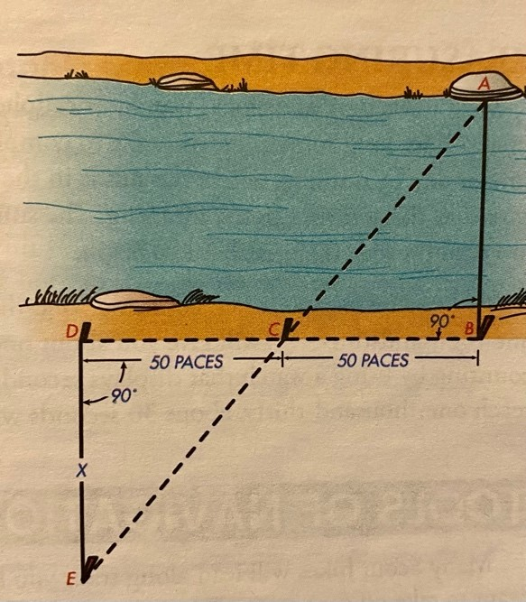
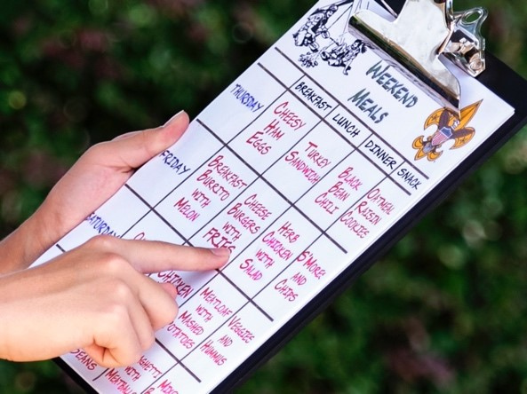
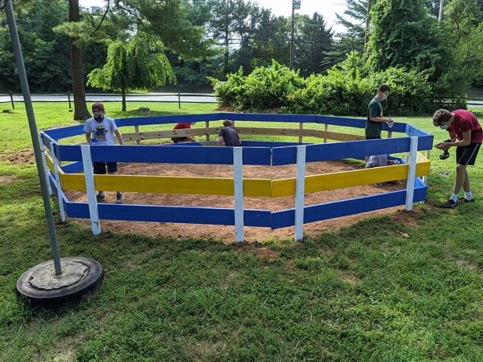
Math explains and models our world
Notes:
(click) When a Scout determines how much food to buy for the camping weekend, they are doing math.
(click) When a Scout calculates the materials needed for a project and compares alternatives, they are doing math.
(click) When a Scout measures the distance across a stream using a reference, they are doing math.
Math is more than calculations. For example, the measurement of the stream involves geometry.
Much of the math in normal Scouting activities is simple, but it is applied to real-world problems. Is there enough money to build this project? Are there enough eggs to make a double batch of this recipe? Do we have enough time to take that side trip off the trail? Scouts learn to use math.

Slide 8
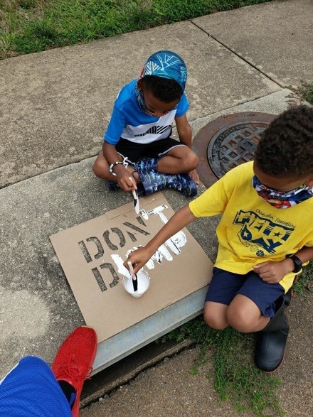
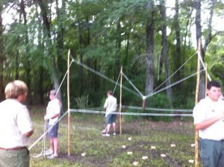
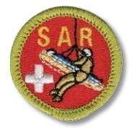
STEM in usual Scouting activities
Notes:
Narration:
Scouts use STEM throughout our program. Many of these activities teach critical thinking and help the scouts learn skills for their future.
For example, they learn about the environment and how things that happen in one place affect other places. Those activities also help them learn how to apply STEM solutions appropriately as they consider consequences.
Many merit badges focus on STEM topics or have STEM connections. The experience with STEM areas might lead to careers or lifelong hobbies.
Scouts work in teams, as dens, patrols, and crews. Many STEM careers involve such teamwork and collaborative problem-solving. Many aspects of Scouting are applied uses of STEM concepts.

Slide 9
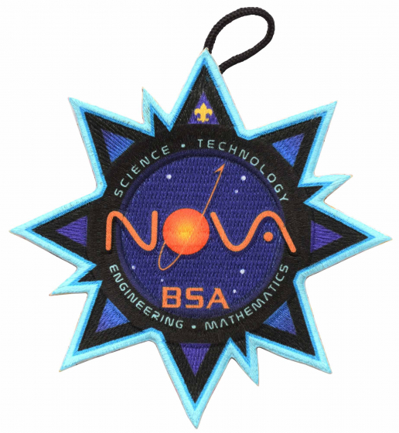
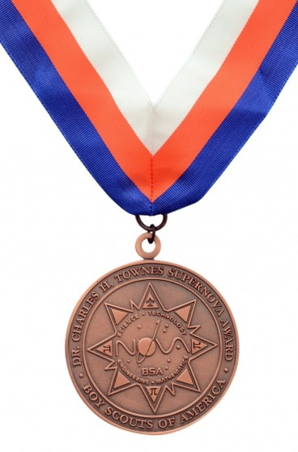
STEM specialized activities: Nova Awards and Supernova Awards
Notes:
In addition to the usual Scouting advancement, Scouts can earn the Nova Awards and Supernova Awards. These awards have scouts explore a theme in more depth. For example, in Down and Dirty, Cub Scouts explore earth science. They might create a dinosaur dig or keep a weather journal.
Each level of Scouting has its own program-appropriate Nova Awards involving each area of STEM. Scouts can work together as a group on a Nova Award that interests them.
Adults who help the youth earn these Nova Awards register and are trained as Nova Award Counselors.
Scouts wanting to work more in depth and individually can earn the more complex Supernova awards. These often involve earning Nova awards, participating in additional STEM activities, and conducting experiments or building projects. Supernovas are substantial experiences.
Adults who help the youth earn these awards register and train as Supernova Award Mentors. They may not be the Scout’s parent or unit leader and should be STEM experts.

Slide 10
Exploring and STEM
Notes:
In addition to the more well-known Scouting programs, Exploring posts have connected Scouts to careers for over 50 years. Some Exploring units are specific to STEM-career exploration and workforce development.

Slide 11
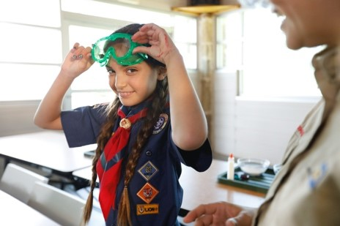
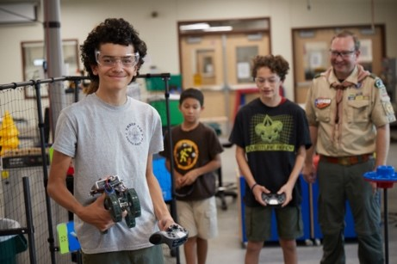
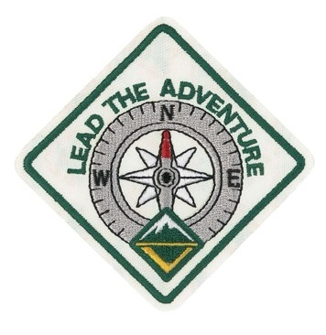
STEM in Scouting - Survival Skills for the Future
Notes:
STEM has always been a part of Scouting. Scouts learn and practice skills that will help them help others as they become the leaders of tomorrow. STEM is part of their survival skills for the future. Through Scouting and its use of STEM, they will “Do Their Best” to “Be Prepared” to “Lead the Adventure”.

Slide 12
Quiz
How long have STEM concepts been part of Scouting?
They have always been part of Scouting
1960
1995
2015
Notes:
A is answer

Slide 13
Quiz
Nova Awards provide Scouts opportunities to
demonstrate astronomy skills
explore STEM themes in more depth
write songs to sing around the campfire
perform service for their communities
Notes:
B is answer

Slide 14
Quiz
STEM activities
are naturally included in other Scouting activities
encourage Scouts to be “mentally awake”
are often fun and exciting
all of the above
Notes:
D is answer

Slide 15
Quiz
STEM advancement opportunities include
Adventures, Nova Awards, and Supernova Awards for Cub Scouts
Merit Badges, rank advancement, Nova Awards, and Supernova Awards for Scouts BSA
Nova Awards and Supernova Awards for Venturers
all of the above
Notes:
D is answer

Slide 16
Congratulations!
Notes:
Course completed.

