Slide 1
A Guide to International Scouting

Slide 2
What is International Scouting?
World Organization of the Scout Movement (WOSM)
Is the union that binds world scouting together. The BSA, along with 170 other member organizations belong to WOSM along with 54 million scouts, making it the largest youth organization on the planet.
Strategic Priorities
Youth Engagement
Educational Methods
Diversity & Inclusion
Social Impact
Communication & External Relations
Governance
The Mission of Scouting is to contribute to the education of young people, through a value system based on the Scout Promise and Law, to help build a better world where people are self-fulfilled as individuals and play a constructive role in society.

Slide 3
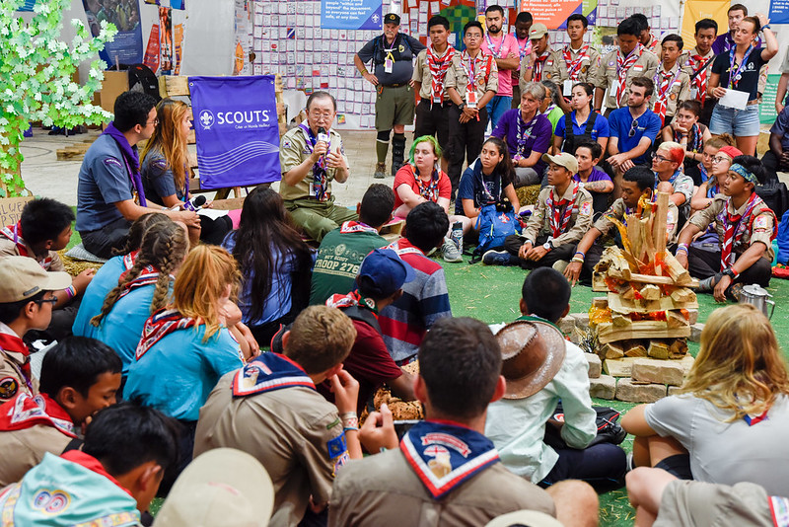
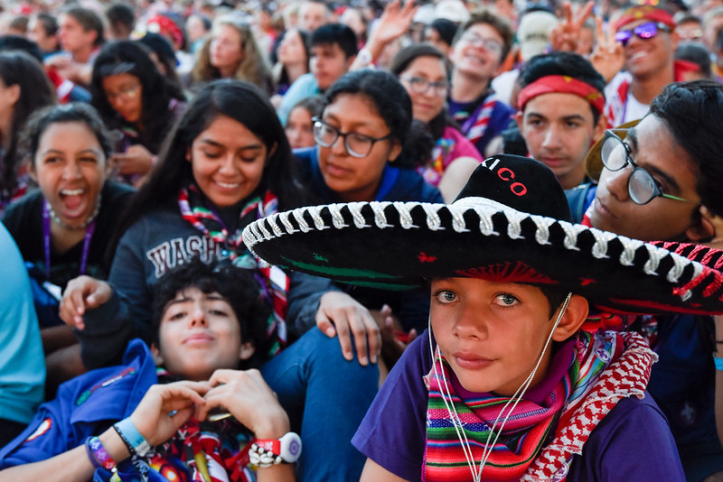
WOSM Structure
World Scout Bureau
Geneva, Switzerland (Legal Seat)
Kuala Lumpur, Malaysia (Operational Headquarters)
Regions
European Region – Geneva, Switzerland and Brussels, Belgium
Arab Region – Cairo, Egypt
Africa Region – Nairobi, Kenya
Asia-Pacific Region – Makati City, Philippines
Interamerican Region – Panama City, Panama
Eurasian Region – Kiev, Ukraine

Slide 4
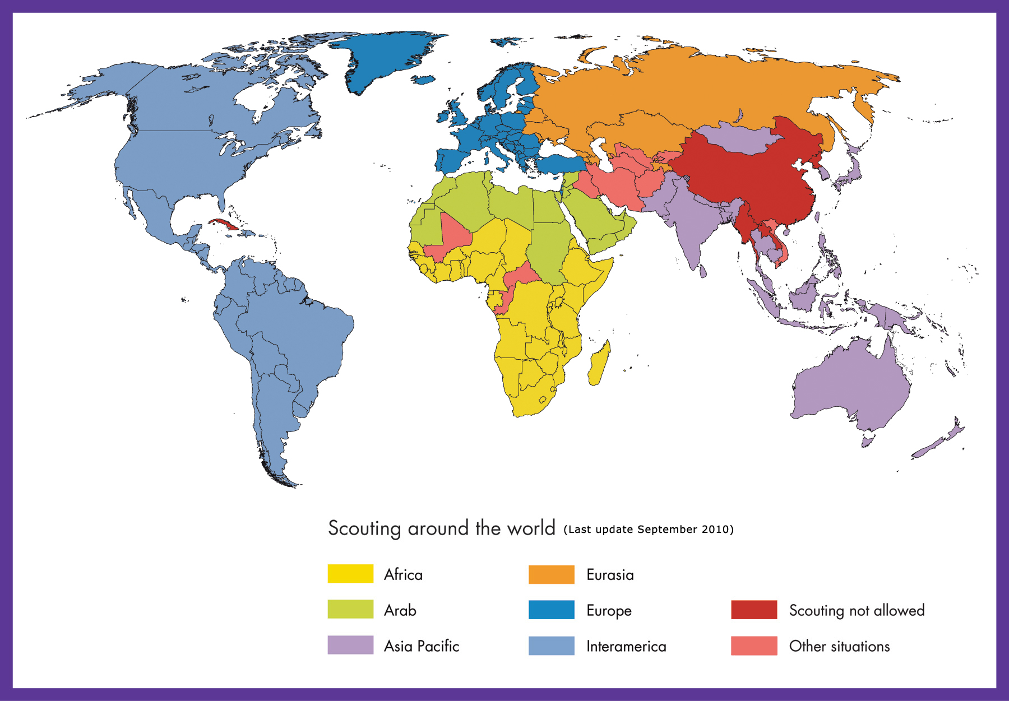

Slide 5
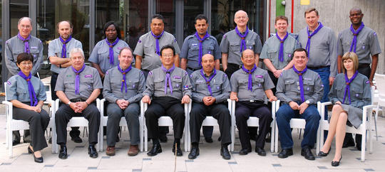
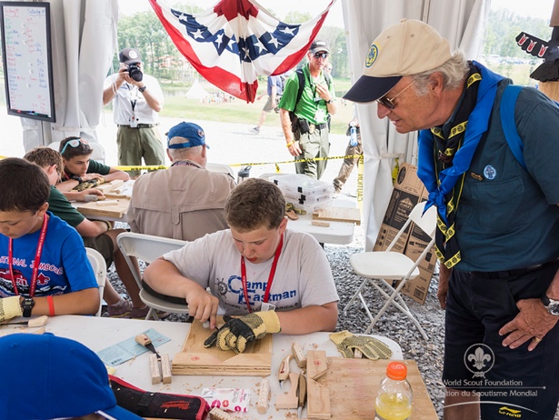
WOSM Structure (cont.)
World Scout Committee
Is the executive body that is responsible for the implementation of the resolutions of the World Scout Conference (General Assembly)
12 elected members for 6-year terms
Secretary General and Treasurer (non-voting members)
6 Regional Chairmen and 6 Youth Members (non-voting members)
Representative of the World Scout Foundation (non-voting member)
Meet 2-3 times per year
World Scout Foundation
Helps the growth and development of Scouting worldwide through financial support through generous donations.

Slide 6
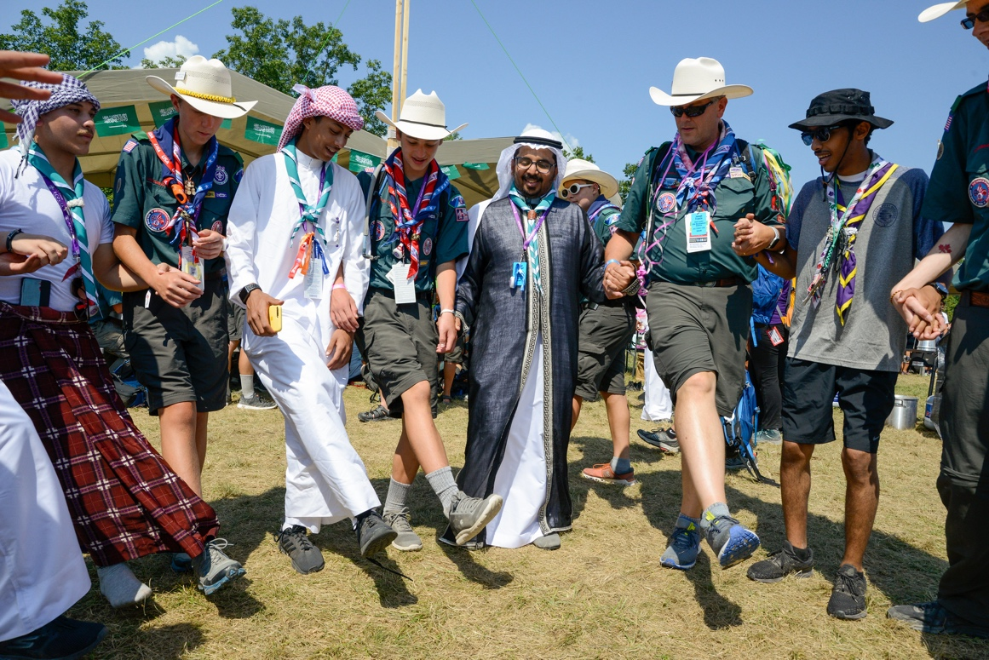
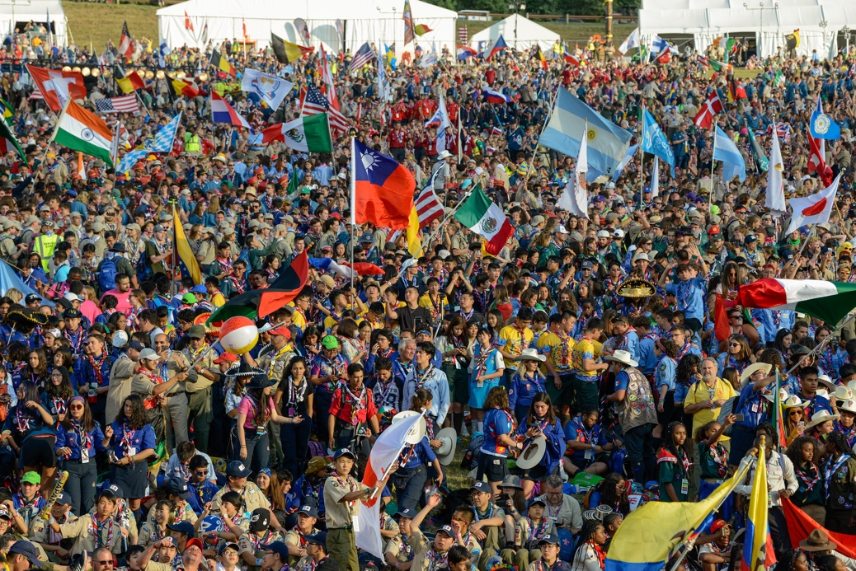
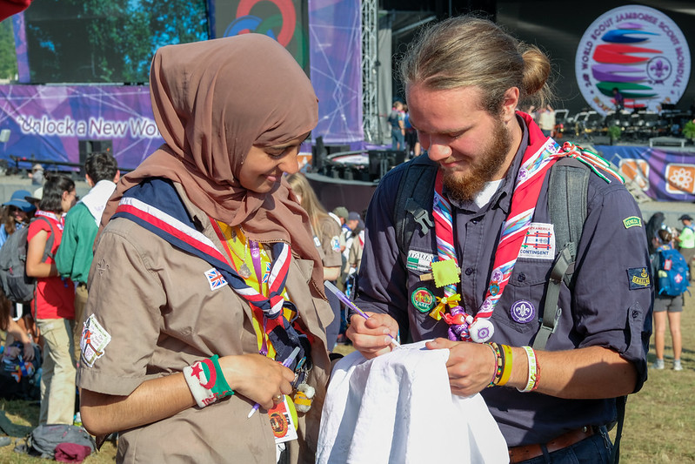
The Big Three – World Scout Jamboree

Slide 7
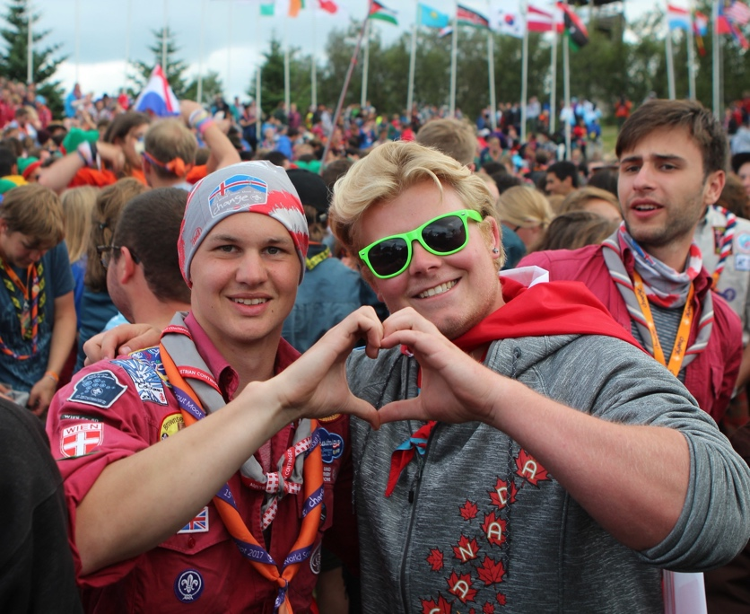
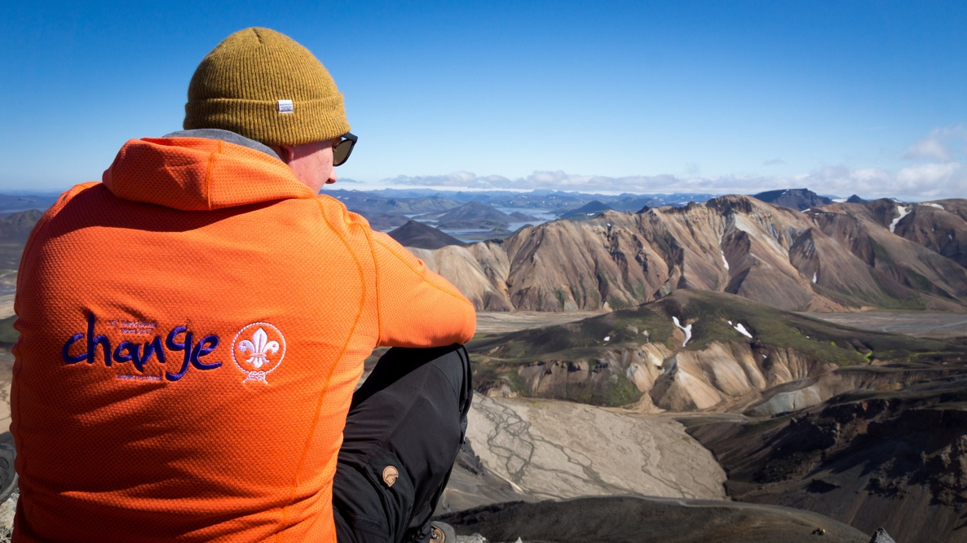
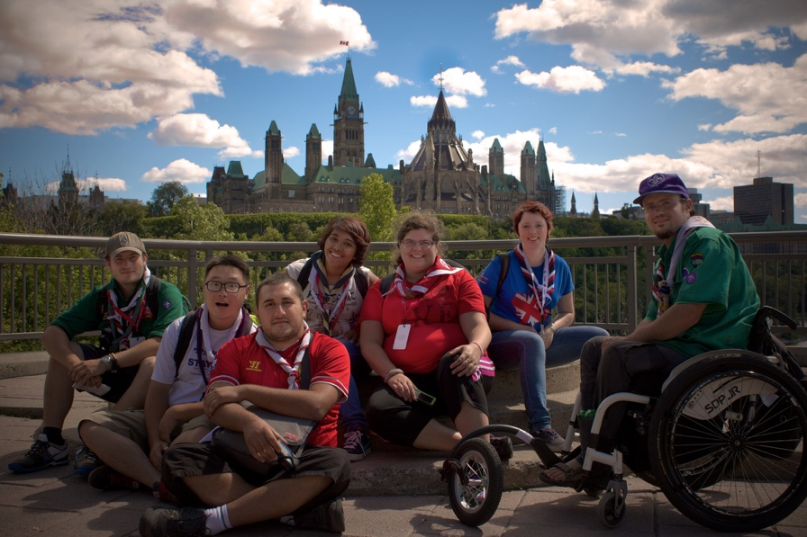
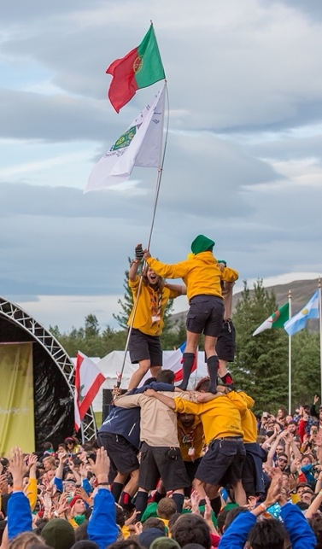
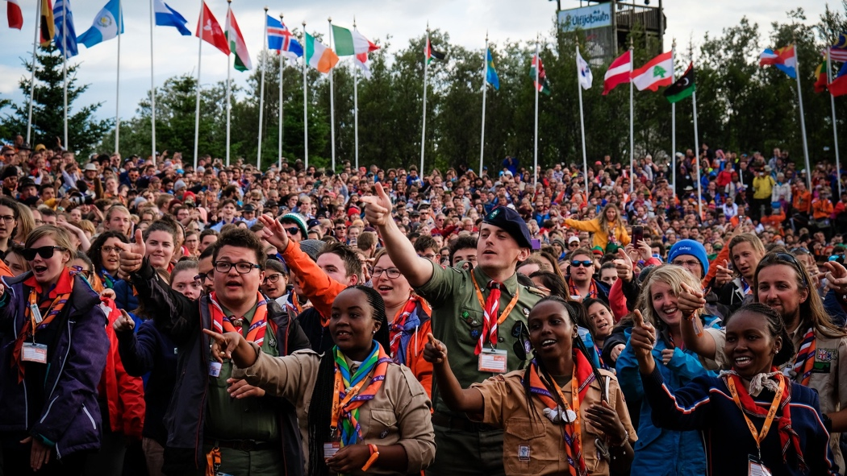
The Big Three – World Scout Moot

Slide 8
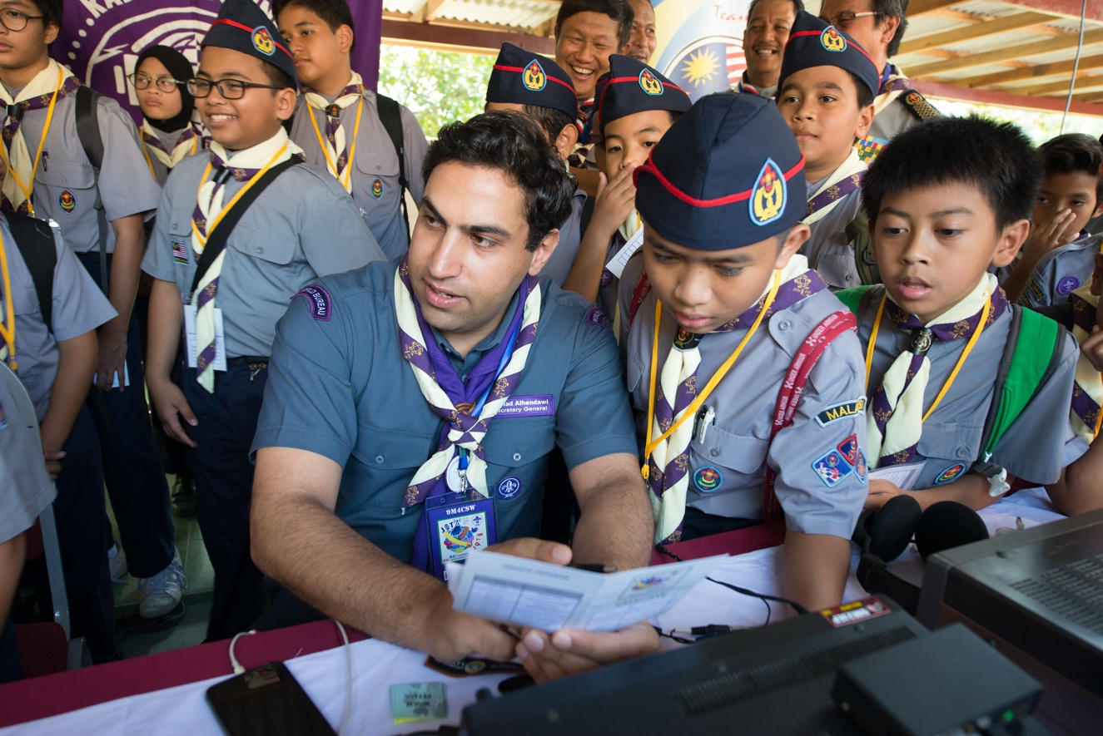
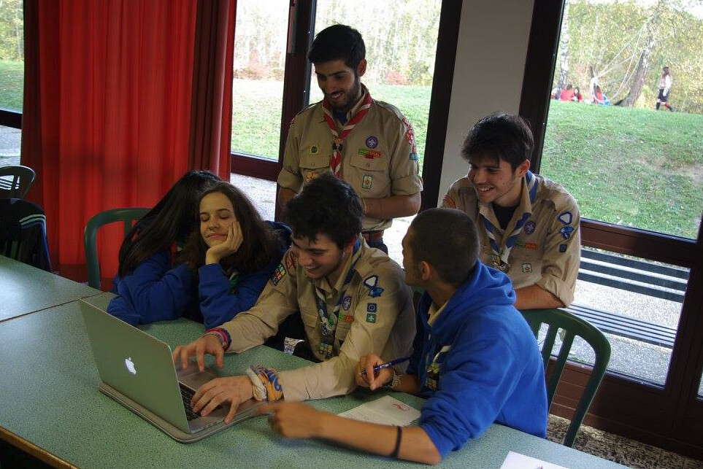
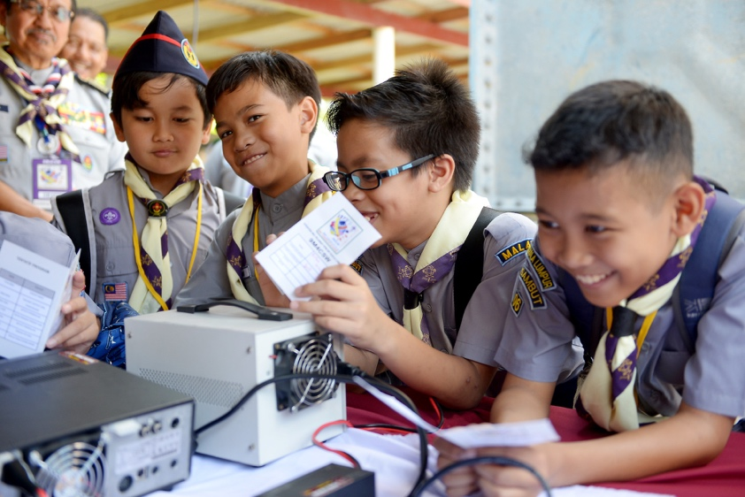
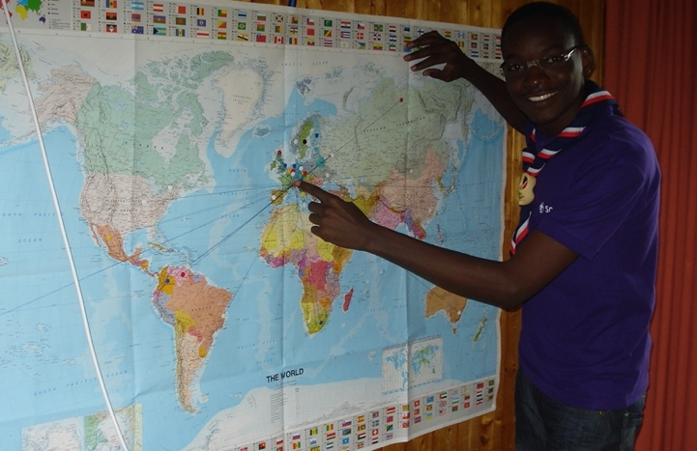
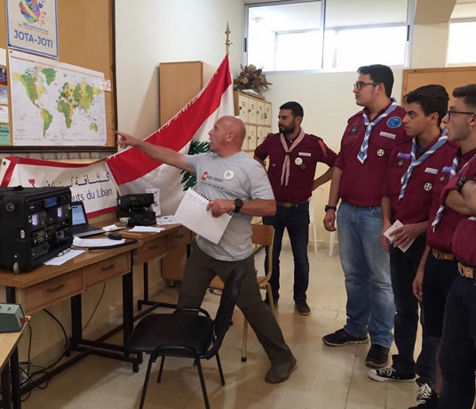
The Big Three – JOTA/JOTI

Slide 9
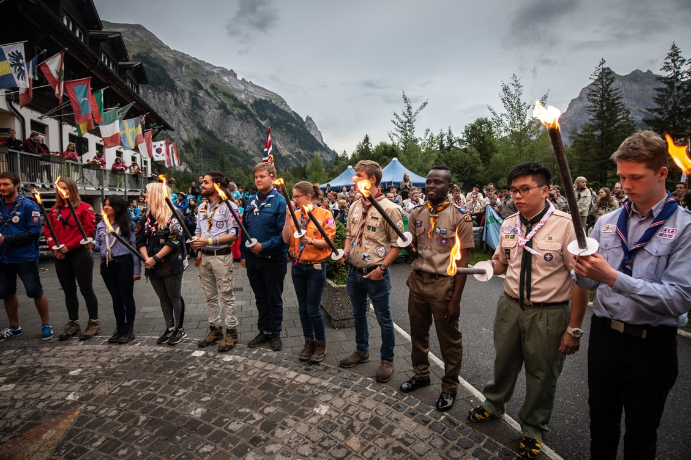
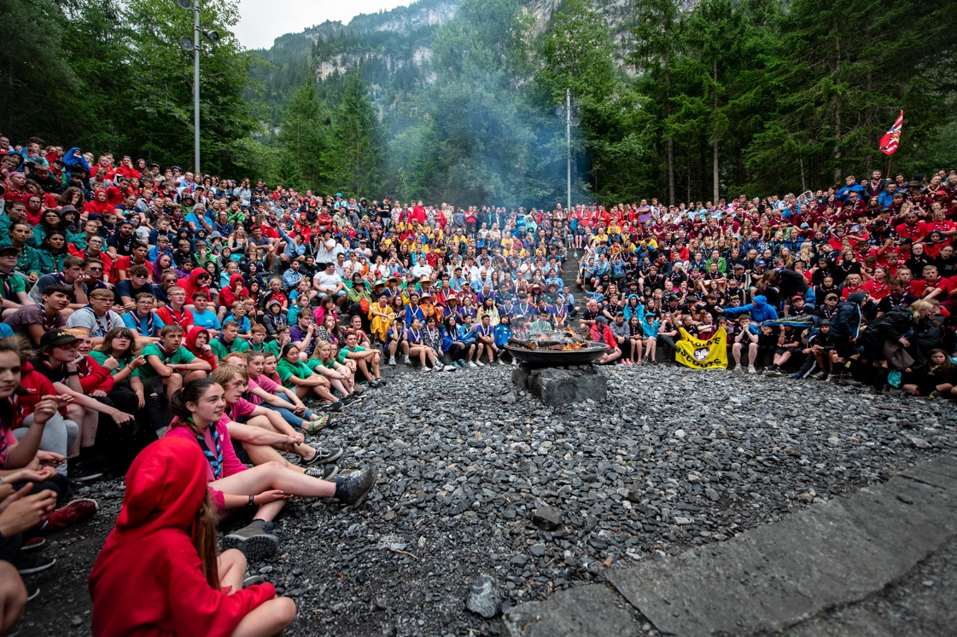
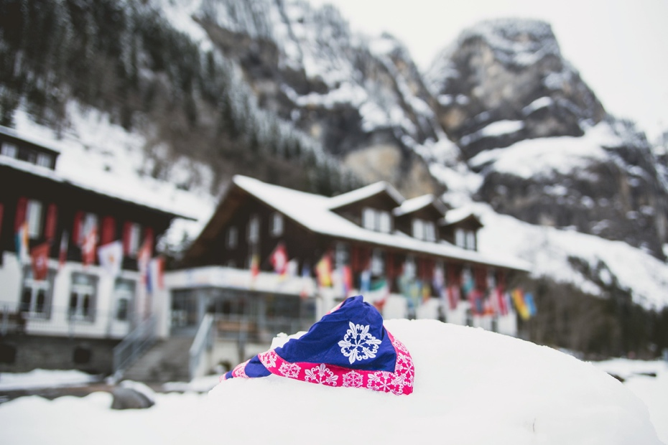
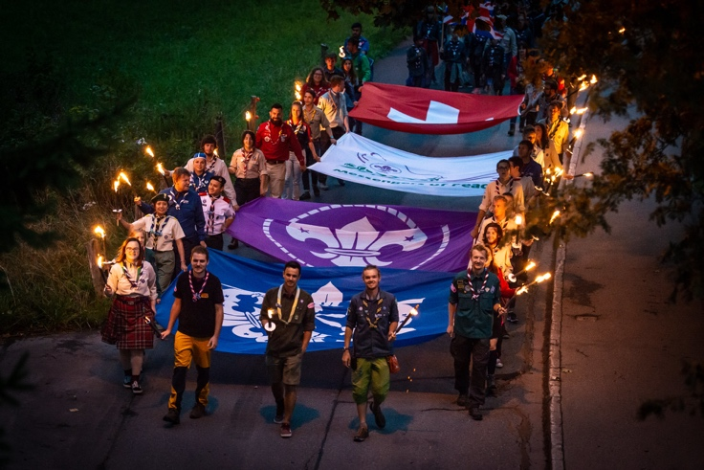
Opportunities – Kandersteg International Scout Centre

Slide 10
Opportunities with WOSM and
Other National Scouting Organizations
World Scout Jamborees
Held every four years
Next Jamboree will be in South Korea
World Scout Moot – Rover Scouting
Held every four years
Age group 18-26
International Service Team (IST) can be above 26
Next Moot will be in Ireland
JOTA/JOTI
Held yearly online or over the airwaves
Kandersteg International Scout Centre, Switzerland
Located in the heart of the Swiss Alps
WOSM permanent camp facility
Open year around
Camp staff opportunities
WOSM Regional Jamborees
Take part in one of WOSM’s regional jamboree, such as the European Jamboree or the InterAmerican Jamboree
NSO Jamborees
Attend a national scouting organization’s jamboree, such as the Carijam (Caribbean Jamboree), Nippon Scout Jamboree (Scout Association of Japan)
International Camp Staff Opportunities
Staffing opportunities through Kandersteg and the European Camp Staff Program
International Summer Camp Opportunities
Attend summer camp at another National Scout Organization’s summer camp(s)
Ex. Haliburton Scout Reserve, Scouts Canada

Slide 11
International Recognitions
International Scouter’s Award
Adult Award
Requirement Categories
Giving leadership to International Scouting
Giving leadership to international events held in the United States
Giving leadership to international events held in other countries
Educating self and others
Giving support to International Scouting
Learn More: https://www.scouting.org/international/resources/22-721/
International Spirit Award
The International Spirit Award is awarded to registered Scouts and Scouters who have completed the necessary requirements, have gained a greater knowledge of international Scouting, and have developed a greater appreciation and awareness of different cultures and countries.
Requirements and Form: https://www.scouting.org/wp-content/uploads/2020/02/International-Spirit-Award-app.130-044-Rev.-June-2021-2.pdf

Slide 12
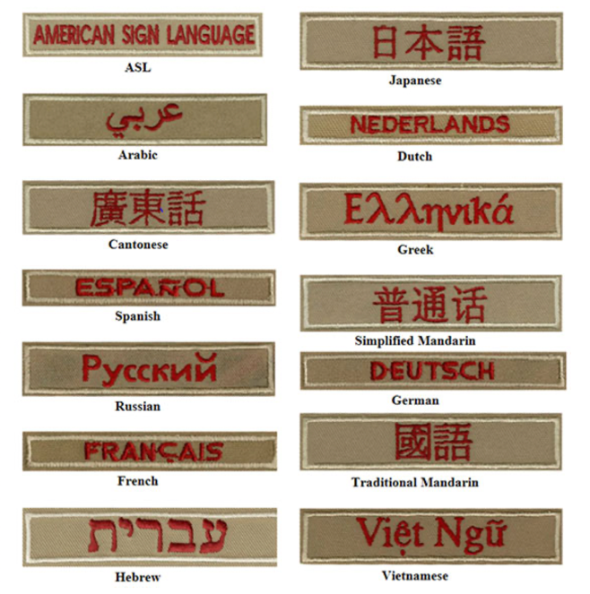
International Recognitions
Messengers of Peace
Launched in September 2011, Messengers of Peace is a global initiative designed to inspire millions of young men and women in more than 220 countries and territories to work toward peace. Using social media and other Scouting networks the initiative lets Scouts from around the world share what they’ve done and inspire fellow Scouts to undertake similar efforts in their own communities. The initiative is inspired by the World Scout Committee, administered by the World Scout Bureau, and driven by youth volunteers worldwide.
Learn more about qualifying service projects here:
https://www.scouting.org/international/messengers-of-peace/
Interpreter Strip
Do you speak another language, then you should consider earning this award.
Learn more:
https://www.scouting.org/awards/awards-central/interpreter-strip/

Slide 13
Support World Scouting
The Boy Scouts of America has created several avenues of financial support of the world Scouting movement. These avenues include:
World Friendship Fund
World Baden-Powell Fellowship
Order of the Condor
Gilwell Park
Kandersteg International Scout Centre
United States Fund for International Scouting
More can be learned about each of these funds by visiting the BSA’s website below.
https://www.scouting.org/international/world-support/

Slide 14
Upcoming BSA Contingent Trips
2023 World Scout Jamboree – Korea
Participant: 14-17
IST: 18 and up
BSA Contingent Website:
https://wsj2023.us
Social Media:
https://www.facebook.com/WSJ2023USA

Slide 15
A Guide to International Scouting

