Slide 1
TRANSFORMING ROUNDTABLE: FOR YOUR INFORMATION
TIP: Share information before roundtable starts with virtual announcements.
Use a PowerPoint slide like this, or
Use the Chat or Q & A function.
New Roundtable Support web page:
https://www.scouting.org/commissioners/roundtable-support/
Further questions: commissionerserviceteam@Scouting.org

Slide 2
Transforming Roundtable
Roundtable Project Team
July 15, 2020
Notes:
SPEAKER: JEFF GOLDSMITH
Good evening and welcome to the webinar. My name is Jeff Goldsmith and I will be your moderator tonight as we discuss Roundtables.
A number of people have asked how to do pre meeting announcements for a virtual roundtable meeting. On the screen when you
entered this webinar, you saw one possible way to handle pre-virtual meeting information and announcements.
The Commissioner Roundtable Team values your input. The team has collected some input already, will be conducting a participant
poll tonight and will seek your thoughts through a Question & Answer segment towards the end.
We have ____ people registered for tonight’s webinar. Due to the large number of participants and to best facilitate tonight’s
recording for future use, all participants are muted. This PowerPoint and the URL to access the webinar recording will be posted
on the News for Commissioners page on the commissioner website: scouting.org/commissioners
To ask a question, go to the Question & Answer icon located at the bottom middle and type your question. We will try to answer
as many questions as possible. If your question is not answered or if you have further questions, please email us at
commissionerserviceteam@Scouting.org. When send an email to that address, please include your email address in the body of
your email so that we will be able to respond to you.
Again, this webinar is being recorded.
I will now turn the program over to National Commissioner Service Team Chair Larry Chase for opening remarks.
SPEAKER: LHC
Welcome, and thanks for joining us this evening!
Our objectives are to give you an overview of our new approach to roundtable, get your thoughts on how we can
help our councils implement it and answer your questions.

Slide 3
PROJECT TEAM
Chris Beaver – Glacier’s Edge (WI)
Christie Hust – South Plains (TX)
Catherine Kaser – Del-Mar-Va (DE)
Tina Kerr – Atlanta Area (GA)
Mati Mayfield – Crossroads of the West (UT)
Mike Moegenburg – Bay Lakes (WI)
Notes:
SPEAKER: LHC
But first, I want you to meet some people. I’m working with a great group of volunteers and national staff members on this project. They bring a
variety of knowledge and experience to our work; many of the volunteers are commissioners, but they have equally valuable personal and
professional skills and experience and they come from all over the country

Slide 4
PROJECT TEAM
Mike Weber – Michigan Crossroads (MI)
Darlene Sprague – Greater Niagara Frontier (NY)
Bill Cameron – Washington Crossing (PA)
Larry Chase – Atlanta Area (GA)
Wendy Shaw – National Service Center (TX)
Notes:
SPEAKER: LHC
You’ll hear from many of them this evening. Also with us is Wendy Shaw, National Director – Membership Growth, who is leading the overall team.

Slide 5
PURPOSE OF ROUNDTABLE
Provide information
Capture information
Offer current program training
Provide networking opportunities
Notes:
SPEAKER: LHC
Let’s start here: the purpose of roundtable.
From its earliest days, it has had four core functions:
To provide information
To capture information
To offer current program training
To provide networking opportunities
Roundtable should be one of the key tools we use as commissioners to support unit leaders.
Unfortunately, we’ve seen a steady decline in roundtable participation for a number of years. That has made it less effective in fulfilling its purpose. Repeated attempts
have been made to try new approaches to in-person roundtables; none has changed the trend. Over 50% of unit leaders responding to a recent survey indicated they had
attended either none - or less than half - of the roundtables offered in their district in the 6 months prior to the onset of COVID-19. Nearly 90% of those respondents indicated they
would be likely to attend a virtual roundtable.
High-speed internet access isn’t yet universal, but it has increased dramatically in recent years. Our recent experience with COVID 19 drove expanded use of virtual meetings to
enable us to keep on Scouting. It worked. Specifically, many local districts continued to offer roundtables over the last several months – virtually. In a recent survey of commissioners,
over 80% of respondents identified several key strengths they had to implement virtual roundtables, including: support from district executives, commissioner internet access,
commissioner embracement of virtual roundtables, council staff embracement of virtual roundtables, knowledge of how to run virtual meetings, and unit leader internet access.
The new approach you’ll hear about tonight strongly encourages the use of virtual roundtables. They respond to our volunteers’ request for greater efficiency and respect of their time.
The new approach is also flexible. It can be applied in districts where high speed internet access isn’t available It can be used for single-district, multi-district, and council-wide roundtables.
Tonight you’ll hear details of the new approach and the new resources that are available today. There is more work to be done; resources will continue to be added. We’re counting
on you to help us identify any gaps that we can fill as quickly as possible.
So, let’s get to the details…Mike Weber will get us started with some additional details about the changes underway.

Slide 6
ADVANTAGES
Consistency
Timeliness
High quality video content
Efficiency
Flexibility
Notes:
SPEAKER: MIKE WEBER
INTRODUCTION: Thank you Larry. Good evening everyone! My name is Mike Weber from the Michigan Crossroads Council.
With an understanding of what the four functions of roundtable are and the encouragement to use in a virtual setting, let us transition to what several of the advantages are of this new approach to roundtable.
It is no doubt that you have experienced roundtable meetings that have been monopolized with announcements, minimal time to experience needed training for use in your unit meetings, and a high degree of travel and preparation time for roundtable meetings. The new roundtable approach was created to minimize your personal time and still deliver all the valuable needs you expect.
CONTENT: Over the past few months, I am sure many of you have likely been using some form of a virtual roundtable. I expect many of the benefits I will mention you may have experienced, but I anticipate that some of these you will surely appreciate as they are new to how we’ve done roundtables in the past.
The first advantage is …
The new approach provides a consistent means for delivering content for each RT meeting – Another is …
It will have ready-made, timely material, for each meeting throughout the year – Also …
High quality videos, produced by national, will provide monthly consistency – Another advantage is …
The new formats will result in improved efficiency and minimize meeting preparation time, thereby respecting the valuable time constraints of our volunteers and professionals
If a RT meeting is held in person, the video content and topics can be downloaded for easy use
Eventually, a useful library of recorded video files will be available for each element of the new RT approach so that leaders
can use for reference or for a future presentation, and …
The virtual format has the ability to separate a joint meeting into smaller, breakout meetings, as well as enable chat features
to connect with anyone in the meeting

Slide 7
FLEXIBLE FORMATS
Notes:
SPEAKER: MIKE WEBER
One additional advantage of the new roundtable approach is the flexible meeting format. You will note these two outlines appear very similar, with the same topical content suggested for your meeting. The difference between these two formats is how time is allocated to those topics. The format on the left is a suggested 50-minute format while the one on the right is planned for 75 minutes.
It is useful to note that there is a high degree of flexibility in how a roundtable meeting can be managed. Today, many councils and districts usually run roundtables in either 60 or 90 minutes. Most would agree that there are many inefficiencies in the way our meetings are run today. With those factors in mind, these two flexible formats were developed. Additionally, if a roundtable team were to decide to not use one of the topics, or to take more time than is suggested for another topic, that is completely acceptable.
The overall intent of these two formats is to reinforce that roundtables can be tailored to meet the local district and council needs. It has also been developed to provide a suggested outline to help provide some structure and uniformity for your meetings, yet at the same time allow as much flexibility as needed so that each council can meet their own local needs. Encourage your roundtable teams to take advantage of how these new formats can be more time efficient and also provide all the meaningful benefits to your volunteers.
In a recent survey of commissioners, over 90% of respondents agreed that the new formats would work well for distributing and collecting information. Also, 75% of those respondents agreed the new format would work for program training and networking.
In another survey of unit leaders, the majority agreed that the new formats will enable achieving the four core functions of roundtables.
WRAP-UP: In summary, the new RT approach and virtual meeting tool is simple, flexible, utilizes a common approach, and meets all the needs that our volunteers expect from a RT, and it saves us all a most valuable resource – Time! Given the experience that many of you acquired during our shut-down time periods, this new approach will be an easy and welcomed transition for use going forward.
Our next presenter is Christie Hust to review the Opening segment of the new roundtable format.

Slide 8
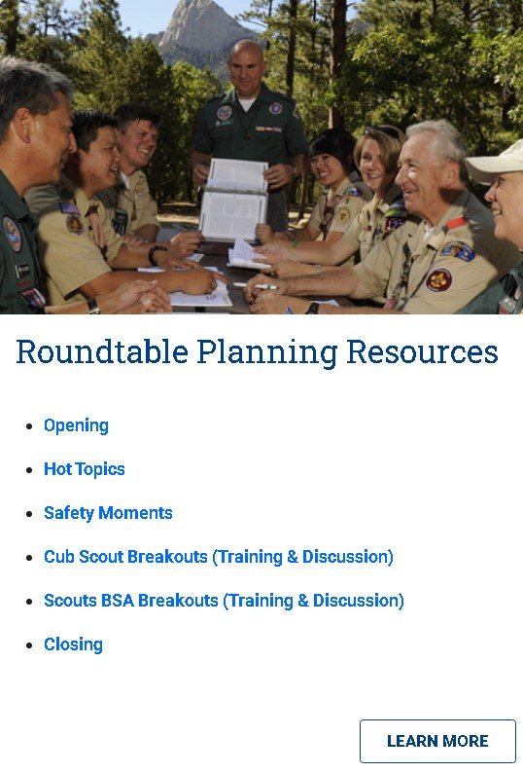
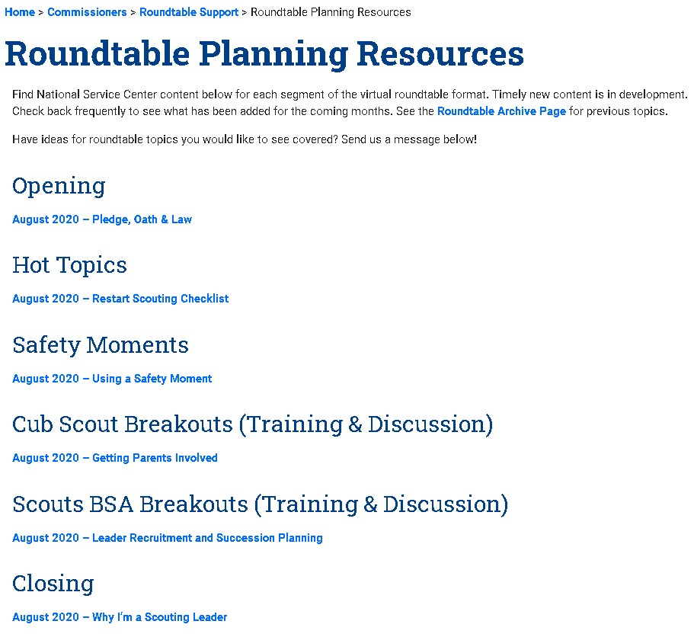
TRANSFORMING ROUNDTABLE
Opening
Hot Topics
Safety Moment
Breakouts (Training & Discussion)
Opening
Hot Topics
Safety Moment
Breakouts (Training & Discussion)
Opening
Hot Topics
Safety Moment
Breakouts (Training & Discussion)
Opening
Hot Topics
Safety Moment
Breakouts (Training & Discussion)
Notes:
SPEAKER: CHRISTIE HUST
Thank you, Michael. Hello everyone, my name is Christie Hust and I am from the South Plains Council in Lubbock, Texas. I am here to talk with you about the opening
section of the “Virtual Roundtable”.
The RT Commissioners have the opportunity to start the “virtual” roundtable as they wish. If they want to start the meetings with the pledge, oath, and law they will be
able to. As part of the “Virtual Roundtable,” RT Commissioners will have access to video-based openings from the Virtual Roundtable Resource page that they can use
to open the meeting. To use the August 2020 content as an example, RT Commissioners will be presented with a short video with a pledge, oath, and law that lasts just
under a minute. New openings will be added monthly and may or may not be the pledge, oath, and law. If the opening does not include those pieces the RT Commissioner
can add it themselves or use a video from a previous month. If the RT Commissioners create their own pledge, oath, and law; we need to stress that if youth from units
are involved then no taping of that section of the RT is permitted. The opening videos will be brief leaving ample time for the RT Commissioner to incorporate other
program as desired.
The opening gives the RT Commissioner several opportunities to tailor the opening time to meet the needs of the council and district. There are many options for
the RT Commissioner:
Such as setting the stage for that month’s roundtable. For example, in August we are discussing parent recruiting, a simple poll to see how many
leaders find it hard to recruit new volunteers is a great way to set the stage.
Another opportunity is for the RT Commissioner to become a “champion” for the program. This is a great time for significant accomplishments
that have been seen in the council, district, or unit level.
Networking is another great opportunity in the opening time. If you’re a small group let everyone introduce themselves, if you’re a larger group
maybe an introduction from new people to help them feel more welcome.
If a RT Commissioner is creative, they can also engage in virtual icebreakers. Things like poll questions, would you rather activities, and a myriad
of other options are doable.
Not all the examples above are necessary for a good opening. The RT Commissioner should decide what is best for their RT and what will fit the
suggested timeframe. For the 50-minute version, the opening would last 8 minutes and for the 75-minute version, the opening would last 10 minutes.
As I end my time with you tonight, I hope you have a clearer picture of what the opening could be in “Virtual RT”. It is a time to set the stage for
a great meeting where everyone is encouraged to participate, learn, and grow. The best aspect of the opening is the ability to add information
that is specific to your council and district.
Now I would like to turn the presentation over to Tina Kerr.
SPEAKER: TINA KERR
Hi – I’m Tina Kerr from Atlanta Area Council. Let’s review roundtable Hot Topics.
Hot Topics are akin to the previously roundtable “Big Rock Topics” utilized after the opening and before breakouts.
As part of the “Virtual Roundtable,” Cub Scout and Scouts BSA volunteers will have access to new and exciting hot topics each month.
DURATION: These hot topics will run 5 to 20 minutes depending on the topic and the length of the roundtable program (50 minute or 75 minutes)
CONTENT: Going forward, Hot Topics will be National or council information that significantly impacts local Scouting or requires immediate volunteer
actions (such as program changes, new membership recruitment tools, fee changes, new opportunities, etc). These hot topics will be supported either
by videos from the National Service Center or other National Service Center Resources announced during roundtables and later distributed via
handouts, website postings, emails, etc.
For example, the hot topic for August is restarting Scouting activities with your units in person and how to do so as safely as possible. A very important
topic and of keen interest to all Scouting families at all levels in the BSA. It will be up to the Roundtable Commissioner with the support of their local
District and Council Professionals to ensure these hot topics are clearly presented.
WRAP-UP: To conclude, the hot topics session provides both Cub Scout and Scouts BSA leaders with significant information that they will need in order
to lead their units to be successful and to grow and improve their programs.
Next, Mati Mafield will give you an overview of another new component of roundtable, the Safety Moment.
INTRODUCTION: Hello, My name is Mati Mayfield, I’m from the Crossroads of the West Council.
I’ll be discussing the safety moment. The safety of all scouting participants is a top priority. Introducing a safety moment to scout meetings
is timely and relevant in order mitigate dangers and remind youth and adults about youth protection policies.
DURATION: The Safety moment should take 5 minutes in the 50-minute roundtable format and no more than 10 minutes in a 75-minute roundtable.
CONTENT: At the beginning of any Scouting meeting a safety moment can be given to discuss a risk or hazard that can be prevented
and then educate the audience on safety procedures.
A safety moment should be appropriate to the audience and can be delivered using slides, videos, checklists or a demonstration.
Demonstrations and discussion help to reinforce and expand upon the content. Youth and adults can present the safety moment
information and lead the discussion about the topic. Questions and discussion regarding the topic should be encouraged.
A short high-quality video is available for the August roundtable discussing who, what, when, where and how a safety moment
can be done. This should be shown during roundtable and provides for an efficient discussion on safety. Accompanying the video
is a .pdf provided by national which focuses on restarting scouting meetings in a safe manner.
This .pdf is a checklist for following local and state guidelines before the meeting, identifying risk, reviewing annual health
and medical records and verifying that proper handwashing and hygiene supplies are available at meeting places. It can be
used on unit websites, blogs, and emailed to families to ensure that all volunteers, scouts and families are aware of safety
protocols before beginning in person meetings.
Safety moment topics will be provided for monthly roundtables, or you can choose one that is appropriate to your activity
such as: evacuation routes, hydration, knife safety and youth protection.
WRAP-UP: In conclusion, the safety moment should be used at the beginning of all scouting meetings and activities for
learning and prevention of possible hazards or risks. Remember to follow local, state, and youth protection guidelines, then get ready to have fun
Breakouts have always been an important part of roundtable and Chris Beaver will explain how they can continue in a virtual meeting.
SPEAKER: CHRIS BEAVER
As we have established, the four main functions of Roundtable are: the give and take of information, networking, and supplemental training.
Let’s dive into this last point: Training. The goal of the program-specific breakout portion of Roundtable is to provide Scouters with information
they can take back with them to their home units, ultimately to bring a better program to the youth they serve.
As part of the “Virtual Roundtable,” Cub Scout and Scouts BSA volunteers will have access to new and timely topics each month, all of which
will be tailored to their respective program level. Following a short introductory video, the Roundtable Commissioner will lead a guided discussion
to drive home the desired message of the month; additionally, the facilitator may then provide a “Call to Action” where each attendee will be
asked to put into practice what they’ve learned.
DURATION: Both 50- and 75-minute Virtual Roundtables will provide more than enough time to engage Scouters in valuable discussions. For the
50-minute version, program-specific breakouts will be allotted ~25 minutes. For the 75-minute version, the breakout portion would last ~30 minutes.
CONTENT: As in the past, suggested program-specific topics will be available on the Roundtable Planning Resources web page, with frequent updates to
provide Roundtable Commissioners with fresh, new content. To use the August 2020 content as an example, Cub Scout leaders will be presented
with a short video explaining best practices for engaging adult volunteers at the Pack-level. Likewise, Scouts BSA adult leaders will learn about
the importance of selecting appropriate adult leadership and, most importantly, establishing a succession plan for each Troop-level adult leadership position.
DISCUSSION: The Roundtable Commissioner will play an important role in these program-specific breakouts—a guide or facilitator of discussion.
After the short introductory video by a subject matter expert, the RT Commissioner will then lead the breakout session and drive home the topic
at hand while engaging the attendees. While these topics will serve as informal training, there will likely be a dose of networking involved, as well.
When Scouters share information, they will likely meet new people with whom they share commonalities.
WRAP-UP: In essence, the program-specific breakout session provides Cub Scout and Scouts BSA leaders with the information they need to be
successful in their units. After all, every Scout deserves a trained leader. Equipped with a new skill, Scouters will be better able to act!
I’LL NOW TURN YOU OVER TO CATHERINE KASER TO TALK ABOUT THE ROUNDTABLE CLOSING.

Slide 9
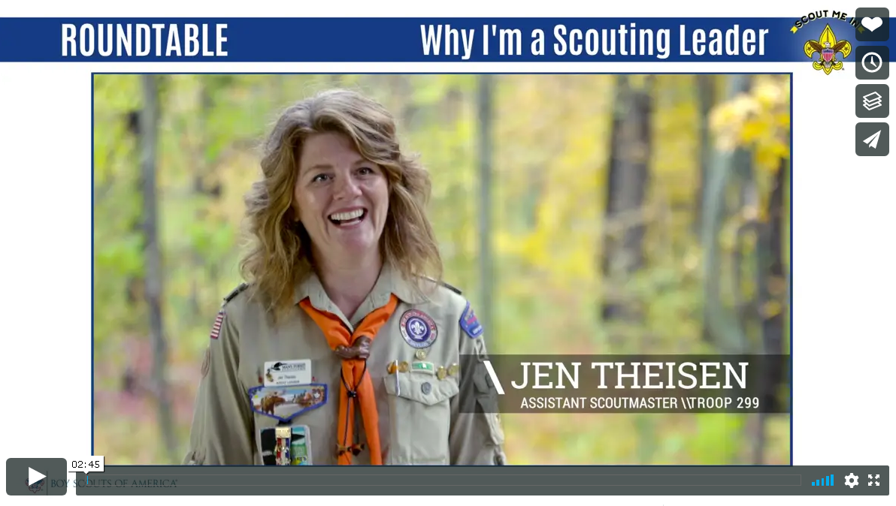
TRANSFORMING ROUNDTABLE
Closing
Networking
Linking Needs
Closing
Networking
Linking Needs
Closing
Networking
Linking Needs
Notes:
SPEAKER: CATHERINE KASER
INTRODUCTION: Now let’s discuss the roundtable Closing. Especially when you’ve had a really lively discussion, it’s easy to rush,
or even skip, a meeting’s Closing when you happen to notice the clock. But there are some great reasons to make sure you safeguard
time for a thoughtful closing before your participants start to log off or head home.
First, it’s a great way to tie together the themes from your program. Using videos from the National Service Center means your
Scouters can hear reflections from local volunteers around the country who are doing just what they’re doing by attending
Roundtable—seeking connections, ideas, and methods from others to make their units even stronger for the Scouts they serve.
Second, a good closing—like a good Scoutmaster’s Minute—sends your Scouters out on a high note. Your meeting program made
sure to give them the skill to do; the Closing provides a final reflection that reinforces their will to do. And it doesn’t have to be long!
DURATION: Both the 50- and 75-minute Virtual Roundtable formats allot 5 minutes for this final, brief, motivating thought.
CONTENT: You can find suggested Closings on the Roundtable Planning Resources web page. National is developing and adding new content
all the time so that new voices and fresh perspectives are highlighting Scouting’s values. The August 2020 content, for example,
reinforces the theme of recruiting and engaging volunteers by showcasing why three different Scouters became involved. It’s a good
reminder of the joy Scouting brings to adults in the program, too, which makes it easier to approach a parent with an offer of fun
instead of simply a request for their time.
FLEXIBILITY: Whether you use a Closing video in person or virtually, you have flexible options. You can use videos as is, or they are
brief enough to pair with whatever your current Closing traditions or roundtable practices are. Or maybe watching one as you prepare
for your program will give you a motivating and empowering idea of your own that you’d like to present, yourself. The Closing videos
are just another tool that’s there to support Roundtable Commissioners and Scouters, alike.
WRAP-UP: In short, be sure to reserve time to wrap up an informative roundtable with a motivating Closing that sends your
volunteers back to their units with both the skill and the will to deliver a great program.
I’ll now turn you over to Mike Moegenburg to talk about networking.
SPEAKER: MIKE MOEGENBURG
Networking is one of the key functions of Roundtable. Networking is easy in
Person, but did you know that there are ways to network in a virtual
environment?
Actually, there are several ways to network, you can even have small group
discussions!
You can use GROUP DISCUSSION BEFORE AND AFTER THE MEETING
You can start your meeting early and keep the meeting open after the close of
business.
Anyone who is in the meeting during those times can talk to all of the other
participants. You should mention that the meeting will be opened early (and how early)
for networking so that scouters who plan to attend can take advantage of this opportunity.
You should also announce whether or not you will keep the meeting open
after the close for a time during the meeting.
You can also use the CHAT FEATURE DURING THE MEETING
Meeting participants can message others(privately to an individual or to the entire group) during the meeting using the chat
function. Using this feature enables a side conversation on a topic such as where
is a good place to take second year Webelos scouts camping while the meeting is
underway. Participants can respond using chat.
Be sure to follow-up with the individual that posted the question to make sure they feel
they have a good answer to their question.
Meeting Rooms are a great option for small group conversations.
You should create additional breakout rooms for small group discussions. When you
are setting up rooms for the Cub Scout breakout and Scouts BSA breakout, be
sure to create meeting rooms for small group conversations. Assign the individuals
who wish to have this type of conversation to these rooms when you get their
request.
Be sure to go to the Zoom Resources on our web page in order to get tech tips to make your interactions run more smoothly.
WRAP-UP
You may still wish to have face-to-face Networking events in your district or
council, but there are several techniques you can use that enable virtual
networking. We will include the settings information in reference materials that
will be posted on our Roundtable Support web page.
Some of you have asked how we can effectively identify and link unit needs to resources in a virtual roundtable; Larry will offer some thoughts on that next.
SPEAKER: LARRY CHASE
Linking unit needs to resources that help address them is one of the five things all commissioners should do. It may be something simple: a unit may just need to know when summer camp registration opens. It may be more involved: a Webelos den leader may want to take Cub Scouts on a more challenging day hike that offers an introduction to back packing concepts – where are good places to do that?
There are ways to identify unit leader needs and link them to resources in a way that doesn’t take time away from other topics on the roundtable
agenda, whether in a virtual roundtable or in an in-person one.
In a virtual meeting, participants can be asked to enter their needs in the chat function the virtual tool provides. We’ve all been in virtual meetings; we
all know everyone monitors the chat function and contributes to it – throughout the meeting. It’s a great way to ask questions, among other things.
If participants are encouraged to enter their needs, some of them will self-resolve: an experienced Scoutmaster will respond to the Webelos den leader
about a great spot for a hike and the two can agree how to connect after the roundtable to share details.
In an in-person meeting, putting up a flip chart or using a white board provides a great place to enter needs without delaying the meeting. Some will
resolve themselves: another participant will make a note and the two leaders can connect after roundtable to discuss details.
But what needs don’t resolve themselves? That’s an opportunity for our roundtable commissioners to ensure we’re getting one of our five key Unit Service
activities done: they need to take responsibility for unresolved needs and use their resources to find someone to resolve them as soon as possible
after the roundtable ends. If would be great if that could be done within 48 hours.
Clearly, there are several changes in our new approach to roundtable. To help you implement them effectively, a completely new Roundtable
Support page was recently implemented. Bill Cameron will give you an overview of it.

Slide 10
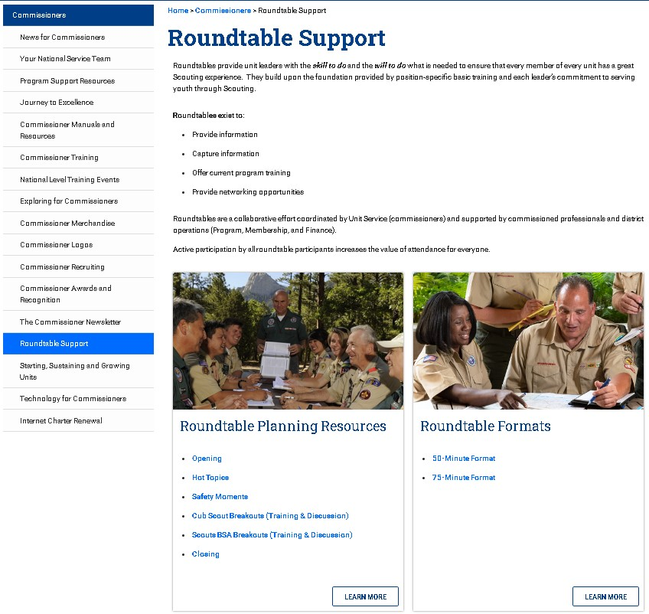
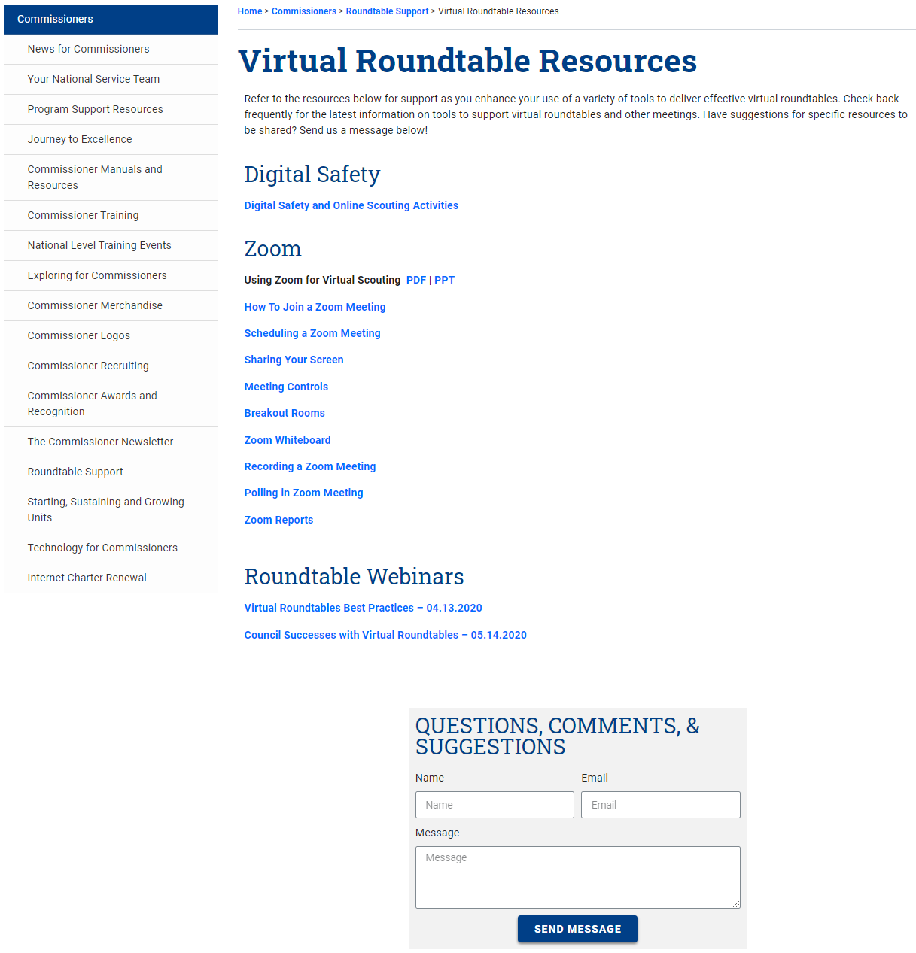
ROUNDTABLE RESOURCES WWW.SCOUTING.ORG/COMMISSIONERS/ROUNDTABLE-SUPPORT
Notes:
SPEAKER: BILL CAMERON
Hello everyone, my name is Bill Cameron and I serve as a commissioner in the Washington Crossing Council. We have covered a lot of material, so at this point you may have questions such as:
Where can I find resources for planning and hosting roundtables as described?
The Roundtable Support page is at scouting.org under Commissioners at the address shown at the top of the screen.
What resources are available there?
Roundtable Planning Resources contains specific content that you can use for your August 2020 roundtables.
Roundtable Formats contains agendas for the 50-minute and 75-minute options.
The Virtual Roundtable Resources page provides links to BSA Digital Safety and Online Scouting Activities as well as videos and reference materials on using Zoom.
Other Roundtable Resources contains archived content including Big Rock topics and program-specific materials.
The current Roundtable Training for Commissioners is also available.
Each page has a place for you to send any questions, comments, or suggestions directly to the service team.
Why the focus on Zoom?
• Zoom is by far the most common virtual meeting tool currently used by BSA volunteers.
In recent surveys, 74% of commissioners considered themselves to be either intermediate or advanced users of Zoom, while less than 3% indicated they have never used it.
• What about other videoconferencing tools? Some commissioners have experience with other tools, but the percentage who have never used them is much higher.
For example, 53% of commissioners have never used Microsoft Teams and 42% have never used GoToMeeting.
• Like commissioners, unit leaders indicated in their recent survey that they are most comfortable using Zoom.
What additional resources are planned?
More video content will continue to be added. As more becomes available, local districts will have more flexibility to match that content to local needs.
For example, a winter camping video may be used in different months or not at all in different geographical areas.
The current Roundtable Basic Training and College of Commissioner Science courses are being updated.
Work is underway to add additional resources to help commissioners plan and host virtual roundtables.
Over 63% of commissioners responding to our recent survey indicated that those resources would be very helpful.
Let’s spend the rest of our time together answering your questions. Our moderator Jeff Goldsmith will help with that.

Slide 11
QUESTIONS, ANSWERS, & DISCUSSION
To ask a question, please go to the ‘Q&A’ icon located at the bottom center of your screen and type a note to “Everyone”.
If your question is not answered or if you have any further questions, please email us at commissionerserviceteam@scouting.org.
Notes:
SPEAKER: JEFF GOLDSMITH
Thank you, Larry and the team, for a great presentation.
We will now proceed to the Question and Answer segment of this webinar. To ask a question, please go to the Question & Answer icon located at the bottom middle of your screen and type your question or ask to be unmuted. We will try to answer as many questions as possible.
If your question is not answered or if you have further questions, please email us at commissionerserviceteam@Scouting.org. When you send an email to that address, please include your email address in the body of your email so that we will be able to respond to you.
We now have a four-question poll that we would like each of you to complete. Please make sure that you answer all 4 questions by scrolling down through all the questions.
I will now turn the program over to Mike Weber for a call to action.

Slide 12
CALL TO ACTION
Notes:
SPEAKER: MIKE WEBER
WRAP-UP: As we begin to wrap up for the evening, let me make a few requests to each of you for help to ensure a smooth transformation of roundtable across our areas and councils:
First – Thank you for your time tonight
We appreciate your interest in participating in this virtual meeting
We sincerely appreciate your questions and comments tonight, which will us to help improve this new process
Next – As noted earlier tonight, the updated website is currently ‘live’ on the commissioner resource page
We encourage all of you to take a look at it, ‘kick the tires’ if you will, and give us your feedback – Both positive as well as any ideas you may have for improvements
Last – Please spread the word about what you heard and saw tonight
For those commissioners that were not able to participate in this call tonight, let them know that this new roundtable format is ready and available for the August roundtable
Let them know, as well, that material for all future roundtables is being developed and will be ready soon
Please encourage all commissioners to review the new website and encourage their feedback to us as well
We want everyone to know what content is available, ask that they check it out, and to provide feedback to us so that this valuable resource can be continually improved
This is your opportunity to be an advocate for the new process – We hope that you will spread the word with an encouraging endorsement
Thank you again for your time and support tonight and remember to Scout On!
Now let me turn it back to Jeff Goldsmith to wrap it up for this evening

Slide 13
Transforming Roundtable
Roundtable Project Team
July 15, 2020
Notes:
SPEAKER: JEFF GOLDSMITH
Thank you all for participating tonight. We hope you found this session of value, we certainly did. We hope to see you all at future Commissioner Roundtables, webinars, and meetings. Have a great night, stay safe, and have a great scouting year!

