Slide 1
ALPS Youth Trainings
Presenter’s Name(s)

Slide 2
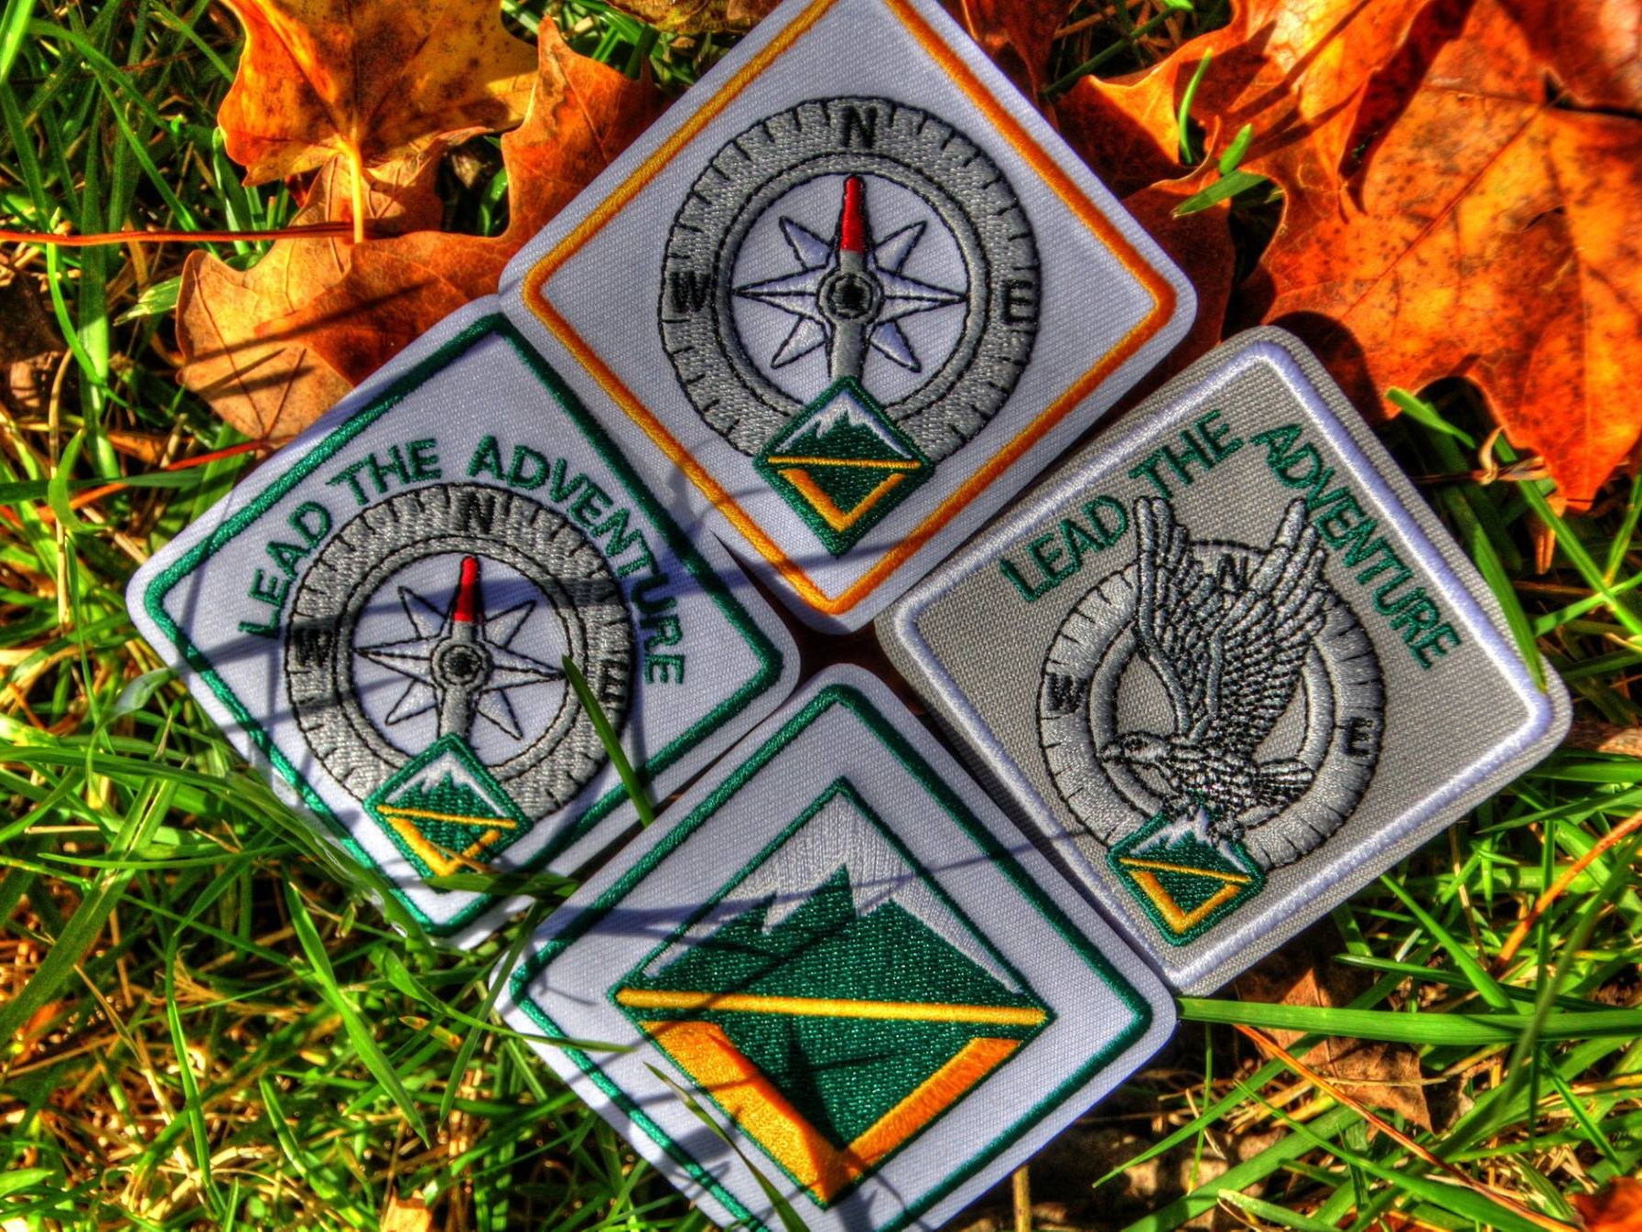
ALPS Model
Adventure, Leadership, Personal Growth, Service
Venturing program model
Framework for a successful program of youth-led adventure
Core Venturing awards provide benchmarks of progress
Venturing, Discovery, Pathfinder, and Summit Awards
Each level requires certain trainings
CREATED BY CR VENTURING, 2016

Slide 3
Venturing Award Trainings
Personal Safety Awareness Training
Addresses personal safety concerns of teenagers
Main topics:
Suicide Prevention
Internet Safety
Sexual Harassment
Date Rape
Award Stage:
Joining
CREATED BY CR VENTURING, 2016

Slide 4
Discovery Award Trainings (pt.1)
Crew Officer Orientation
Helps orient new crew officers to the duties of their positions
Shows how an effective team of officers can lead a crew to success
First-Aid & CPR
American Red Cross or American Heart Association, or an equivalent
Must include an in-person practical component
Award Stage:
Participating
CREATED BY CR VENTURING, 2016

Slide 5
Discovery Award Trainings (pt.2)
Introduction to Leadership Skills for Crews
Helps Venturers with leadership positions in their crews
Gives the knowledge and skills needed to fulfill responsibilities
Goal Setting and Time Management
Introduces methods for improving a Venturer’s ability to effectively manage their lives in relation to time
Works through how to set achievable goals and plans
Award Stage:
Participating
CREATED BY CR VENTURING, 2016

Slide 6
Pathfinder Award Trainings
Project Management Training
Prepares Venturers to effectively manage projects
Leads them through each essential step:
Initiating, planning, executing, controlling, and closing
For a copy of this training syllabus and an accompanying PowerPoint, contact myscouting@scouting.org
Award Stage:
Leading
CREATED BY CR VENTURING, 2016

Slide 7
Summit Award Trainings
Mentoring for Venturing Crews
Designed to help Venturers understand how to mentor other members of the crew
Help them appreciate the role mentoring plays in personal growth and leadership for both the mentee and mentor
Award Stage:
Mentoring
CREATED BY CR VENTURING, 2016

Slide 8
More Information
Venturing.org/alps-youth-training.html
Venturing.org/core.html
Scouting.org/programupdates
Venturing Awards and Requirements handbook, Handbook for Venturers, and the Advisor’s handbook
<insert additional resources>
CREATED BY CR VENTURING, 2016

Slide 9
Questions?
Presenter’s Name(s)
Contact Information

