Slide 1
Introduction to VOAs
Presenter’s Name(s)

Slide 2
What is a VOA?
Venturing Officers’ Association
Set of youth officers throughout the council
Provides a framework for the crew, district, council, etc.
Youth led, adult advised
Plans program opportunities
CREATED BY CR VENTURING, 2016

Slide 3
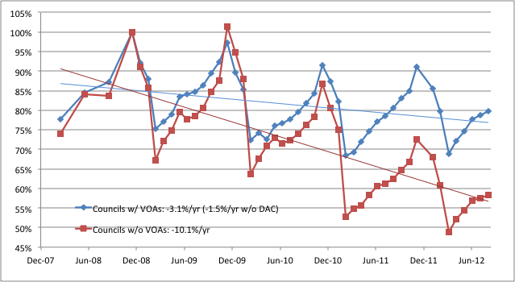
Why is a VOA important?
Membership correlation
Stronger Venturing presence
Keeps Venturing youth led
CREATED BY CR VENTURING, 2016

Slide 4
Starting a VOA
Start at the council
Locate interested youth and adults
Train interested youth and adults
Communicate with the Council Scout Executive
Plan (and execute) 6-12 months of program/meetings
Create a set of Operating Procedures
Set a date for elections
Start creating district VOAs (if necessary) in a similar manner
CREATED BY CR VENTURING, 2016

Slide 5
Benefits of a VOA
Allows crews to share resources
Opportunity to meet other Venturers
More resources + More Venturers = More fun!
Provides organization
Encourages multi-crew events and activities
Ensures communication from tier to tier
Provides leadership opportunities for youth
Keeps Venturing youth led
CREATED BY CR VENTURING, 2016

Slide 6
Further Information
Venturing.org/connect.html
Venturing.org/apply-to-be-a-voa-officer.html
<insert additional resources>
CREATED BY CR VENTURING, 2016

Slide 7
Questions?
Presenter’s Name(s)
Contact Information

