Slide 1
Beyond the Summit:
Ranger, TRUST, & Quest Awards
Presenter’s Name(s)

Slide 2
The Golden Circle
CREATED BY CR VENTURING, 2016
Notes:
WHAT: Every single person can identify what they do. It is easy to tell what you need to do to earn the Venturing awards. WHATs are easy to identify.
HOW: Some people know HOW they do WHAT they do. HOWs are often given to explain how to do something. Not as obvious as WHATs , and many think HOWs are the means to achieving your WANTs (goal setting). It would be false to assume that’s all that is required. There is one missing detail.
WHY: Very few people can clearly articulate WHY they do WHAT they do. This isn’t about earning a patch or medallion – that’s a result. WHY is all about your purpose, cause or belief. WHY are you in Venturing? WHY are you working on earning the awards? And WHY should anyone care?
This training will cover the WHATs and HOWs of earning the Venturing awards (WHAT is required and HOW you can earn the requirements). But an important part of the process of earning awards is to recognize and remember WHY you are earning them. Remember to begin with WHY

Slide 3
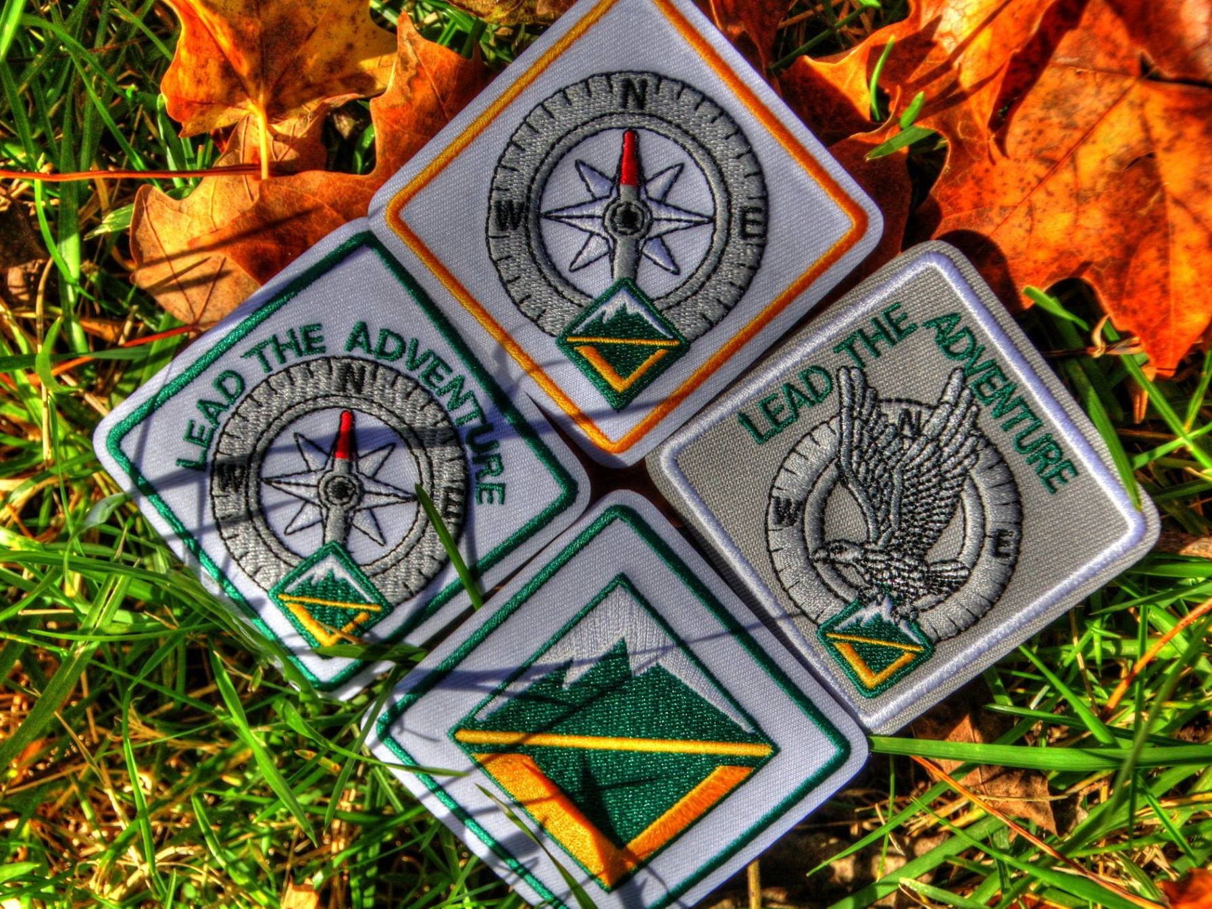
Venturing Core Awards
Venturing Award
Discovery Award
Pathfinder Award
Summit Award
CREATED BY CR VENTURING, 2016

Slide 4
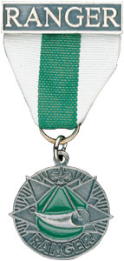
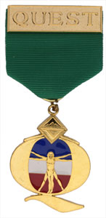
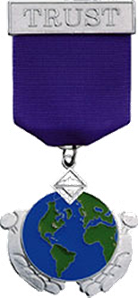
Specialty Awards
Ranger Award
Quest Award
TRUST Award
CREATED BY CR VENTURING, 2016

Slide 5
The Ranger Award
Purpose:
Recognizes Venturers with high outdoor skills proficiency
Highly skilled at a variety of outdoor sports and interests
Trained in outdoor safety
Ready to lead or assist others in activities
CREATED BY CR VENTURING, 2016

Slide 6
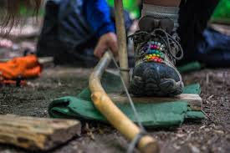
The Ranger Award
Complete eight core requirements:
First Aid
Emergency Preparedness
Leave No Trace
Land Navigation
Wilderness Survival
Communications
Cooking
Conservation
CREATED BY CR VENTURING, 2016

Slide 7
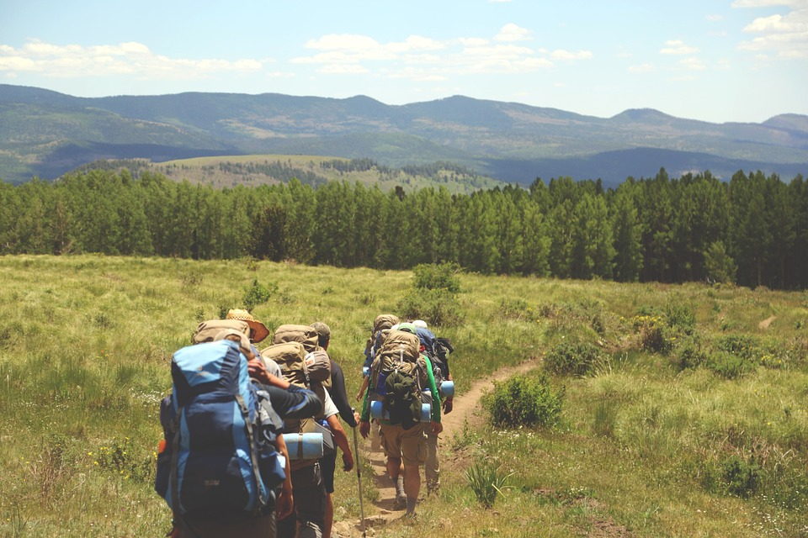
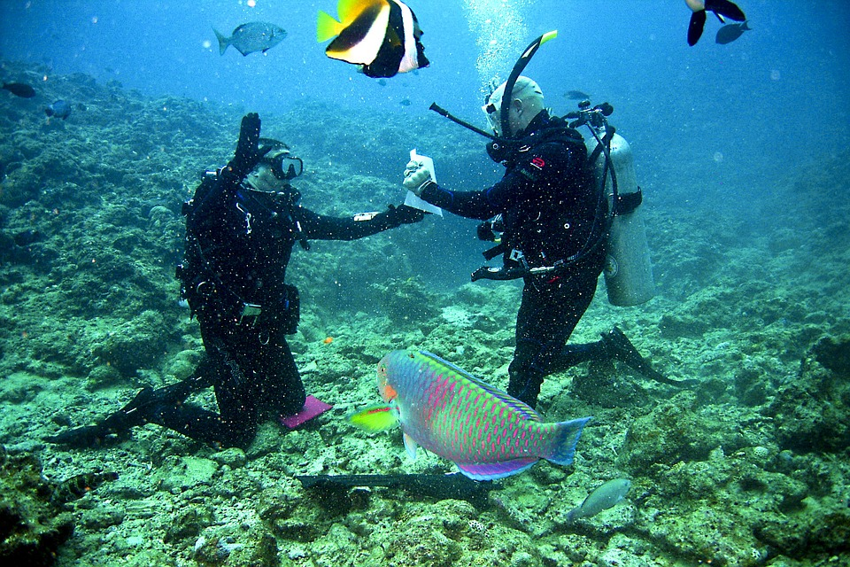
The Ranger Award
Complete four elective activities:
Backpacking
Cave Exploring
Cycling/Mountain Biking
Ecology
Equestrian
First Aid
Fishing
Hunting
Lifesaver
Mountaineering
Outdoor Living History
Physical Fitness
Plants and Wildlife
Project COPE
Scuba
Shooting Sports
Watercraft
Winter Sports
CREATED BY CR VENTURING, 2016

Slide 8
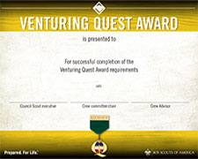
The Quest Award
Purpose:
Provide a variety of sports-related activities that encourage the development of the “whole” person
Promote fitness and sportsmanship
Provide Venturers with a variety of practical, hands-on sports experiences while having fun
CREATED BY CR VENTURING, 2016

Slide 9
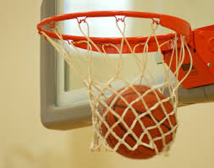
The Quest Award
Requirements:
Complete the Venturing Quest essentials
Complete an American Red Cross Sport Safety Training Course
Complete the Fitness for Life program
Learn and do fitness assessments
Sports Disciplines (choose from list in the Awards Handbook)
CREATED BY CR VENTURING, 2016

Slide 10
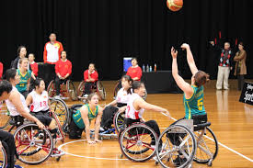
The Quest Award
Complete one elective:
History and Heritage of Sports
Sports Nutrition
Drug-Free Sports
Communications
History and Heritage of the Disabled Sports Movement
CREATED BY CR VENTURING, 2016

Slide 11
The TRUST Award
Purpose:
Help Venturers learn about their own religion and how it affects their lives
Pursue understanding of cultures other than their own
Learn how to resolve conflicts both internally and externally
Tending, Respecting, Understanding, Serving, Transforming
CREATED BY CR VENTURING, 2016

Slide 12
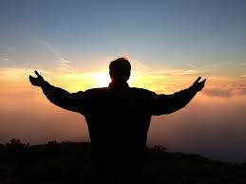
The TRUST Award
Requirements:
Tending your Faith
Learn about your own religious journey, and earn the religious emblem for your faith group
Respecting the Beliefs of Others
Learn about freedom of religion in the US and learn about religions other than your own in your community
CREATED BY CR VENTURING, 2016

Slide 13
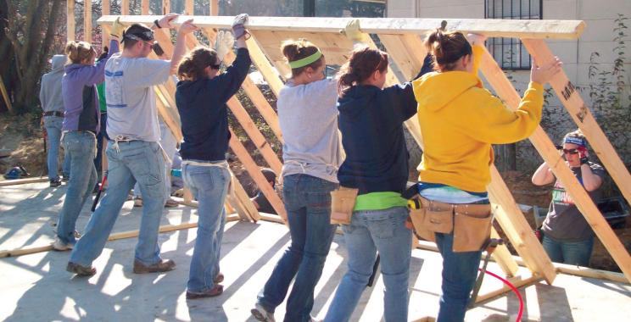
The TRUST Award
Understanding other Cultures
Learn about the historical significance of cultures in the US and study one cultural group in detail
Serving your Community
Complete a community service project and learn about local organizations that serve youth
Transforming our Society
Learn counseling skills, conflict resolution, peace and reconciliation, and how to apply them in your life
CREATED BY CR VENTURING, 2016

Slide 14
Benefits of Specialty Awards
Create highly-skilled resources for crews, Cub Scouts, Boy Scouts, and the community
Allows Venturers to pursue their interest in outdoor skills, athletics, and religion and culture
Encourages Venturers to develop leadership skills
Recognizes Venturers for their achievements in these areas
CREATED BY CR VENTURING, 2016

Slide 15
More Information
http://venturing.org/ranger-award.html
http://venturing.org/quest-award.html
http://venturing.org/trust-award.html
Venturing Awards and Requirements handbook, Handbook for Venturers, and the Advisor’s handbook
<insert additional resources>
CREATED BY CR VENTURING, 2016

Slide 16
Questions?
Presenter’s Name(s)
Contact Information

