Slide 1
Your Turn;
Now that you know about VOAs,
start your own!
Presenter’s Name(s)

Slide 2
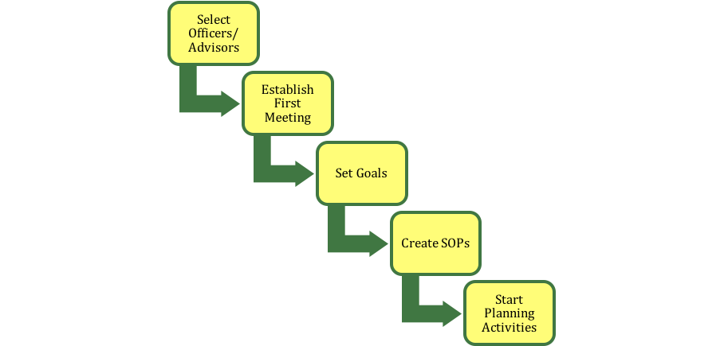
Steps of Starting a VOA
CREATED BY CR VENTURING, 2016

Slide 3
Officer Selection Process
Review existing SOPs of successful VOAs
Determine process that will be used
Selection process is handled at the council’s discretion (eventually written into your Council Operation Procedures)
Typically selected by previous VOA
Elections vs. Selections
CREATED BY CR VENTURING, 2016

Slide 4
Goal Setting & Reporting
SMART
Specific
Measurable
Attainable
Relevant
Timely
As a group, and individual position
Categorically assign goals (Admin, Comm, Training, etc..)
Quarterly/Annual Reports
CREATED BY CR VENTURING, 2016

Slide 5
Creating OPs
Utilize Area OPs as base
Customize to fit individual council
Update and review OPs as needed (annually)
Central Region Online Resource to aid in creation
CREATED BY CR VENTURING, 2016

Slide 6
Planning the Upcoming Year
Map out plan for the VOA program
Newsletter
Events (Program, Training, etc.)
Meetings (date, times, location)
Conference Calls
Contact list
CREATED BY CR VENTURING, 2016

Slide 7
Further Information
Venturing.org/connect.html
Venturing.org/looking-to-start-a-voa.html
Administration Guide: BEST RESOURCE!
facebook.com/BSAVenturing
<insert additional resources>
CREATED BY CR VENTURING, 2016

Slide 8
Questions?
Presenter’s Name(s)
Contact Information

