Slide 1
High Adventure Bases
Presenter’s Name(s)

Slide 2
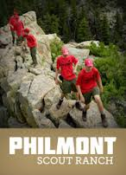
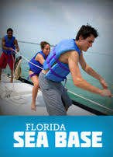
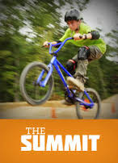
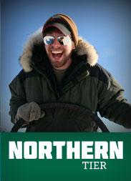
High Adventure
There are four high adventure bases
Each has a specific type of activity
Each base has different adventure, experience and skills set
CREATED BY CR VENTURING, 2016

Slide 3
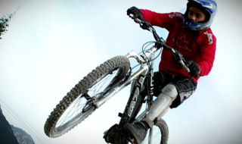
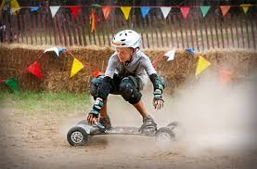
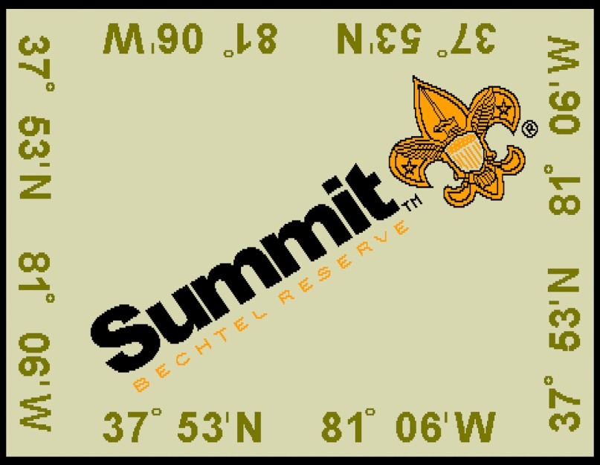
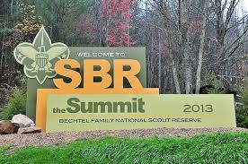
Summit Bechtel Family National Scout Reserve
Located in southern West Virginia, covering 10,600 acres of rugged forest
Announced as a National High Adventure Base on November 18, 2009
Home to the National Scout Jamboree
A High Adventure Base, National Center for Scouting Excellence, and a Scouting Summer Camp
CREATED BY CR VENTURING, 2016

Slide 4
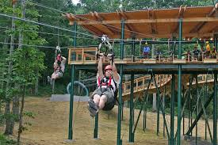
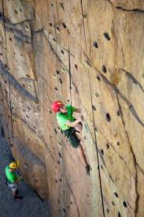
Summit Program
Skateboarding Park: skating
The Trax: BMX
The Pools: scuba and swimming
The Cloud: popular science and robotics
The Bows: archery sports
The Barrels: shooting sports
The Ropes: challenging courses in trees
The Rocks: climbing walls
The Canopy: canopy tours
The Zip: zip lining
Low & High Gear: mountain biking, connecting over 30 miles of downhill and cross country mountain bike trails
CREATED BY CR VENTURING, 2016

Slide 5
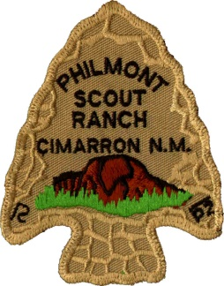
Philmont Scout Ranch
BSA’s largest high adventure base
Covers 137,000 acres of mountain wilderness
Located in the Sangre de Cristo range of the Rocky Mountains in New Mexico
34 staffed camps and 55 trail camps
High mountains with rough terrain and elevations that range from 6500 to 12441 feet
CREATED BY CR VENTURING, 2016

Slide 6
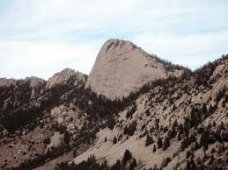
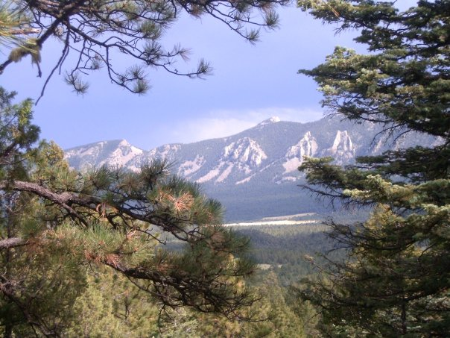
Philmont Programs
Backpacking adventure, with treks from challenging to super strenuous
Features the Old West style activities, such as horseback riding, burro packing, panning, chuck wagon dinners and history
Also features new challenges such as rock climbing, mountain biking, tomahawk throwing, spar pole climbing, ATVs, and rifle shooting
CREATED BY CR VENTURING, 2016

Slide 7
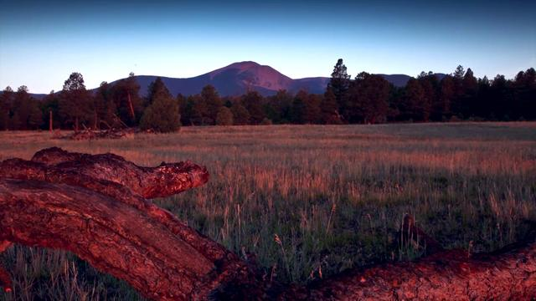
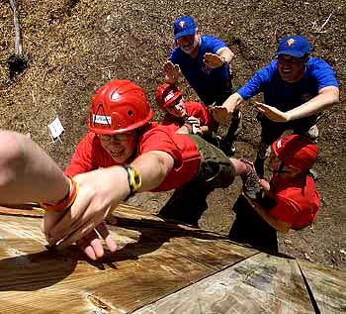
Philmont Individual Programs
NAYLE
National Advanced Youth Leadership Experience
Continuation of NYLT program
6 day course
Must be youth in Venturing to participate
ROCS
Roving Outdoor Conservation School
21 Day Trek
Learn conservation and environmental sciences while backpacking Philmont’s wilderness
Must be 16 and not yet 21
CREATED BY CR VENTURING, 2016

Slide 8
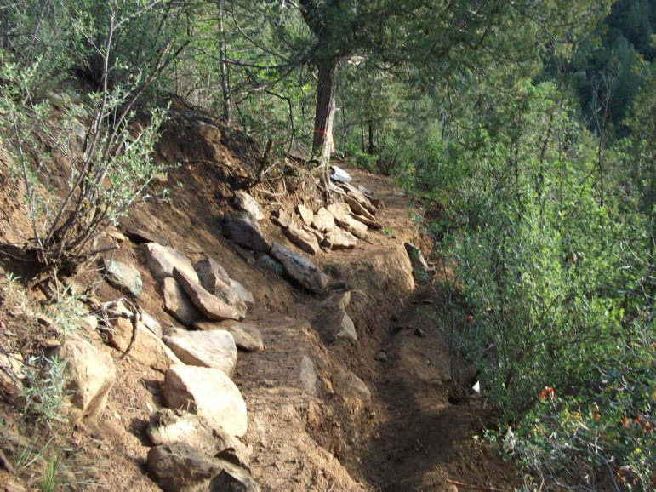
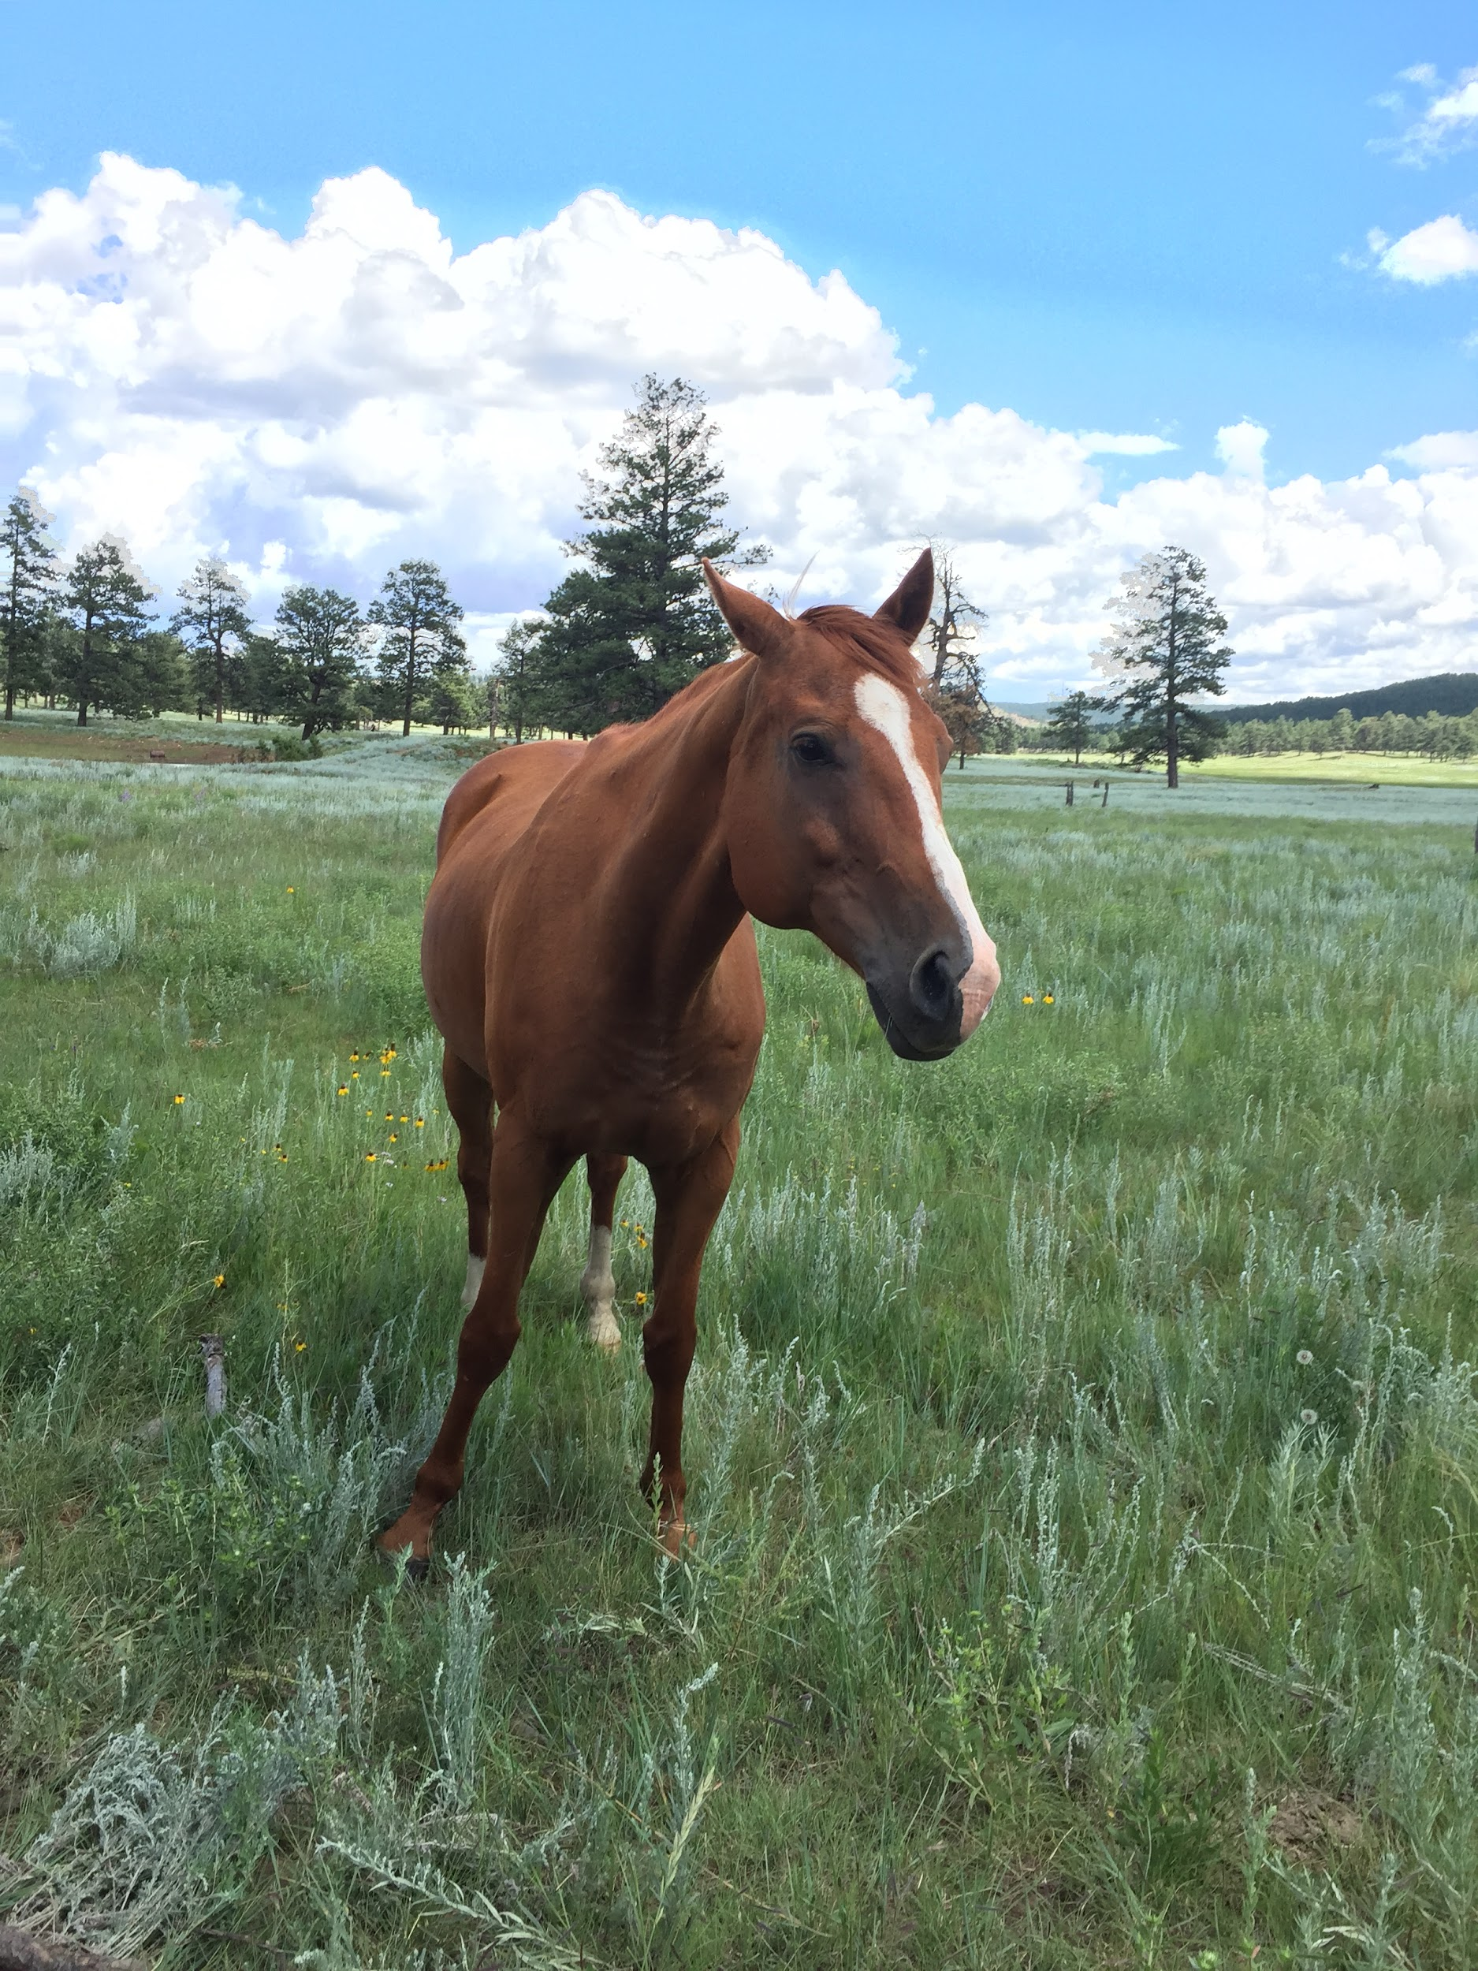
Philmont Individual Programs
Ranch Hands
Must have a knowledge of horsemanship and horse care
Work with horse department staff, assisting them with programs and everyday horse care
8 days for work
8 day Cavalcade Trek with wrangler staff
Trail Crew
Focused on conservation and leadership development
7 Days of trail building
7 Day educational trek
16 years old not yet 21
OA-only version available
CREATED BY CR VENTURING, 2016

Slide 9
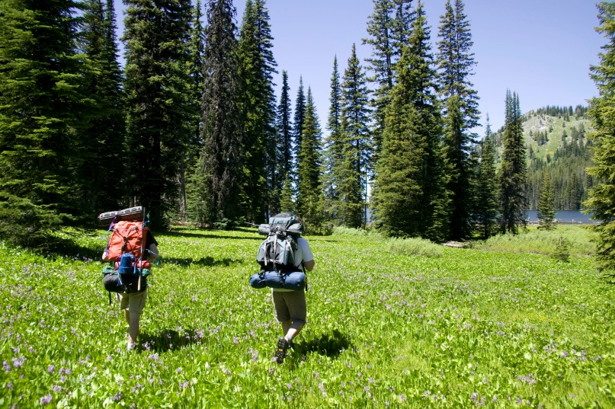
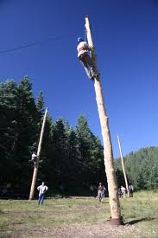
Philmont Individual Programs
Rayado
21 day trek
“Test your limits and expect the unexpected”
Build advanced outdoors skills
Intended to challenge participants physically, mentally, emotionally, spiritually
At least 15 but not yet 21
STEM Trek
12 day trek
Focused on science, technology, engineering, math
See the modern and historical technology used
Insider’s perspective on how everything really works
CREATED BY CR VENTURING, 2016

Slide 10
Northern Tier High Adventure Base
A wilderness canoeing adventure in northern Minnesota, northwestern Ontario, northeastern Manitoba
A trained staff member accompanies the crew for their trek
Ranges from 6-10 days and covers 50-150 miles of hiking, canoeing and portaging
Charles L. Sommers, MN, Donald Rogert Base, ON, or Northern Expeditions Base
CREATED BY CR VENTURING, 2016

Slide 11
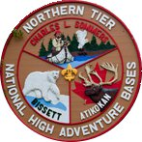
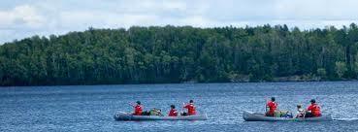
Charles L. Sommers Canoe Base, MN
Has hosted BSA canoeing expeditions on Moose Lake since 1941
Trips out of Sommers base are limited to the size of 8 plus an interpreter
Allows individual Scouts and smaller troops to take a high adventure trip
CREATED BY CR VENTURING, 2016

Slide 12
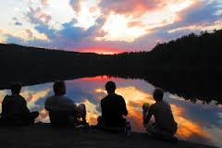
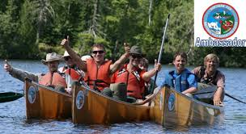
Donald Rogert Canoe Base, ON
Located 80 miles from Sommers base
Expedition spread across Canadian Crown Lands to White Otter Provincial Park
Crew sizes may be up to 11 participants plus and interpreter
Program include a fishing expedition
CREATED BY CR VENTURING, 2016

Slide 13
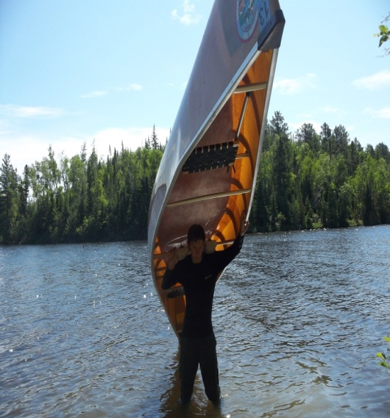
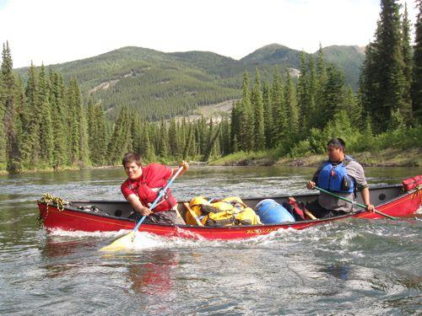
Northern Expeditions Canoe Base, MB
Most rugged and remote region paddled by Northern Tier crews
All crews enter the wilderness in a 20 minute float plane, and dropped off into Atikaki Provincial Park
Crews are limited to the size of 11 plus an interpreter
Fishing in region is world class: northern pike and catfish
Bissett is most appropriate for older crews with previous experience with high adventure
CREATED BY CR VENTURING, 2016

Slide 14
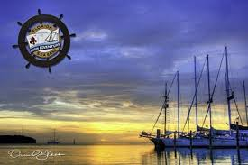
Sea Base
Located in Bahamas and Florida
There are many types of water adventures to choose from
Each has a different type of experience and skill sets
When choosing with your crew, make sure to read each adventure and see which one seems more fun and interesting to you
CREATED BY CR VENTURING, 2016

Slide 15
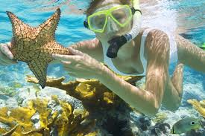
Sea Base Programs
Bahamas Tall Ship Adventure
Fly directly to the Bahamas
Sail throughout the Bahamas aboard a tall ship, 60’ catamaran
18-20 people
Active ship and require everyone to work as a team and experience the workings of sailing
7 day event
Bahamas Adventure
Based in the Marsh Harbour on Great Abaco Island
You will board a traditional Bahama sailing vessel
Snorkeling, fishing, and swimming
7 day event
10-12 people
CREATED BY CR VENTURING, 2016

Slide 16
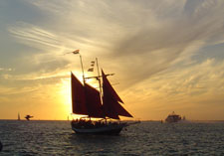
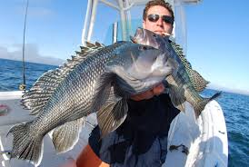
Sea Base Programs
Out Island Adventure
Big Munson. The out island adventure combined with camping on a 100+ acre island
Snorkeling on coral reefs, trolling for sport fish, kayaking and exploring the island
7 day event
10-14 people
Sea Exploring (Keys Tall Ship)
Tall ship sailing on a 75ft boat, with a gaff-rigged schooner
Snorkeling, swimming and hands-on sailing in the Florida Keys
8 day event
20 people plus boat staff
CREATED BY CR VENTURING, 2016

Slide 17
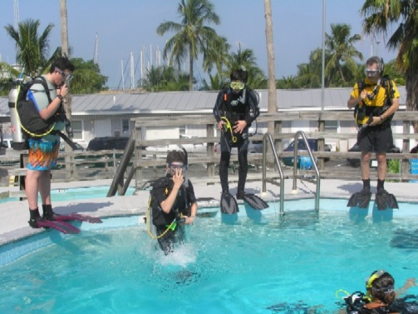
Sea Base Programs
Eco-Adventure
Up-close and hands–on educational adventure
2 40’-45’ sailboats
Snorkeling, mask and fins, kayaking, fishing and glass-bottom viewing
You will discover and explore four major marine habitats
7 days, and 10-12 people
Coral Reef Sailing
40-50 ft. sailing yacht
Captain will teach you about Navigation and sailing
Fishing, swimming and snorkeling
You get to make your own float plan and explore the beautiful keys
“Port day” at Sea Base with fun activities
7 day, and 14-17 people
CREATED BY CR VENTURING, 2016

Slide 18
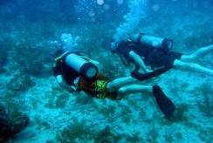
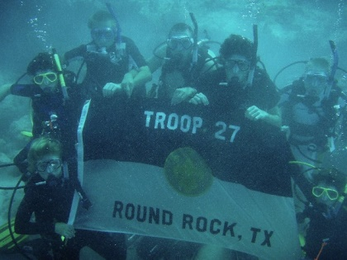
Sea Base Programs
Florida Fishing
Fishing in several different ecosystems so you can catch all different types of fish
Spanning from the Gulf of Mexico to Florida straights of the Atlantic ocean
7 day
10-12 people
Scuba Adventure
Scuba diving in the coral reefs and wrecks of the Florida Keys
Designed for certified drivers. Eleven dives scheduled
You must be a certified diver
8 days
CREATED BY CR VENTURING, 2016

Slide 19
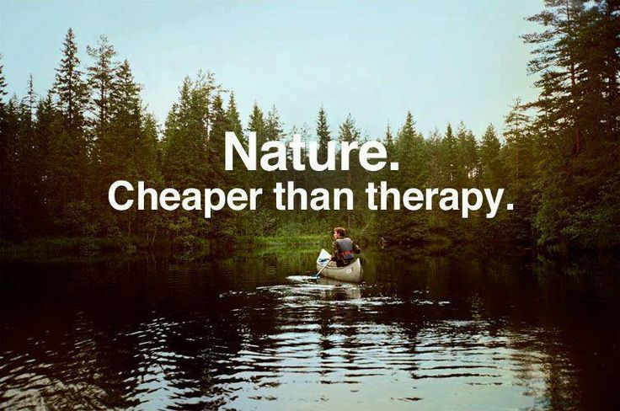
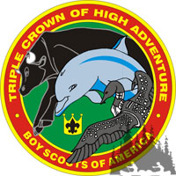
Triple Crown Award
If you complete all 3 high adventure bases, Philmont, Northern Tier and Sea Base you can receive the Triple Crown Award
The basic rule is that if you received a high adventure program participant patch during your program, it qualifies as your participation requirement for that base
CREATED BY CR VENTURING, 2016

Slide 20
Further Information
Venturing.org/connect.html
http://ntier.org/
http://philmontscoutranch.org/
http://www.summitbsa.org/
http://www.bsaseabase.org/
<insert additional resources>
CREATED BY CR VENTURING, 2016

Slide 21
Questions?
Presenter’s Name(s)
Contact Information

