Slide 1
Venturing Crew 1234
Presenter’s Name(s)

Slide 2
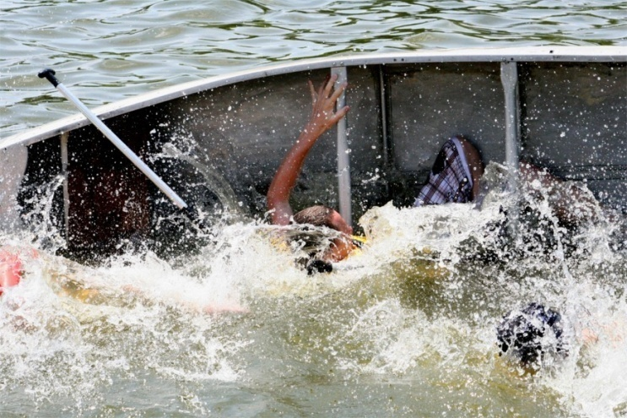
What is Venturing?
Division of the Boy Scouts of America
Founded in 1998
Co-ed
Ages 14-21
High Adventure
Youth Led Activities
Emphasizes Personal Growth, Service
CREATED BY CR VENTURING, 2016

Slide 3
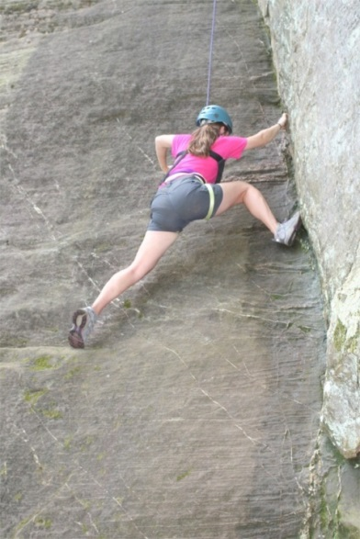
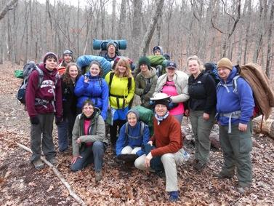
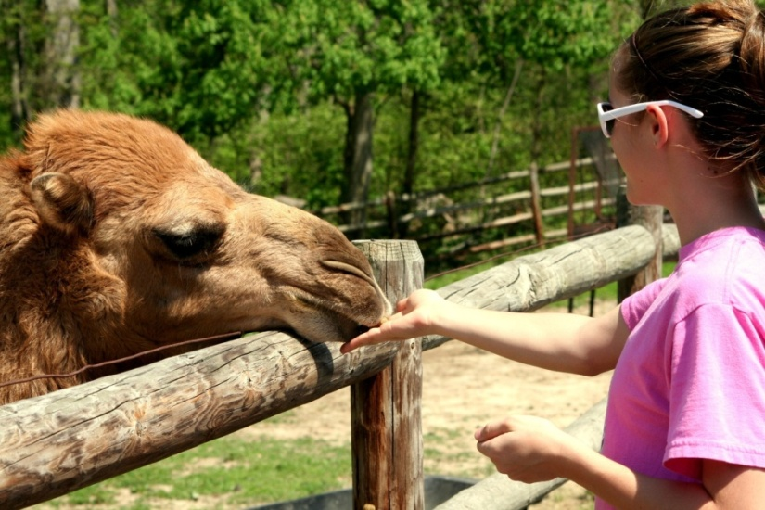
About Crew 1234
30 youth
15 boys
15 girls
Founded in 1998
2 Summit Award recipients
Draws from 11 schools
<other relevant info>
CREATED BY CR VENTURING, 2016

Slide 4
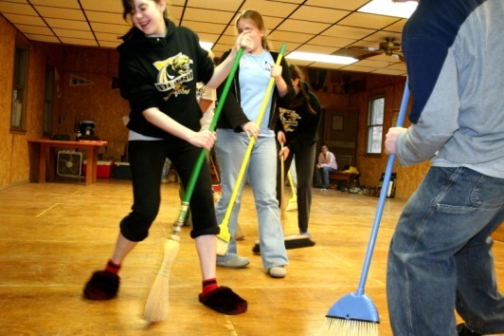
Meetings
Every Wednesday 7:30-8:30pm
Run by Youth
Diverse Activities
Work on Advancement and New Skills
Plan for Trips, Service Projects, and Fundraisers
CREATED BY CR VENTURING, 2016

Slide 5
Service Projects
Car Wash for Wounded Warriors
Decorating Chartering Church
Park Clean-Up Days
Volunteer at Council’s Klondike
Flags for Veterans Day
CREATED BY CR VENTURING, 2016

Slide 6
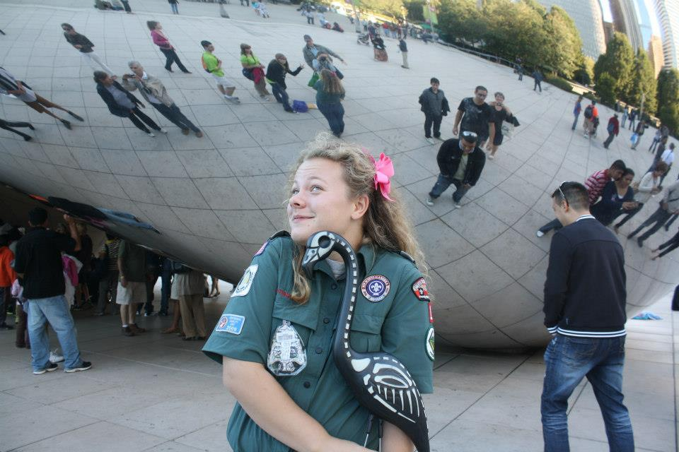
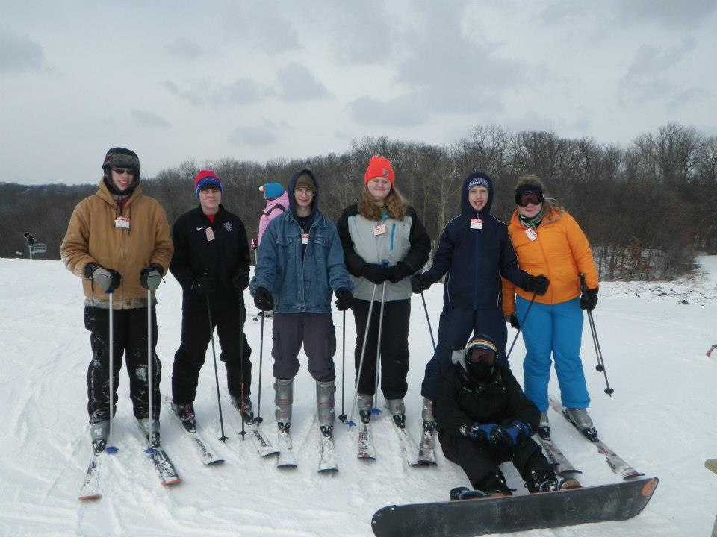
Trips
Monthly Outings
Urban Excursion
Indianapolis Zoo
Backpacking Trips
Kayaking Trips
Lock-Ins
Summer Outings
Philmont
Pamlico Sea Base
Apostle Islands
Summer Camp
West Virginia
CREATED BY CR VENTURING, 2016

Slide 7
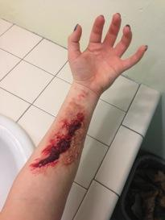
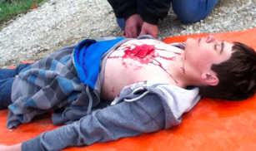
Fundraisers
Wilderness First Aid
Popcorn
Bracelets
Garage Sales
Bake Sales
Car Show
CREATED BY CR VENTURING, 2016

Slide 8
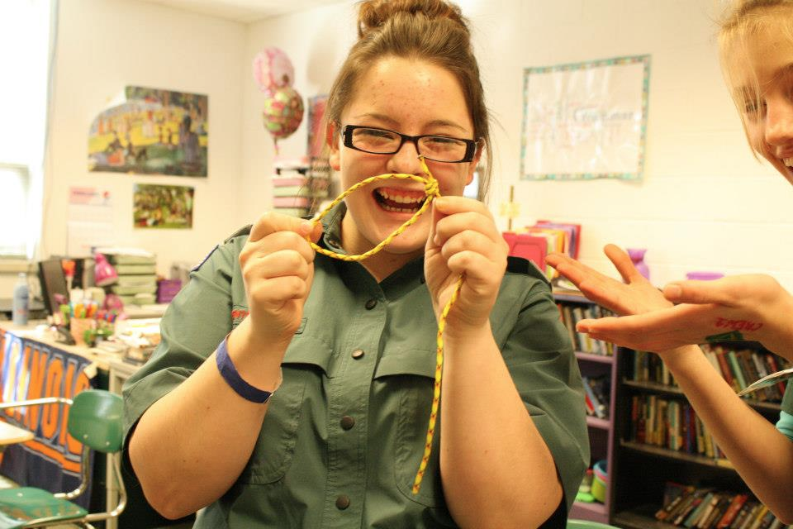
Learn More!
<facebook link>
Venturing.org/learn-more.html
<Crew President/Advisor Emails>
<Other info>
CREATED BY CR VENTURING, 2016

Slide 9
Questions?
Presenter’s Name(s)
Contact Information

