Slide 1
Ten Easy Steps to Creating a Written Development Plan
Notes:
While not a guaranteed roadmap to success, a development plan sets goals that promote growth and create ownership among the whole fundraising team. Fundraising plans also prevent the need for crisis fundraising. They enable you to track your progress and identify problems as they arise. You will always know where you stand related to where you want to be. And, you will be able to proactively set and balance your priorities and avoid competing timelines.

Slide 2
Blueprint for success
Notes:
If we are in fundraising we know we need a plan just like when building a skyscraper
we need a set of blueprints to insure our success.

Slide 3
A Plan:
Moves you from reactive to proactive
Provides a roadmap for development
Gets everyone on the same page
Notes:
If we do not have a plan we are going to spend a lot a time simply being reactive to
the things going around us not being proactive and leading the way.
We will not know where we are going and the plan will allow everyone on our team
volunteers and professionals to be on the same page which will make everyone's job
easier.

Slide 4
Direction?
If you don’t know where you’re going, then any road will get you there.
Notes:
If we do not have a plan then we will tend to believe that any road will achieve our objective but your direction may not be the same as the other members of the team and we create :
Confusion and Frustration for everyone.
We also tend to move from fundraising activity to activity and never really evaluate our efforts.

Slide 5
10 Simple Steps to a Development Plan
Ownership
Information
Analyze
Factors
Team
Goals
Activities
Timeline
Details
Evaluate
Notes:
We have 10 simple steps to create your development plan. Now each of these are going to look pretty simple but their is a lot of detail into each one and we are going to dig into each one as we go.
Step 1 Ownership
Step 2 Gathering information
Step 3 Analyze your data
Step 4 Factors (internal & external)
Step 5 Whose on your development team
Step 6 What are our goals – strategic & monetary
Step 7 What are the activities we are going to use to raise our funds
Step 8 What's our timeline
Step 9 Details of each activity
Step 10 How will we know we are successful

Slide 6
How much money do you need?
Ask yourself, “What will it take to deliver service this year?”
Notes:
In order to get us started on the right track we really need to know where we want to end up.
So ask yourself how much money do you need to raise this year. What is that number_________________?
Also what will it take to deliver service this year.
How many youth do you want to serve this year – what is the cost?

Slide 7
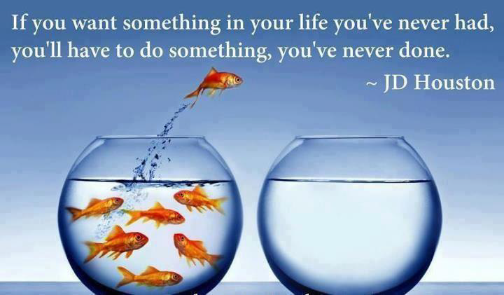
Notes:
We tend to say we want to do more but we also want to raise our funds the same way we have every year.
We have all heard the saying:
If we always do what we always done we will get what you always got.
If you want something that you have never had you’ll have to do something different which might only be the development of a plan of action.

Slide 8
Step 1: Ownership
Board
Volunteers
Staff
Notes:
It’s important to include your executive board, fund development and finance committee volunteers and professional staff in the process of creating your council development plan.
When those who are responsible for implementation have participated in the process from the beginning, they’ll be much more invested in its success.
Involving everyone in the planning process is critical for building the ownership necessary.
Small councils will usually involve their entire board while larger councils may want to delegate the responsibility to their fund development and finance committees.
Regardless of the size of your council the more people you involve, the more buy-in you will have.
That buy-in and engagement will translate directly to more involvement in fundraising, more relationships with donors, and more money to the council.

Slide 9
Step 2: Gather Information
Development | 2 Yrs Prior | 1 Yr Prior | Current Yr
 | Net Income | Net Income | Net Income
Friends of Scouting
Major Gifts
Board Campaign
Community
Family
Product Sales
Popcorn
Camp Cards
Special Events
Distinguished Citizen
Golf Tournament
Sporting Clays
Foundations & Trusts
Project Sales
Legacies
Bequests
United Ways
Endowment
Capital
Notes:
Lots of preliminary information can be gathered before bringing the full group together in order to maximize everyone’s time.
A simple spreadsheet can be used to list your current development strategies including their past two years (minimum) performance.

Slide 10
Evaluate the past
How did it go last year?
What about the previous years?
What worked well?
What didn’t work?
Notes:
Evaluate the past
How did it go last year?
What about the previous years?
What worked well?
What didn’t work?

Slide 11
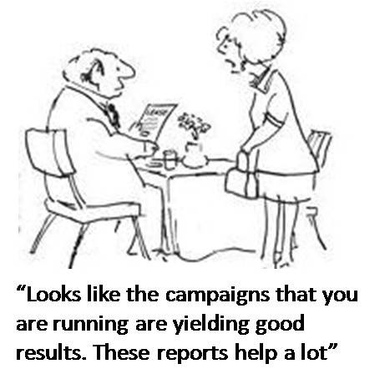
Step 3: Analyze
Notes:
Look at the different strategies you are currently using. Based on your analysis, consider the following questions:
What generates the largest portion of your income?
Which sources are most reliable?
Where is the greatest potential for growth?
Where should you devote more time?
Which areas are not producing and why?
How can you improve or modify the strategy to make it more effective?
Which ones should you consider eliminating?
Where can you involve more board members and volunteers?
If you had the resources, which areas would you invest in more?
Do continue to do things just because you have always done!

Slide 12
Step 4: Factors
Notes:
Goals are often based on how much is needed to balance a budget and this makes sense on the surface. But that number has nothing to do with your ability to raise that amount of money. Set your goals based on all the criteria that affect your council’s fundraising ability, including how much was raised in the past as well as a variety of other internal and external factors.
Internal Factors:
What’s going on inside your council that could impact fundraising?
Do you have new opportunities to take advantage of – a special anniversary, a new Scout Executive?
Have there been changes on your board?
Are you also raising money for a capital campaign?
How much fundraising experience does your staff/board have?
How much attention do you give to donor relations?
How well have you done prospecting?
External Factors:
How could the economy affect your fundraising?
What’s the current political environment?
What are the current giving trends among local donors?

Slide 13
Step 5: Who’s on the team
Notes:
What are your assets?
Organizational assets are things you have going for you that make fundraising easier.
Fundraising assets raise good money for your nonprofit.
The more committed and engaged people you have fundraising, the more money you’ll raise and the more donors you’ll be able to build closer relationships with. Start brainstorming now who you can recruit to your council’s fundraising team.
Board members
Advisory board members
Volunteers
Key donors
Staff
Who else?

Slide 14
Step 6: Goals
Notes:
Now that you have your background information, you and the people who are responsible for implementation must set goals.
You will want to discuss the following two kinds of goals.
Strategic – Non-monetary goals related to your development program. Could be things like become less dependent on United Way funding, increase board participation in fundraising, build closer relationships with donors, etc. What are your strategic goals for the coming year? Hint: Review your current strategic plan.
2. Financial – These are your traditional monetary goals. How much do you hope to
raise overall and from each strategy?

Slide 15
3 Fundraising Targets
Number of dollars to raise
Number of current donors to renew
Number of new donors to acquire
Notes:
3 targets to consider when developing your fundraising targets is:
Number of dollars to raise
Number of current donors to renew
Number of new donors to acquire

Slide 16
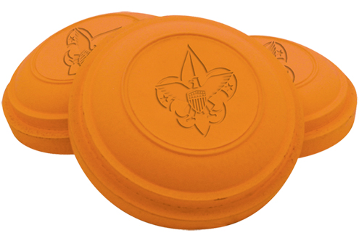
Step 7: Choose activities
Notes:
When you think about what fundraising activities to use, we have lots to consider. Instead of just the approach that this is what we have always done take a look at them in another perspective.

Slide 17
Make sure it works
Activity | Goal | #Acquired | #Renewed | #Upgraded | #Relations
FOS
Foundations
Camp Card
Totals
Notes:
Think about it from the following perspectives – getting new funders, renewing current supporters, and getting current donors to increase their support.
You will also need to incorporate donor relations into your plan, not just solicitations.
Acquire –
What will you do to identify and acquire new donors
Renew –
How will you approach current donors about renewing their support?
Upgrade –
Getting supporters to consider larger gifts usually requires a more personal touch – personal calls, and face-to-face meetings.
Donor Relations –
For all categories of donors.
What will you do to build closer relationships with them?

Slide 18
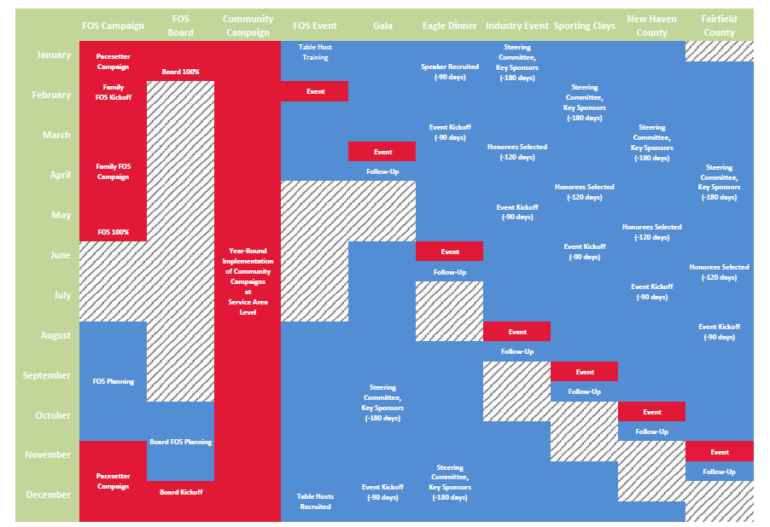
Step 8: Timeline
Notes:
Once you decide what strategies you are going to implement, you’ll need to put them on a timeline.
Some things will only happen at certain times (e.g. special events) and others will happen year round (e.g. donor relations).
Make sure not to oversaturate your donors. Include all campaign activities, events, marketing and communications.

Slide 19
Step 9: Outline Details
Notes:
For each strategy that you plan to use, you will need to outline the following:
Projected gross income
Expenses – cost of executing this fundraising strategy
Net income after expenses
Other goals such as donor appreciation, acquiring new donors, generating publicity, involving board members in fundraising
Which volunteers and staff are needed to carry out the strategy?
Pull all your plans together into one chart showing what fundraising activities you will be doing, how much you intend to raise, from whom, when, who will do what, and how much it will cost.

Slide 20
Step 10: Evaluate
Notes:
Sure, the bottom line is usually measured by how much money is raised. But, there are other factors that should also be included in evaluating the success of your fundraising strategies and your development plan each year
For a more complete assessment of your development program, include these types of metrics as part of the evaluation component of your fundraising plan in addition to traditional measures.
Track and measure:
Number of contacts with donors
Number of donors who renew their support compared to the year before (your donor retention rate; the reverse is your donor attrition rate)
Number of donors who increase their support
Number of new donors acquired
Number of donors who attended events (both cultivation and fundraising events)
New volunteers and new board members involved in fundraising
Number of first-time donors who become regular donors (your conversion rate)
Number of prospects identified and the percent of those who become donors
The impact of donor relations can also be evaluated. You can measure:
Frequency of contact with donors without asking for a gift
How many different ways donors participate in your council
Amount of donor-initiated contact with your council
Number of donor responses to your contacts (returned surveys, call backs, etc)
How often donors refer others to your council
Diversity, regularity, and frequency of your contact with donors
Level of personalization in your communications
Level to which your communications speak to the donor and write the donor into the story

Slide 21
Questions

