Slide 1

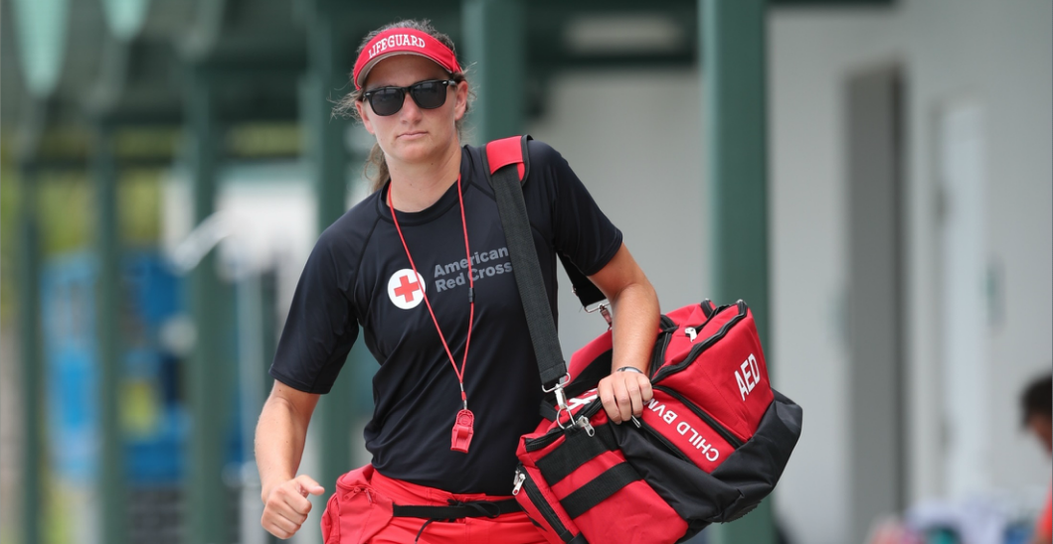
American Red Cross Aquatics Update

Slide 2

Lifeguarding Program
AQUATICS UPDATE
Released January 2017
Instructors are no longer required to maintain a basic level lifeguarding certification to teach
Must maintain basic level certification to lifeguard
LGIs and LGITs required to do an in-person skills review every two years with an LGIT – 7 hours
Minimum water depth 7 ft – 9-10 ft recommended

Slide 3
Lifeguarding Program
AQUATICS UPDATE
Blended Learning option released April 2017
Uses Direct Links. Preregistration not required
Every well done
Reduces instructor classroom facetime by about 7 hours. Allows more time for in-water skills training

Slide 4
Junior Lifeguarding Program
AQUATICS UPDATE
Released December 2017
Target audience – ages 11-14
Designed to build a foundation of knowledge, attitudes and skills of future lifeguards
No expiration
Focused on swimming skills & in-water rescues
Pretest similar to BSA Swimmer test

Slide 5
Water Safety Instructor Program
AQUATICS UPDATE
Scheduled to be updated in 2019
Does your aquatics staff have certified WSIs?
Learn-to-Swim program – Your camp may be able to apply to waive the annual Learn-to-Swim fee if you do not charge for swimming lessons.
Contact your regional aquatics representative

Slide 6
Red Cross Lifeguarding Instructor
AQUATICS UPDATE
Full course – 24 hours
BSA Lifeguard Instructor to Red Cross Lifeguarding Instructor Crossover – 8 hours
RC Lifeguarding Instructor can teach First Aid/CPR/AED and Administering Emergency Oxygen
Options to teach Waterfront and Waterpark LG

Slide 7
Lifeguarding Management Course
AQUATICS UPDATE
Online training only
Designed to prepare aquatics professionals to effectively manage lifeguards and help keep patrons, staff and facilities safe
Register at redcross.org/take-a-class

Slide 8
CPR/AED Course Options
AQUATICS UPDATE
CPR/AED for Professional Rescuers
Basic Life Support for Healthcare Providers
Both courses teach the same skills but use different teaching styles
CPR/AED for Professional Rescuers should be taught when training lifeguards
An LGI cannot automatically teach BLS

Slide 9
Instructor’s Corner
AQUATICS UPDATE
Instructorscorner.org has been completely redesigned
Requires a username and password to access
Instructor certifications with expiration dates are listed on the right side of the home page
All course material is available in digital format
Community Forum – Ask questions

Slide 10
Red Cross Course Administration Fees
AQUATICS UPDATE
Course fees will increase every year on January 1st
Courses taught to BSA youth and adults pay 53% of the full course fee
Course catalog with course codes and administration fees is available on Instructor’s Corner

Slide 11
BSA/Red Cross Agreement
AQUATICS UPDATE
Every council sets up its own Licensed Training Provider (LTP) agreement
Usually signed by a council professional
Contact your RC Regional Aquatics Representative to set up an LTP, if you don’t have one
Get a discount coupon code, for your council, from the Regional Aquatics Representative

Slide 12
BSA/Red Cross Agreement
AQUATICS UPDATE
Add courses (by course code) to your agreement
Reference the Price List you downloaded from Instructor’s Corner
Lifeguarding and Waterfront Lifeguarding are two different courses
Adult First Aid/CPR/AED and Adult and Pediatric First Aid/CPR/AED are two different courses
Every unique course must be added to the agreement

Slide 13
BSA/Red Cross Agreement
AQUATICS UPDATE
When submitting a course record, enter the coupon code on the payment page and select the “Apply” button
The course fee should be 53% of the full course fee

Slide 14

Questions
AQUATICS UPDATE
?

